Slide 1


Reading at Claygate

Slide 2

Our Reading Vision
Reading is a fundamental lifelong skill which is key to our understanding of the world and unlocks learning. Reading is a partnership between all of us. Our children become fluent, competent readers who develop a strong desire to read.

Slide 3
Teaching reading
Reading for Meaning – lessons on reading skills
Accelerated reader – practicing reading regularly

Slide 4
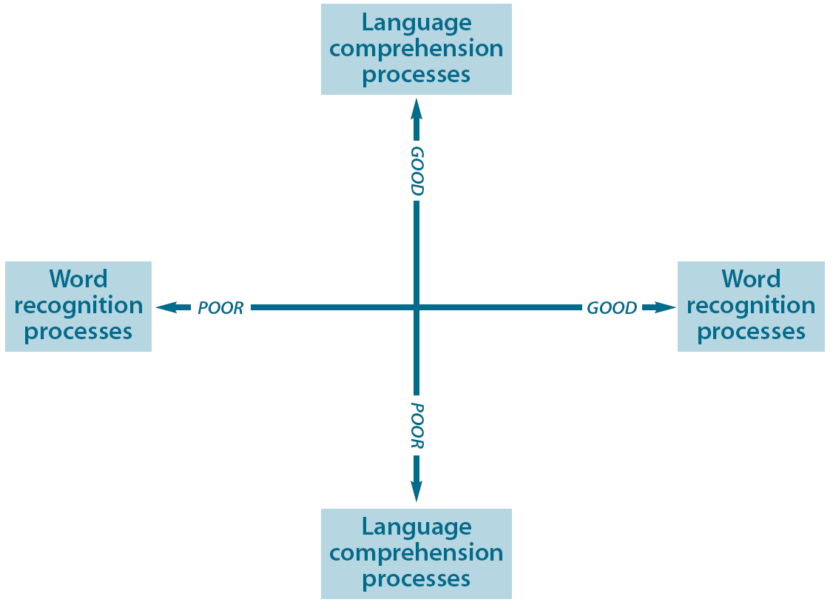
Teaching reading
Good language comprehension, poor word recognition
Good word recognition, good language comprehension
I need support to read words but I understand what I read
I read confidently with good understanding
I need support to read words and understand what they mean
I can read the words but don’t understand what I have read
Poor word recognition, poor language comprehension
Good word recognition, poor language comprehension

Slide 5
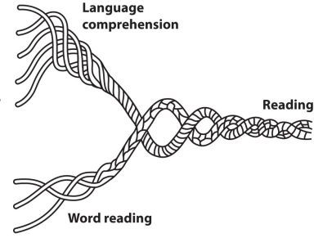
Language Comprehension
Scarborough’s Reading Rope: Strands for Skilled Reading (2001)
Background knowledge
(facts, concepts etc.)
Vocabulary knowledge
(breadth, precision, links etc.)
Language structures
(syntax, semantics etc.)
Verbal reasoning
(inference, metaphor etc.)
Literacy knowledge
(print context, genres etc.)
Ability to monitor understanding
increasingly strategic
Mental Model
Word Recognition
increasingly automatic
Phonological awareness
(syllables, phonemes etc.)
Decoding (and spelling)
Sight recognition
(of familiar words)
Reading is a multifaceted skill gradually acquired over years of practice and instruction.

Slide 6
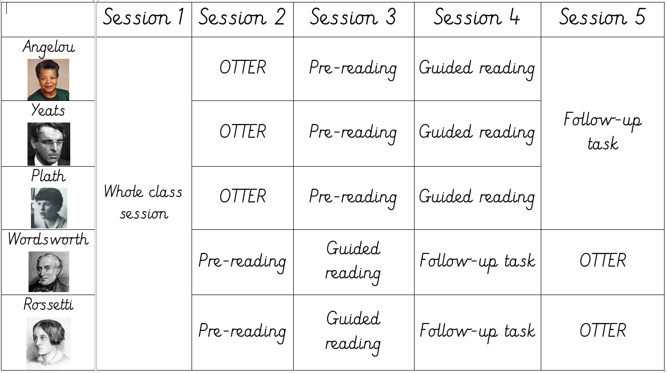
Reading for Meaning example timetable
The order of sessions will vary across classes, as will the number of groups.
Whole class session: used to teach a reading skill (e.g. prediction)
OTTER: Own time to enjoy reading
Promotes reading for pleasure
Pre-reading: children to read the text independently
Guided reading: children discuss the text and explore questions it raises with the teacher
Follow-up task: an opportunity for children to explain what they have learnt in their books.

Slide 7
Curriculum – Reception and KS1
Reading - word reading
Pupils should be taught to:
apply phonic knowledge and skills as the route to decode words
respond speedily with the correct sound to graphemes (letters or groups of letters) for all 40+ phonemes
read common exception words
read books aloud, accurately, that are consistent with their developing phonic knowledge and that do not require them to use other strategies to work out words
reread these books to build up their fluency and confidence in word reading
Reading - comprehension
Pupils should be taught to:
develop pleasure in reading, motivation to read, vocabulary and understanding
understand both the books they can already read accurately and fluently and those they listen to
participate in discussion about what is read to them, taking turns and listening to what others say
explain clearly their understanding of what is read to them

Slide 8
Curriculum – KS2
Reading - word reading
Pupils should be taught to:
apply their growing knowledge of root words, prefixes and suffixes, both to read aloud and to understand the meaning of new words that they meet.
Reading - comprehension
Pupils should be taught to:
maintain positive attitudes to reading and understanding of what they read
discuss and evaluate how authors use language, considering the impact on the reader
distinguish between statements of fact and opinion
retrieve, record and present information from non-fiction
participate in discussions about books, building on their own and others’ ideas and challenging views courteously
explain and discuss their understanding of what they have read, including through formal presentations and debates
provide reasoned justifications for their views.

Slide 9
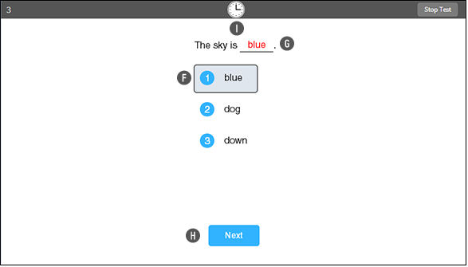
Accelerated reader
Star reading test
  34 questions
  Questions become easier or harder dependent on success
  Children repeat the star reading test half termly and ZPD levels changed as necessary

Slide 10
Accelerated reader
  Children are given their ZPD level in their reading journals
  They can choose books within their level, but can also go above if they would really like to read that book: particularly if it is a sequel
  There are over 36,000 books registered on AR to quiz on – so most books they read at home can also be quizzed on!
  Children should put their names on the class list to be quizzed when they have finished reading their book so they can quiz on it as quickly as possible

Slide 11
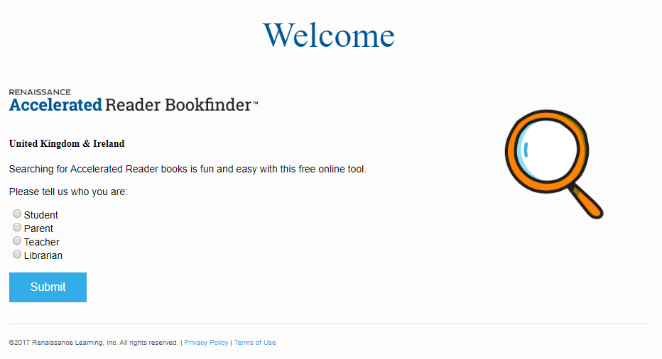
Accelerated reader
  There are over 36,000 books registered on AR to quiz on – so most books they read at home can also be quizzed on!
  Click on the image below or google ‘AR Book finder’ to be taken to the AR website to find books which match a child’s ZPD level and age (use the advanced search tool)

Slide 12
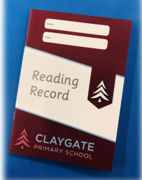
Reading journals/records
Children are expected to read regularly, either alone or with an adult
If children are not reading regularly, they will be asked to attend homework club that week
Diaries will be checked on Fridays

Slide 13
Listening to an audio book
Books linked to topics in class
Read for pleasure
Library Trip
Ask questions about the books children have read
Newspaper
Leaflets or brochures
Computer task
Why do we ask questions?
Other reading activities for home

