Slide 1


Phonics Workshop for Parents
Wednesday 17th November 2021

Slide 2
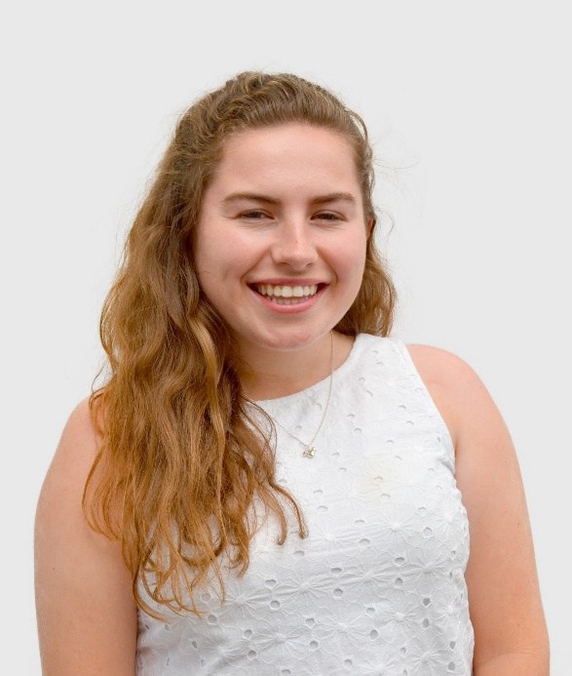

Phonics & Early Reading at CPS
Phonics Scheme: Little Wandle Letters & Sounds Revised
In Year 1 we teach phases 3, 4 & 5 in the following ways:
  Discrete whole class daily phonics sessions
  Oral blending and segmenting
  Individual reading with a teacher
  Group reading sessions at least twice weekly

Slide 3

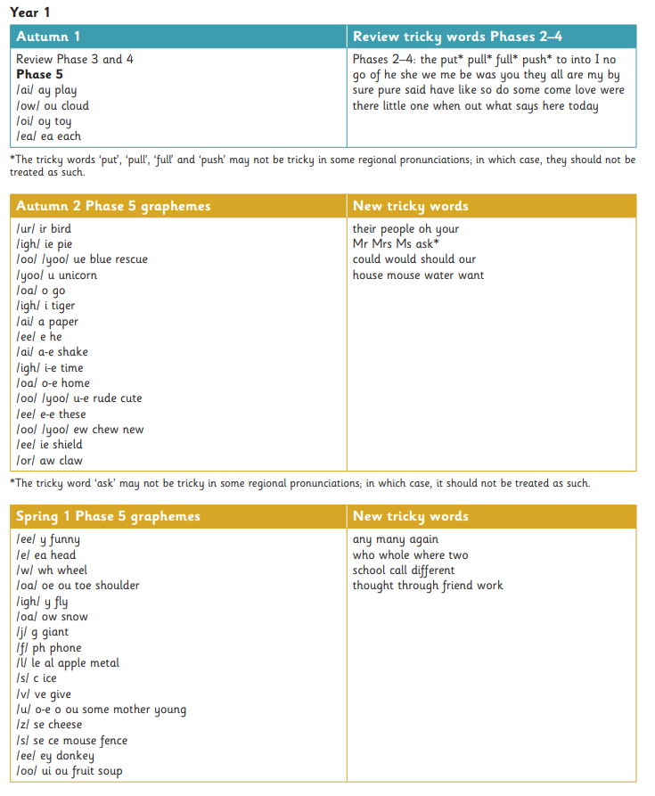
Overview of Progression
- Clear progression from one week to the next
Clear progression of tricky words – introduced weekly
All staff clear on what should be taught and when

Slide 4

Key Terminology
A phoneme is the smallest unit of sound in a language. There are 44 phonemes
A grapheme is a letter or group of letters which represent a sound
Letters (graphemes) are used to represent sounds (phonemes)
c-a-t
sh-o-p

Slide 5
Key terminology
Digraph: a combination of two letters representing one sound
ck sh ch th ng nk ee oa oo ar or ur oi er
Trigraph: a group of three letters representing one sound
igh air ear

Slide 6
Key terminology
Decoding: the ability to apply your knowledge of letter-sound relationships, including knowledge of letter patterns, to correctly pronounce written words
Encoding: the process of hearing a sound and being able to write the symbol that makes that sound.

Slide 7


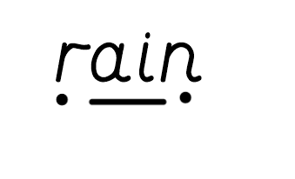
Phoneme Buttons
At CPS children are encouraged to ‘phoneme button’ words during phonic lessons. A dot is used for a single phoneme. A dash is used for a digraph or a trigraph.
Sweep: the action of joining the phoneme buttons together to say the word. The blending of the sounds.

Slide 8

Phoneme Fingers - to aid oral blending and segmenting for writing
Children are encouraged to count the phonemes in words. We do this by segmenting the word into phonemes on our fingers.
Oral blending: children listen to the spoken phonemes and then blend to say the word
Segmenting: splitting a word into the individual phonemes

Slide 9
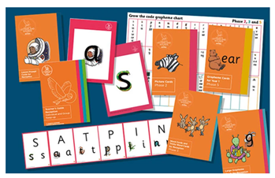
Daily Phonics Lesson Structure
Review – previous sounds
Teach – new sound
Practice
Apply

Slide 10
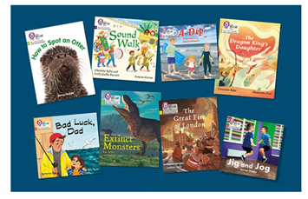
Group Reading Session
Minimum twice weekly for each child
Intelligent practice: Teaching not listening to children read
Children should be able to read the book chosen at 90% fluency
Sessions recorded in reading diaries with stamper
Each reading practice session is designed to focus on a different skill:
  Decoding
  Prosody
  Comprehension

Slide 11
Reading in Year 1
Each week children will receive a phonics book after they have read in school with an adult in a group reading session. These books will be decodable and will only contain phonemes the children have been taught and have securely retained.
At CPS we no longer use ‘colour bands’ when grouping books. All books will be decodable and books are closely matched to the phonemes and tricky words that your child is confident with.

Slide 12
How can you help at home?
Practising phonics flashcards and reading words containing new phonemes
Reading the phonics book – decoding & reading tricky words fluently
When you’re reading with your child please make sure your child is not over pronouncing phonemes
Practising weekly spellings (phoneme focus and tricky words)
Reading bedtime stories/reading for enjoyment – this is where YOU model fluency!
Please record each time you practice reading at home in your child’s reading diary e.g
John was confident decoding words in his head today and read with some fluency. He needed a little encouragement to chunk longer words, such and ‘sunlight’.

Slide 13
Reading Assessments
Every half term the teachers assess each child on the phonemes taught. The children will decode, blend and encode selected phonemes and words.
Children may be selected for interventions which are targeted for children who have gaps in their phonics knowledge.
Each day teachers continually assess the children. Children may only be in an intervention for a short period of time.

Slide 14
What is the Phonics Screening Check
The Year 1 phonics screening check is a short assessment to confirm whether individual pupils have learnt phonic decoding to an appropriate standard. This will take place in June 2022
It will identify the children who need extra help – these children will be given support to improve their reading and phonic skills.

Slide 15
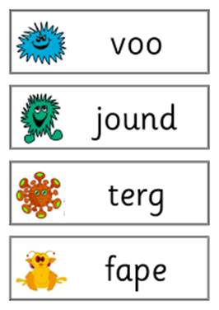
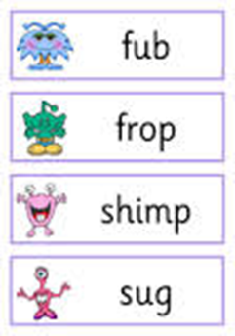
What is the check like?
Each child has to read 40 words with his/ her teacher.
The non-words are identified by a picture of an imaginary character and children will be told which are real and which are made-up words.

Slide 16
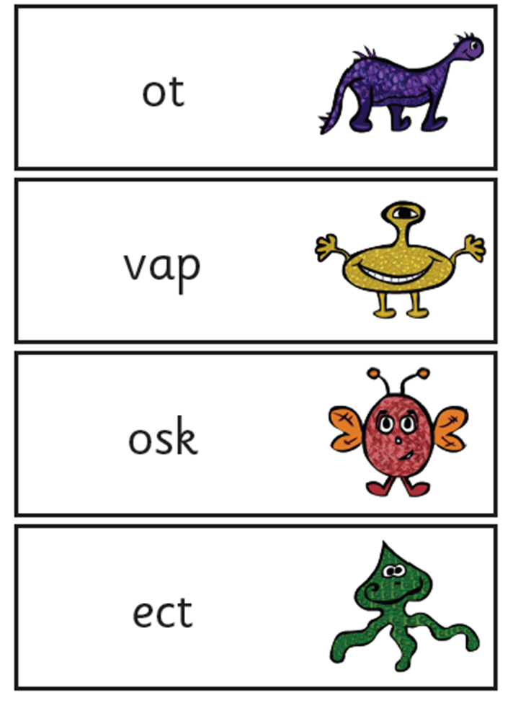
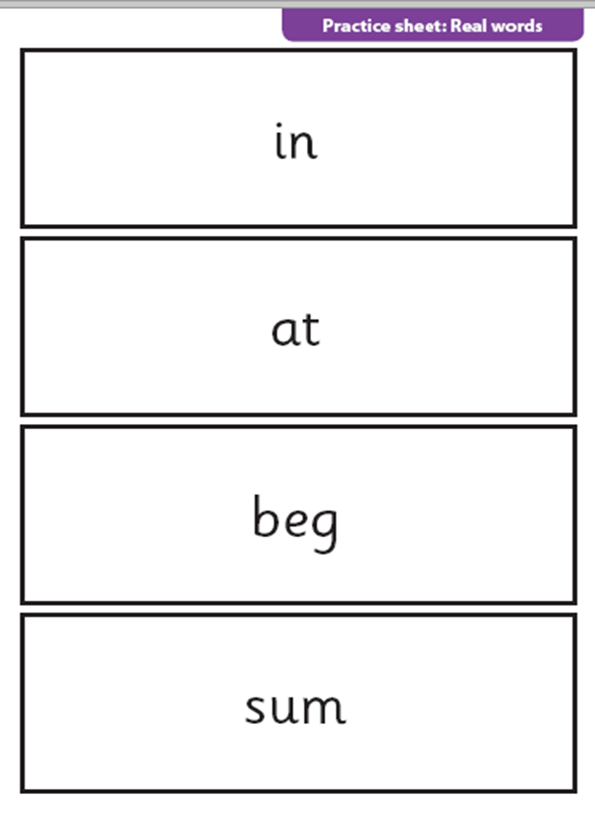
How will results be used?
Results will be reported to parents at the end of the Summer Term
Results will be used to plan support

Slide 17
Any questions?

