Slide 1

Computer Science Week
@ CPS

Slide 2
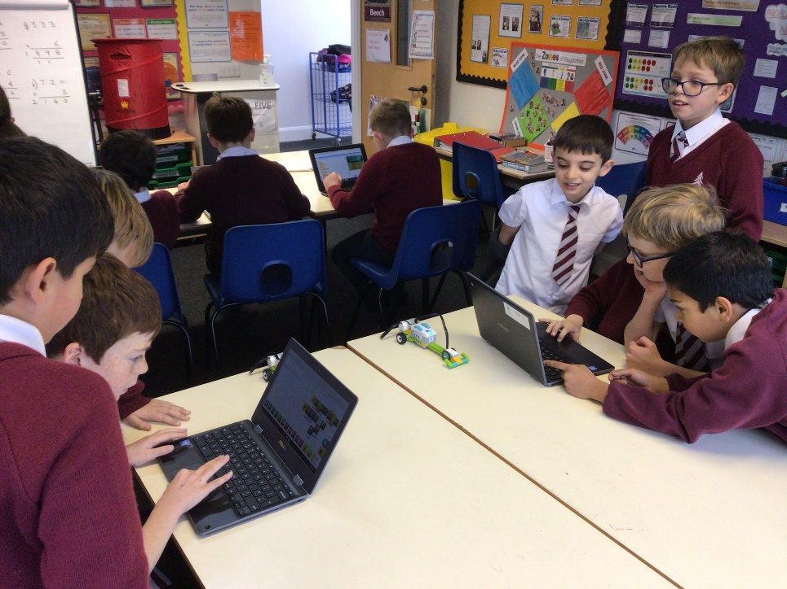
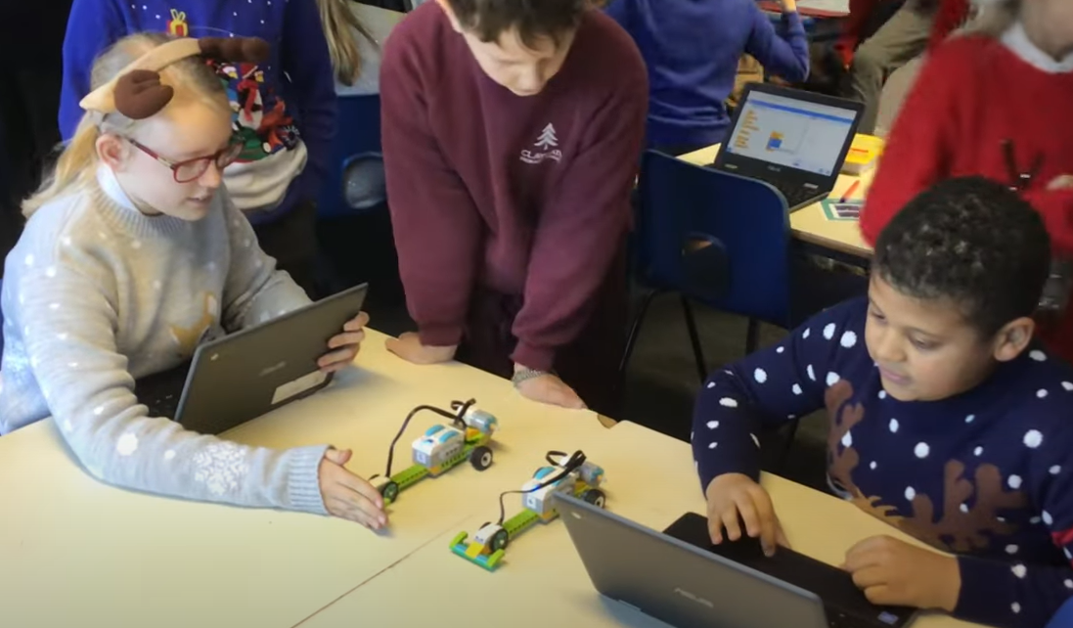
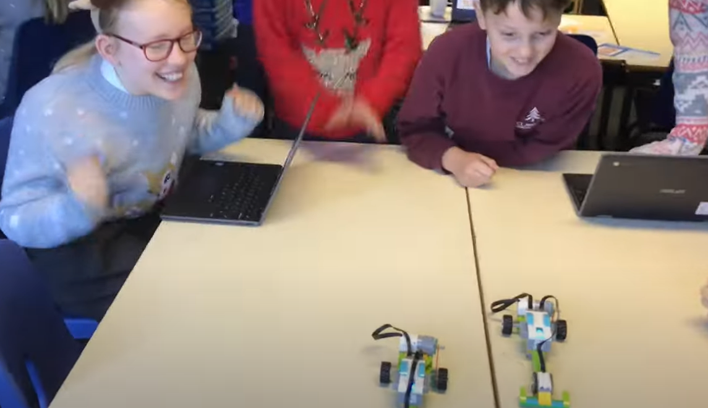
Lego WeDo Racing
We Used block coding to programme the racing cars to move.
By constructing our own algorithms, we made our car go faster than our opponent’s.

Slide 3
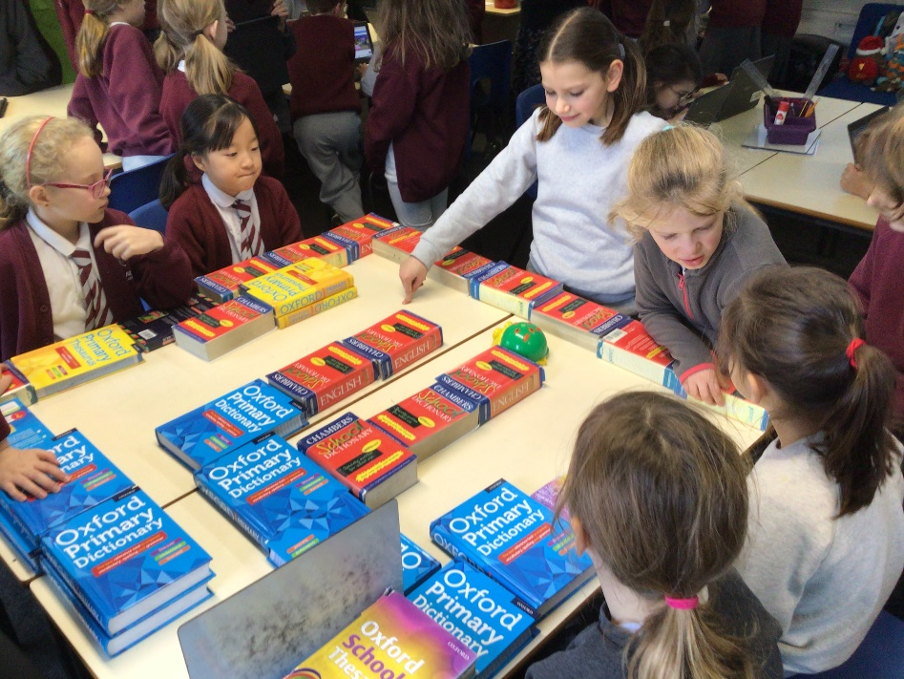
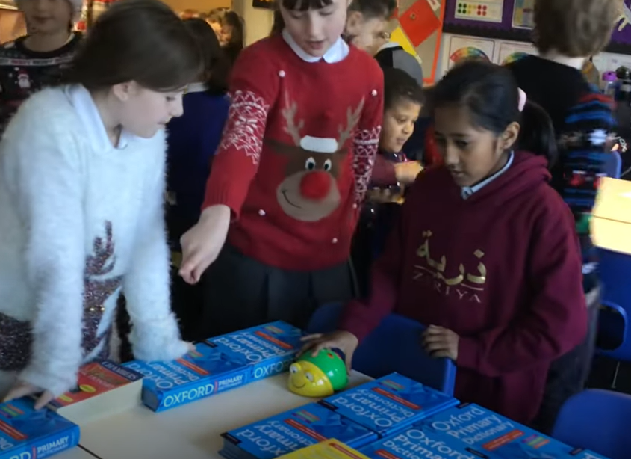
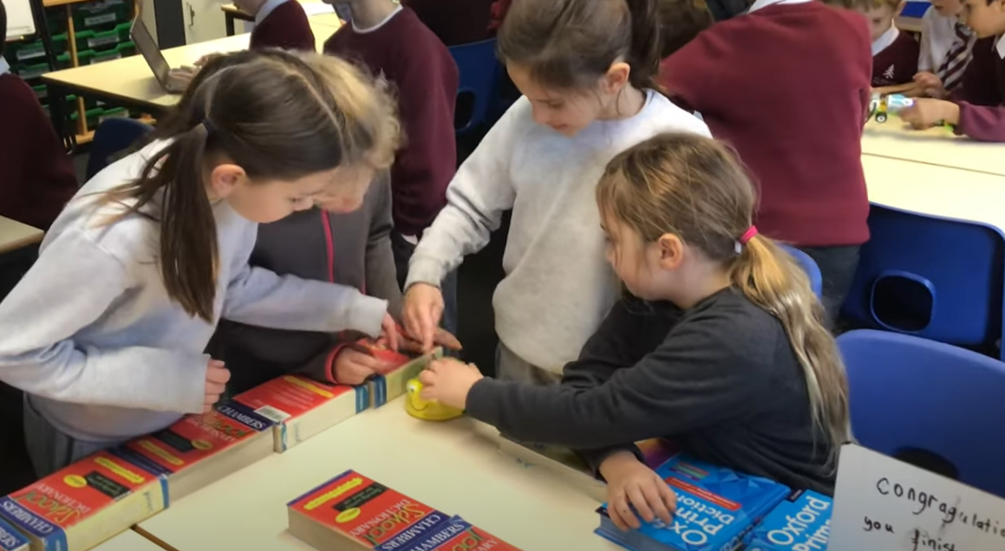
Bee Bot Maze
We created an algorithm to code our bot to move through the maze.
Our challenge was to be a computational thinker! This meant that we had to think about an algorithm that would work. If it didn’t, we had to tinker and debug it.

Slide 4
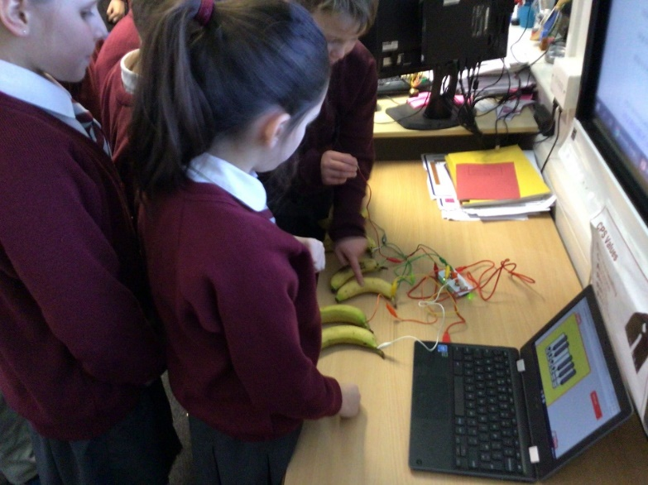
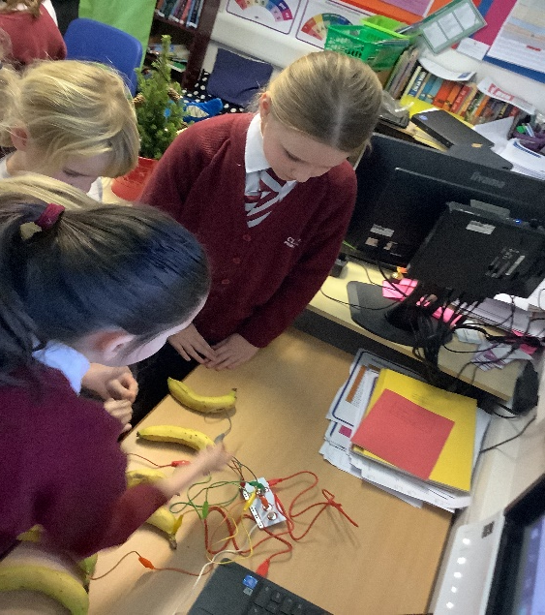
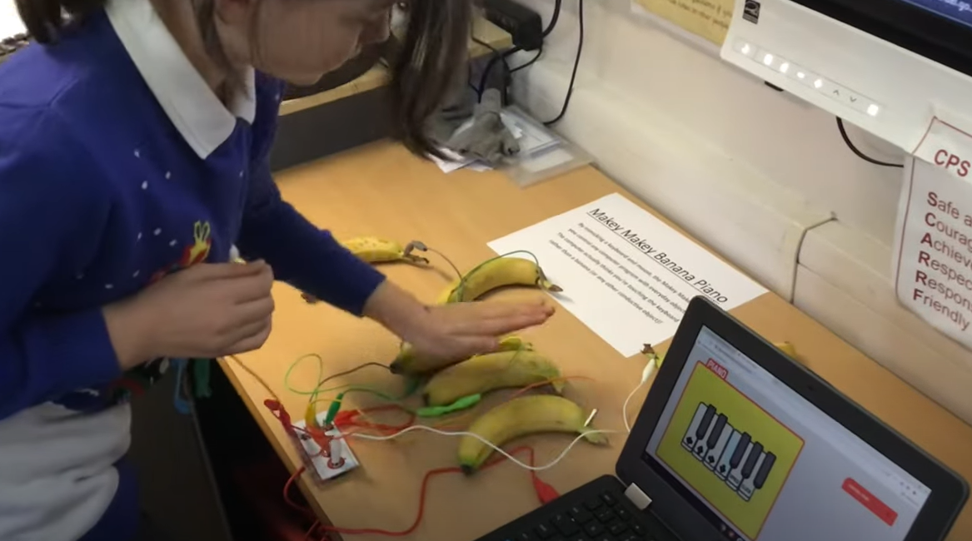
Makey Makey Banana Piano
We learnt about circuitry and motherboards when playing on a Makey Makey banana piano.
By connecting crocodile clips to the circuit board in specific places, we turned pieces of fruit into a computer keyboard which the computer then understood.

Slide 5
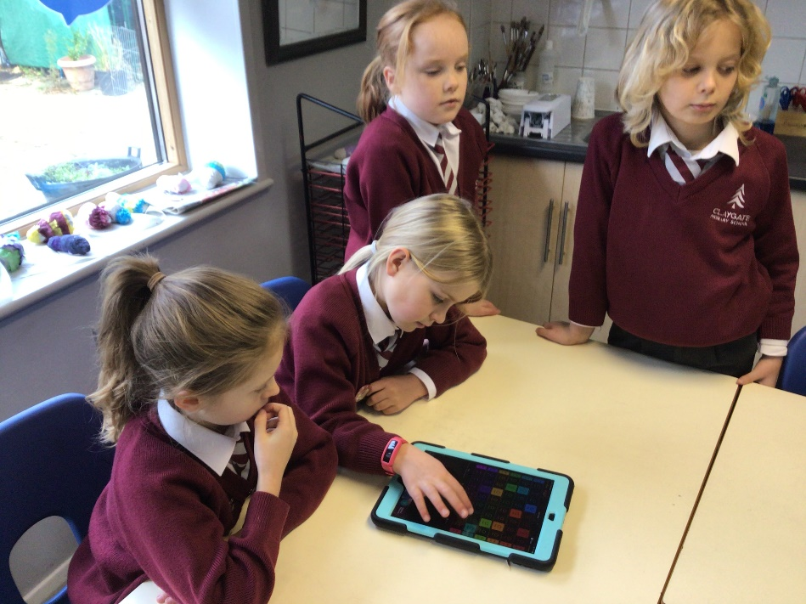
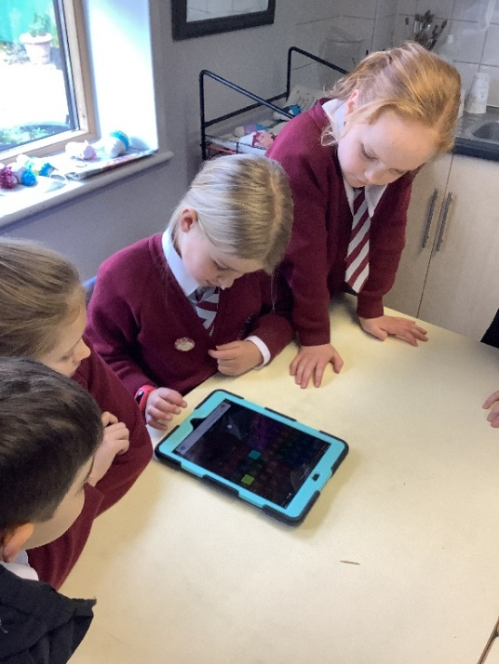
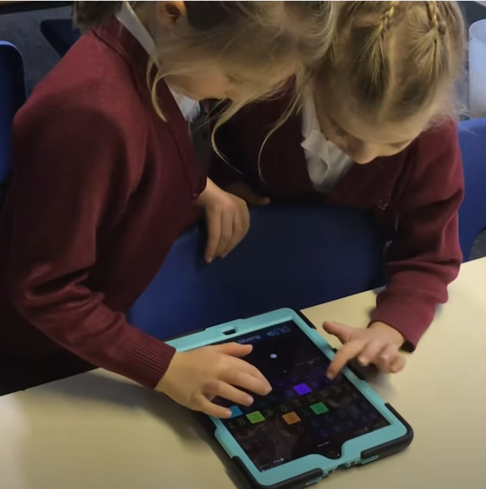
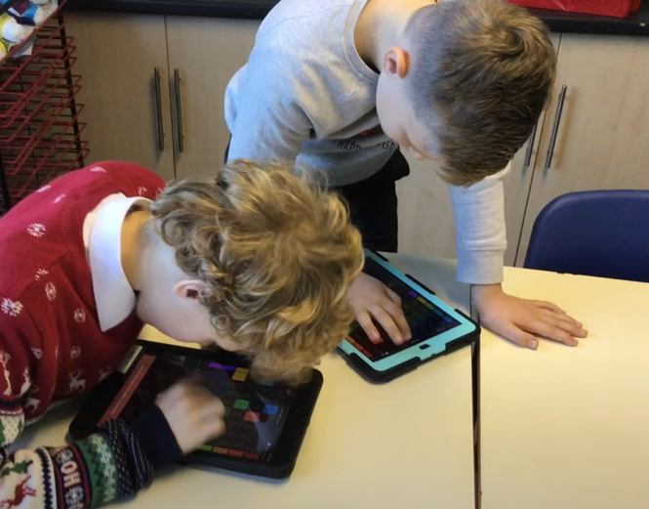
Groove Pad
We learnt what loops are and how they can be used in Computing, and how we can use loops to create a continuous melody in music.
We were encouraged to tinker with variables to see what happens, for example, if we switched between drum beats, what would happen?

Slide 6
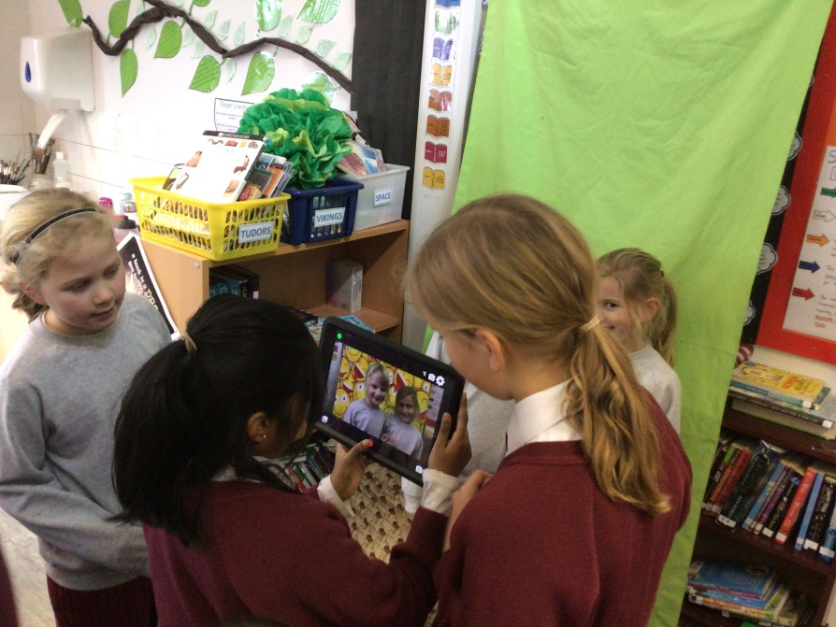
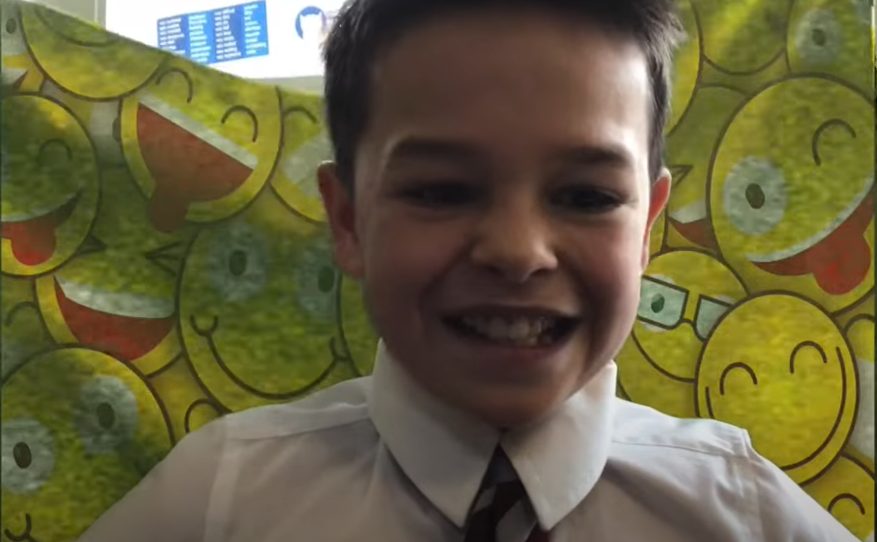
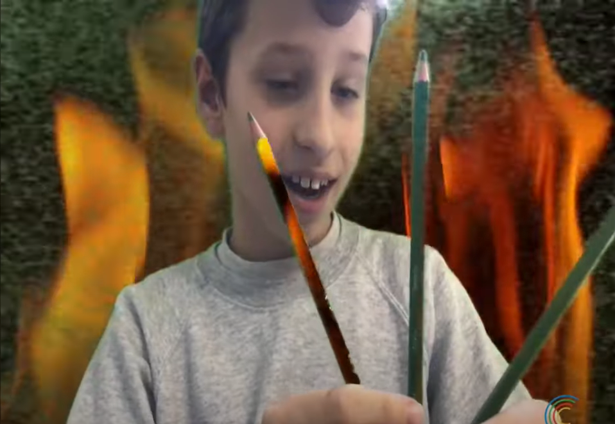
Green Screen
We learnt about green screen and thought about the computer science involved.
We experimented with different backgrounds, and if different shades of green worked as well.

Slide 7
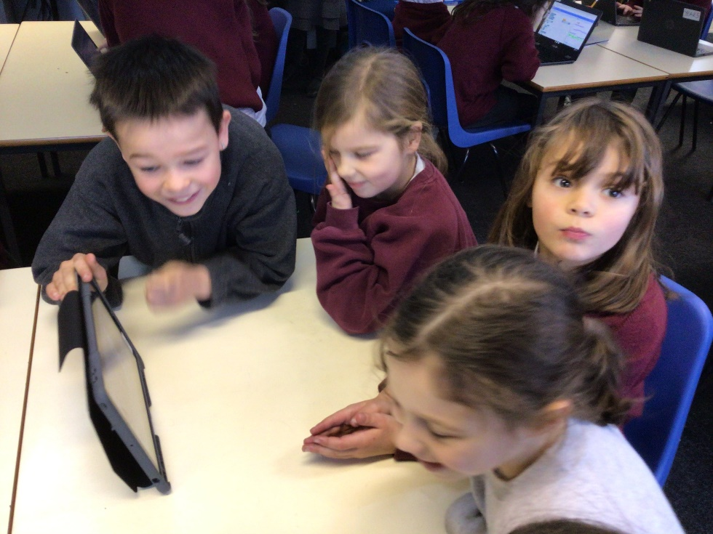
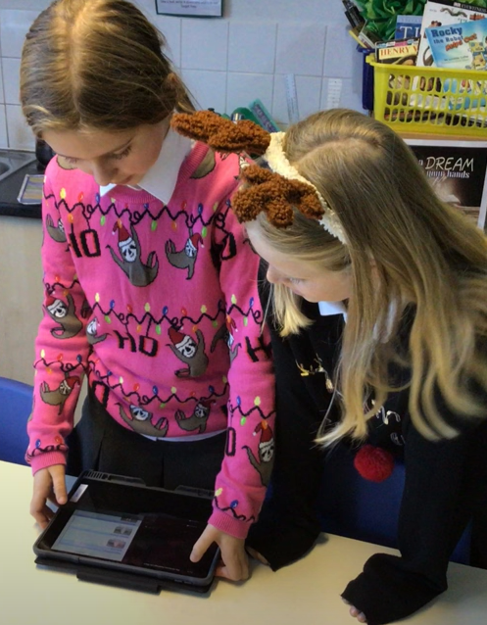
Movie Making
We used iMovie to create film clips.
We added a video, learned how to edit and how to add sound to a video.
We were challenged to create a transition between two clips.

Slide 8
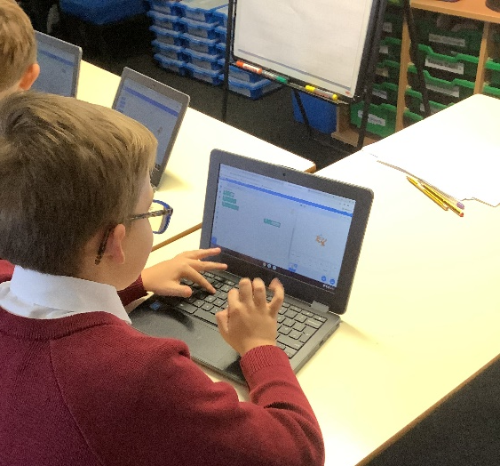
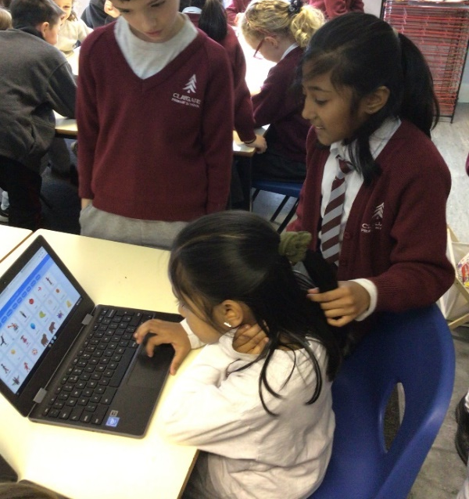
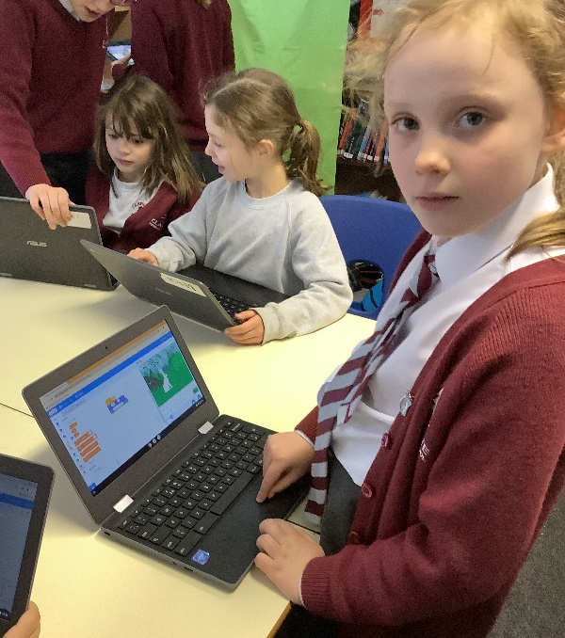
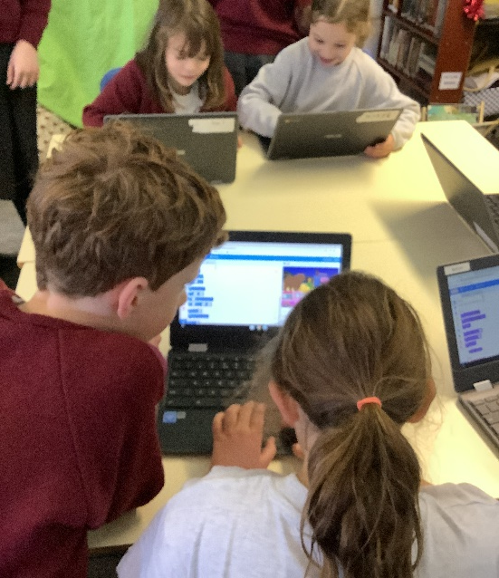
Scratch Coding
Scratch is a block coding programme which helps you learn the basics of computer coding.
We used this to create different algorithms to create a range of outcomes.
We also explored using different functions and even had a go at creating a variable.

