Slide 1


Reading at Claygate
Parent Forum
03.02.22

Slide 2

Our Reading Vision
Reading is a fundamental lifelong skill which is key to our understanding of the world and unlocks learning. Reading is a partnership between all of us. Our children become fluent, competent readers who develop a strong desire to read.

Slide 3
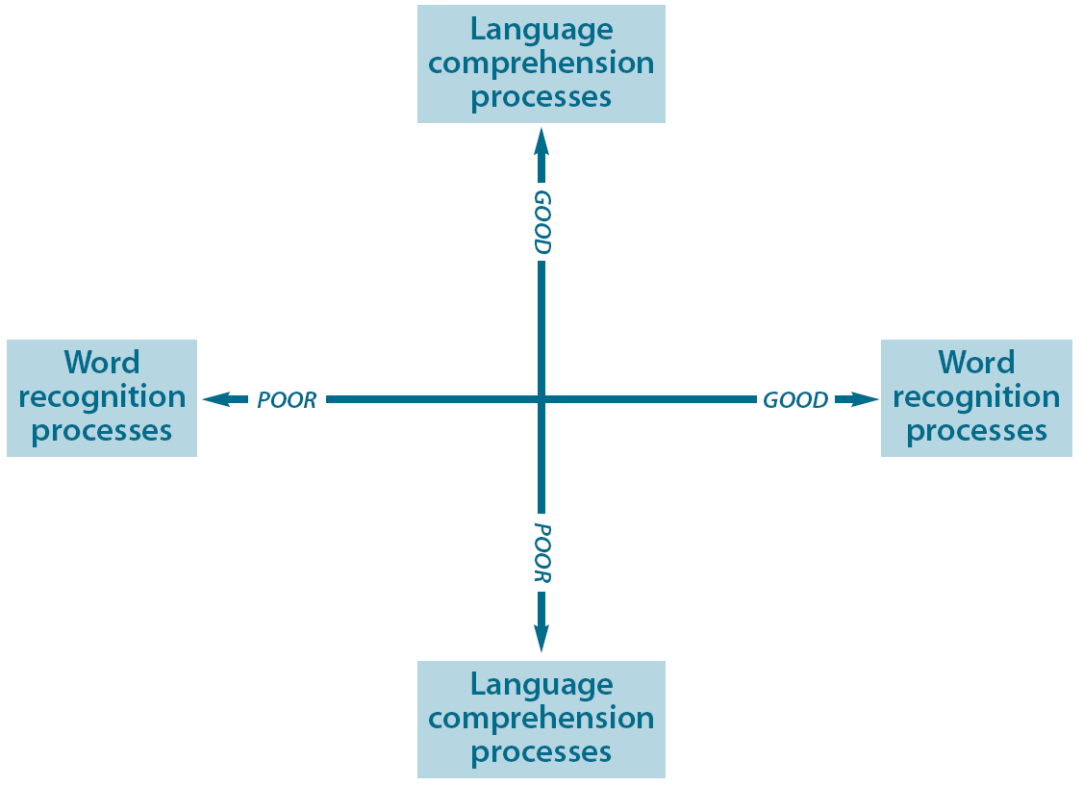
Teaching reading
Good language comprehension, poor word recognition
Good word recognition, good language comprehension
I need support to read words but I understand what I read
I read confidently with good understanding
I need support to read words and understand what they mean
I can read the words but don’t understand what I have read
Poor word recognition, poor language comprehension
Good word recognition, poor language comprehension

Slide 4
Teaching reading at CPS
Phonics (Nursery to Year 2)
Reading for Meaning – lessons on reading skills
Accelerated reader – practicing comprehension skills regularly
OTTER
Library visits – will be reinstated Spring 2
Inviting and interactive book corners in every classroom

Slide 5
OfSTED’s View on Early Reading
Reading deep dives will consider the extent to which:
direct, focused phonics is taught every day in Reception and key stage 1
children read from books with the sounds they know, while they are learning to read
teachers and teaching assistants provide extra practice through the day for the children who make the slowest progress (the lowest 20%)
all children in Year 3 and above can read age-appropriate books
teachers instil in children a love of literature: the best stories and poems

