Slide 1


Parent Forum on Writing
26th January 2023
CPS Writing Lead: Libby Cannons

Slide 2

CPS Writing Priorities 2022/23
Maintain increase in progress and attainment:
Use of purposes of writing across KS1 and KS2
Development of proof reading and editing skills (purple pen)
Word of the Week
Use of Doodle English (Y3-Y6)
Increase Proficiency in Spelling:
Higher profile of spelling across the school
Training from Literacy specialist
Statutory spelling lists (in reading records)
Improving accuracy of spelling of common words
Assessment:
Ongoing using key concept grids
Formal assessment for Yr 2 & Y6 using teacher assessment in Summer term

Slide 3
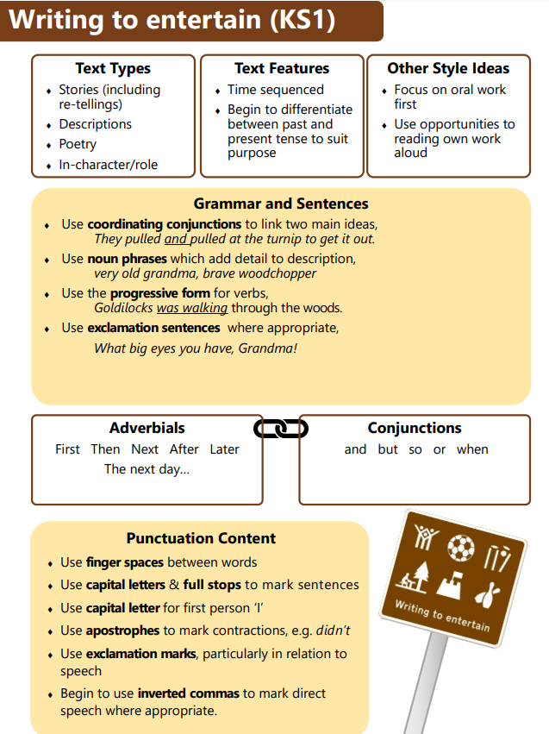
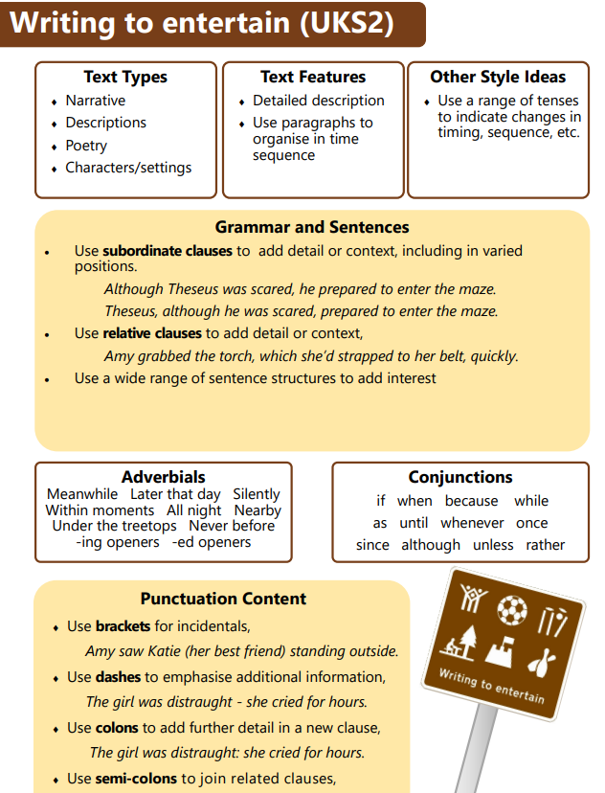
Purposes for Writing

Slide 4
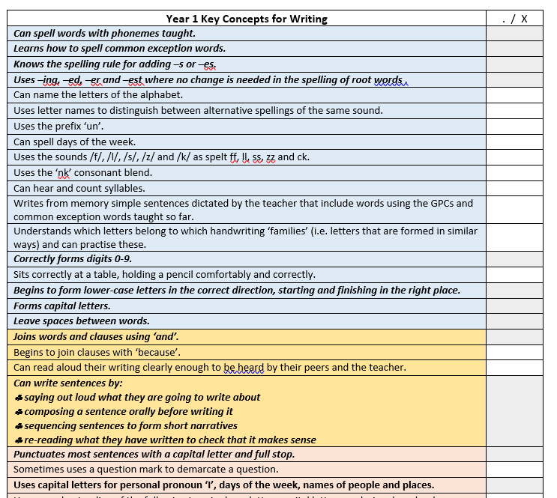
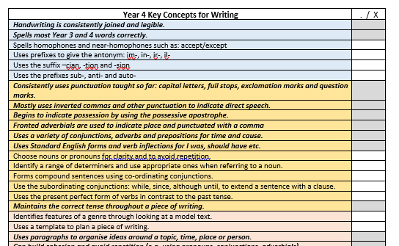
Key Concept Grids
> Key concepts to be taught over the course of the year.
> Based on the National Curriculum
> Focus for teacher assessment

