Slide 1

Parent Forum on Computing
24th April 2023
CPS Computing Lead: Mike Godfrey

Slide 2

CPS Computing Successes
Each year group has a stack of 16 chromebooks (2 roaming sets)
Kapow Computing scheme (KS1 & 2)
Assessment system
Clear progression in skills and knowledge
All three strands of NC covered: Digital Literacy, Information Technology & Computer Science
Computer Science Week
Jam Coding Club
Online Safety Workshops for parents and children (Breck Foundation, Childnet and Online Safety week)

Slide 3
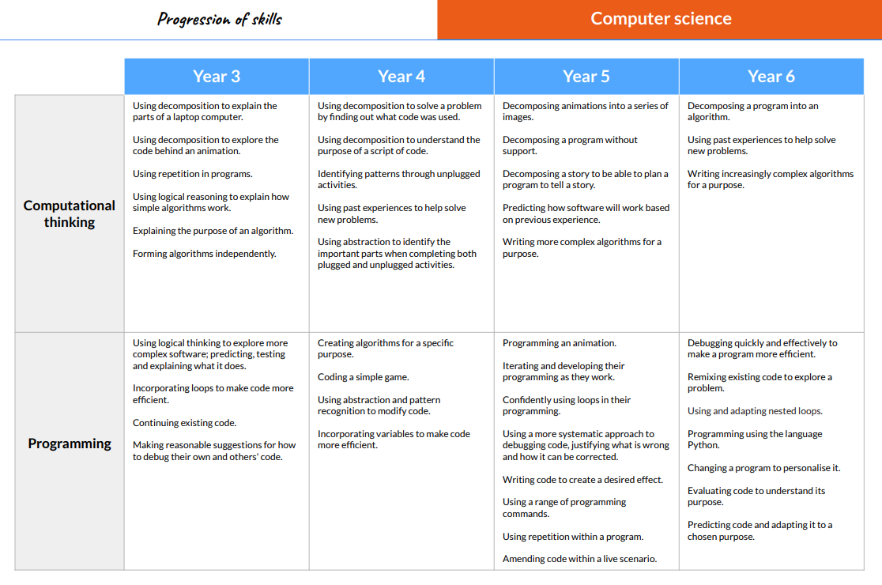

Slide 4
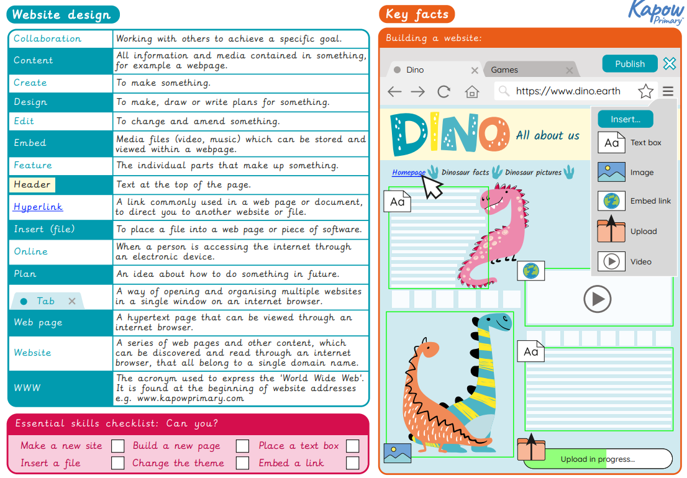

Slide 5
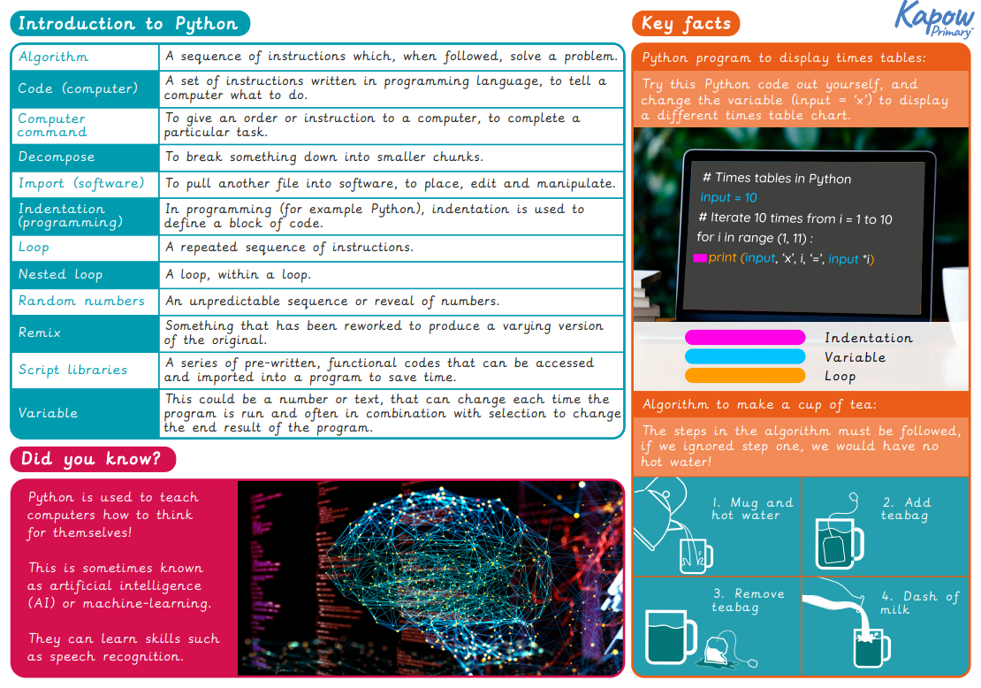

Slide 6
CPS Computing Priorities 2022/23
Embed Kapow scheme – Computing Lead is teaching every year group as part of enrichment programme
Use of VR Headsets, Microbits, Lego Wedo and other tech
Further assessment practice including retrieval questions at the start of every lesson
School podcast!
Continue to offer team teaching and enhance staff knowledge

