Slide 1
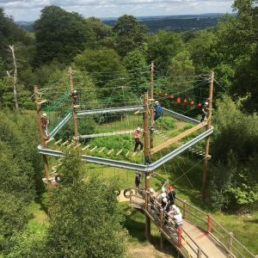
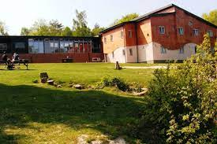


Hindleap Warren
Wednesday 17th – Friday 19th May 2023

Slide 2
Staff Attending
Miss Jenkins
Mrs Ali
Mr Hales
Mrs Sisterson
Mrs Mason

Slide 3
Wednesday 17th Arrangements
Drop off your child at school at 8:40- bags can be left in the hall
All medication to be taken to Mrs Ali in the hall
Coach pick up is at 9:15 am
Please come and wave us off from Foley Road if you would like to
Children MUST bring a PACKED LUNCH and a drink (no nuts, fizzy or glass bottles please)

Slide 4
Medication
All medication to be handed directly to Mrs Ali on the morning of Wednesday 17th.
Medicine must be clearly named and labelled including travel sickness medication.
If travel sickness medication is needed, please administer before coming to school and provide clearly labelled meds for the return journey.
First aid trained staff on site.
Duty staff on site at night in the event of emergency.

Slide 5
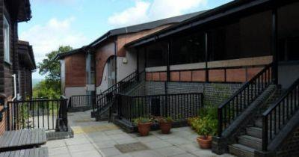
Accomodation
Sleeping in dorm rooms with bunk beds
X6 children per room
Staff rooms in same area
Children have been asked to nominate friends they would like to share with
Children will be in charge of making their own bed, practise beforehand is always appreciated!

Slide 6
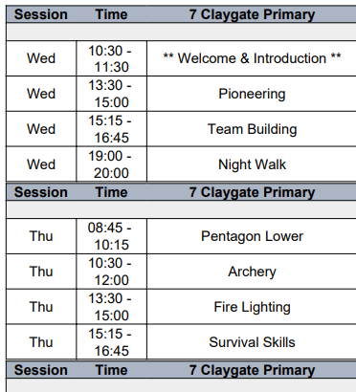
Activities:
Free-time
Sing-alongs
Football
Games
All activities are led by qualified instructors
A member of CPS staff will be supporting each group
Example of timetable of activities:

Slide 7
Food
All meals are freshly prepared on site and special dietary requirements are catered for.
We will provide children with snacks throughout the day. Please do not send children with any food, snacks or sweets.
Children will have an opportunity to visit the tuck shop where they can buy souvenirs and treats.

Slide 8
Kit List
Items not permitted:
Electronic devices including mobile phones
Sweets and snacks (we will provide some snacks and treats)
T-shirts (mixture of long and short sleeve)
Jumpers
Trousers/leggings (not jeans)
Waterproof top/coat & trousers
Sun hat
Plenty of underwear and socks
Slippers
Indoor footwear
Old trainers
Wellington boots
Towel
Toiletries
Couple of bin liners
Sun cream
A teddy or mascot
Useful tip:
Provide a bin bag or large carrier bags for dirty clothes to be packed in.
£5 spending money for the tuckshop

Slide 9
Friday 19th Arrangements
Activities will continue in the morning
Lunch will be eaten at Hindleap Warren
Pack up and depart for return to school
Departing Hindleap Warren at 14:00
Expected to arrive at school by normal pick up 15:15. Updates will be sent if we are delayed by more than 15 minutes.

Slide 10
Contact during the trip
Twitter
A member of staff will contact you on the contact numbers you have provided if there are any concerns during the trip. Please inform the office immediately if your details change.
Pleaser answer an unknown number - it may be Miss Jenkins or Mrs Ali calling from a mobile!

Slide 11
What happens next?
> Activities will be shared and arrangements will be and explained to the children
Any further questions?
Please contact Miss Jenkins, Miss Nelson or Mrs Ali if you have any further questions.

