Slide 1


Parent Forum
Oracy
30.06.23

Slide 2

What is Oracy?
Oracy - YouTube
Oracy is the ability to articulate ideas, develop understanding and engage with others through spoken language.
There are two types of Oracy talk:
Exploratory Talk – used in the early stages of approaching new ideas
Presentational Talk – speaker’s attention is primarily focused on adjusting the language, content and manner to meet the needs of an audience
What do the professional’s say?
‘Quality of pre-school children's language correlates highly with academic achievement’
(Hart & Risley 1995)

Slide 3
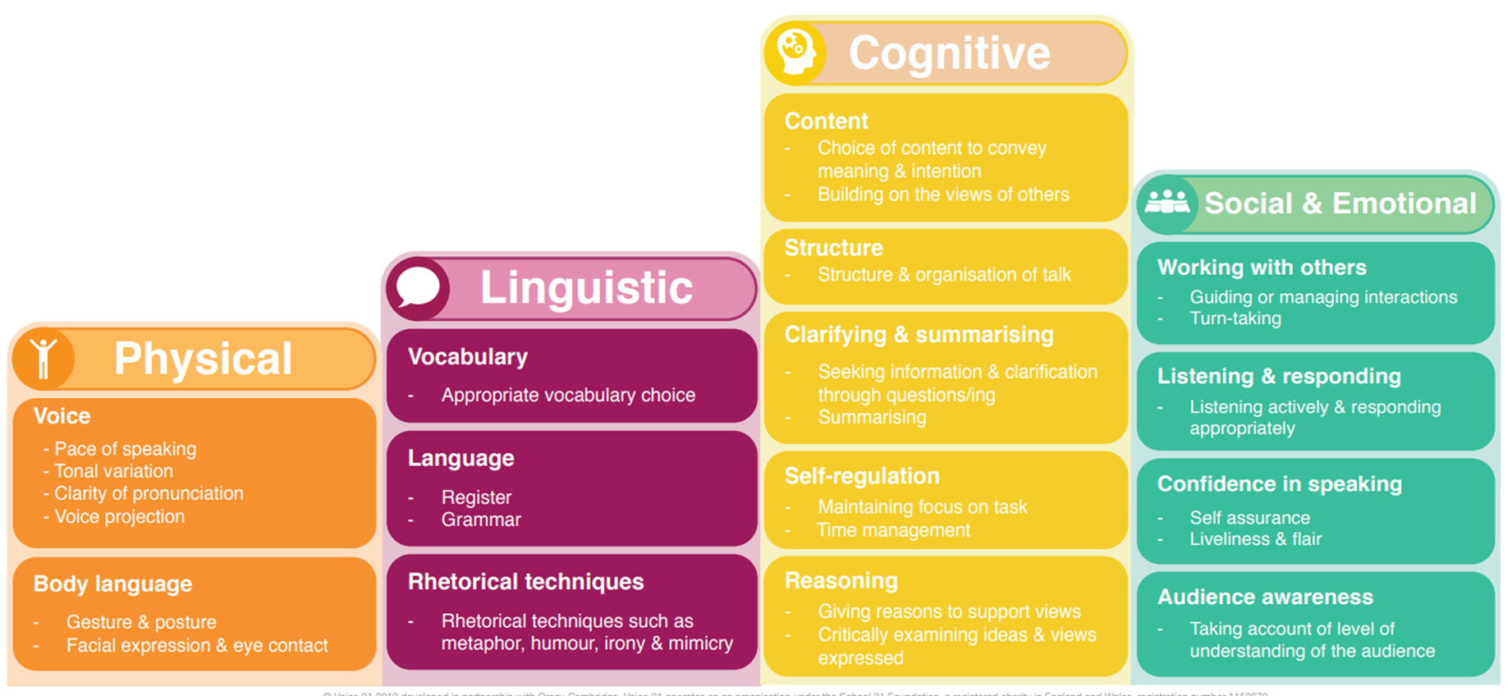
The Oracy Framework

Slide 4
Implementation at CPS
Oracy champions (across all Key stages) and regular training for all staff
Adult modelling of vocabulary
Use of sentence stems across all subjects
Expectation that all responses are in full sentences
Sentence stems used in the playground (supporting initiation of play and dealing with conflicts)
Thumbs-up
Praise oracy skills directly linked to the strands on the framework (verbally and bespoke certificates)
Ask me about… stickers
Explore different structures for discussions and assign roles
to pupils

Slide 5
Any Questions?

