Slide 1


Parent Workshop
Oracy – KS2
10.10.23

Slide 2

What is Oracy?
Oracy - YouTube
Oracy is the ability to articulate ideas, develop understanding and engage with others through spoken language.
There are two types of Oracy talk:
Exploratory Talk – used in the early stages of approaching new ideas
Presentational Talk – speaker’s attention is primarily focused on adjusting the language, content and manner to meet the needs of an audience
What do the professional’s say?
‘Quality of pre-school children's language correlates highly with academic achievement’
(Hart & Risley 1995)

Slide 3
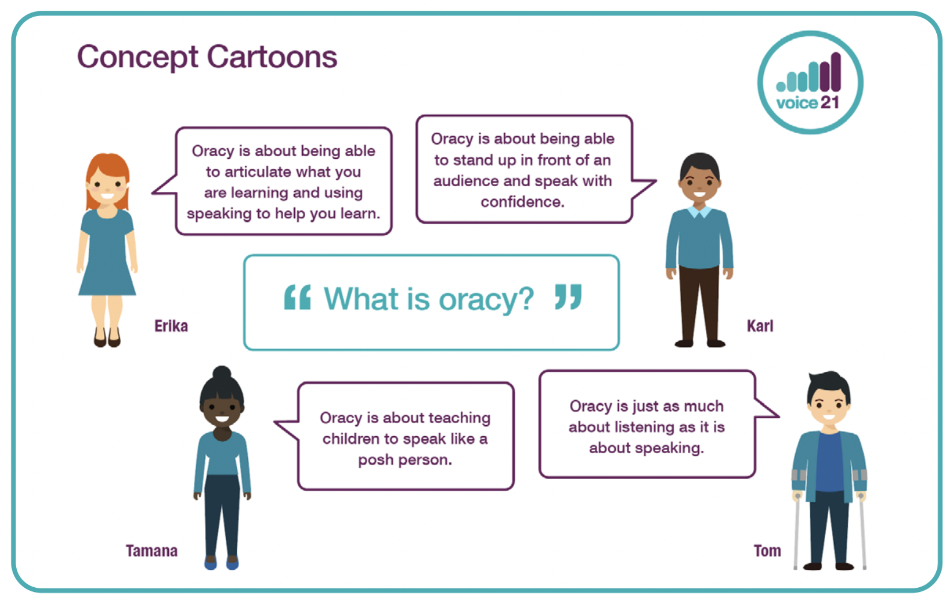

Slide 4
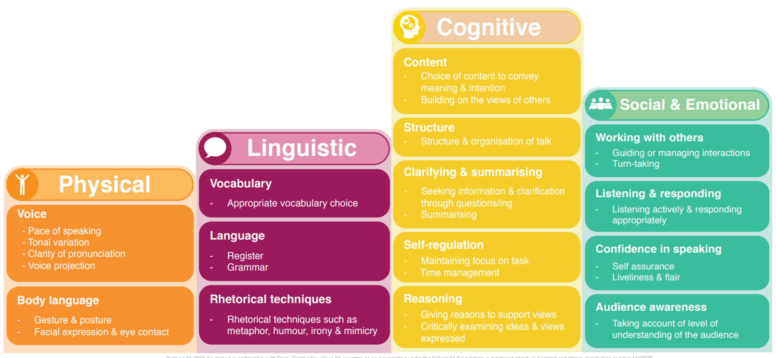
The Oracy Framework

Slide 5
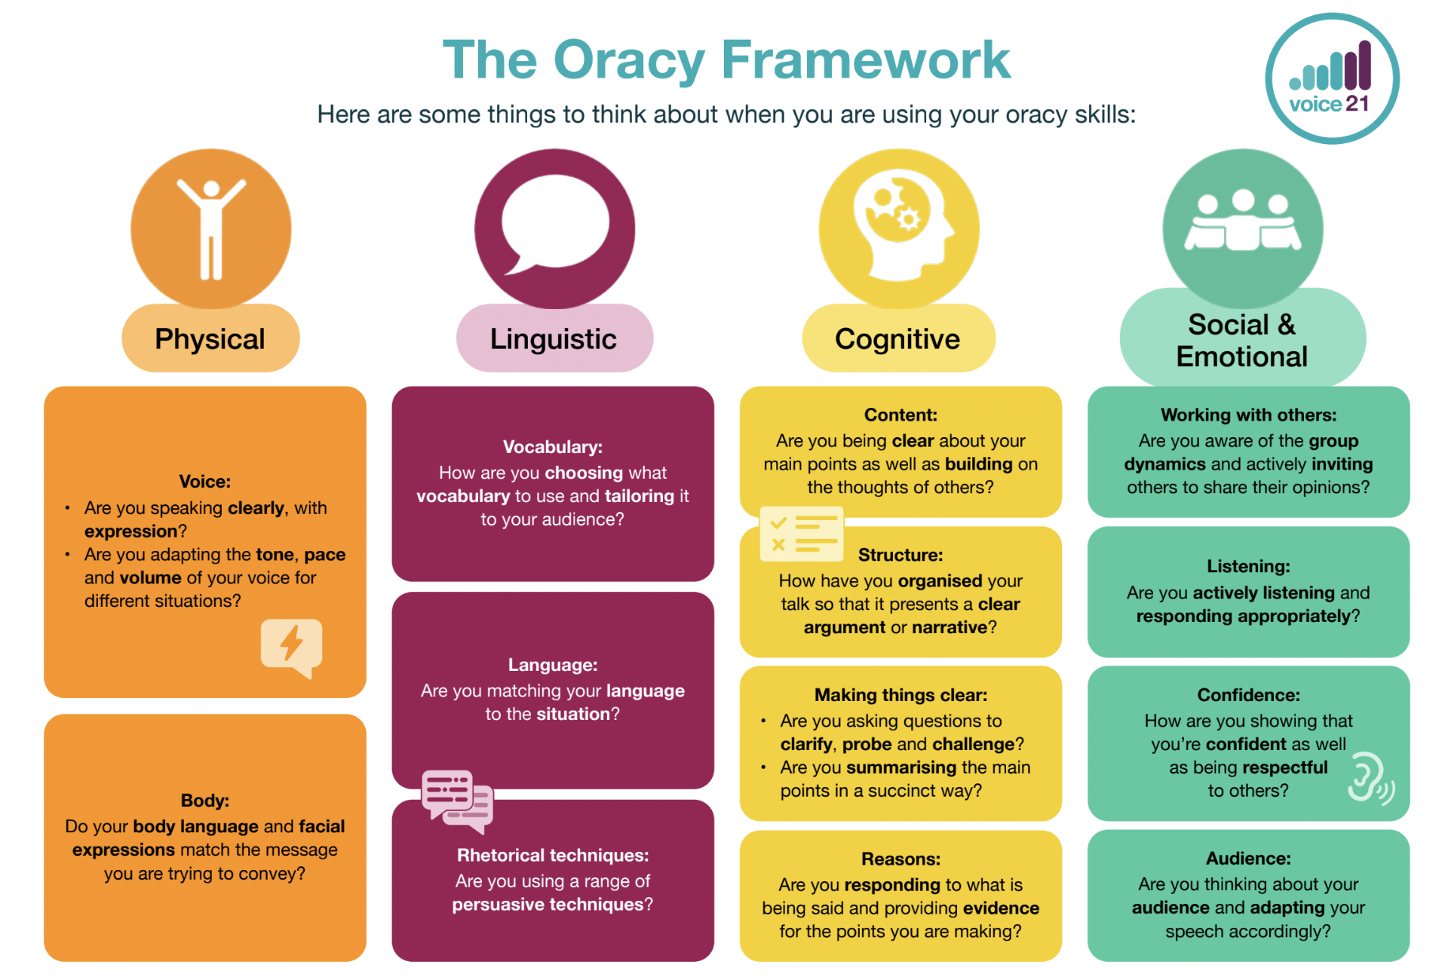
KS2 Framework

Slide 6
Implementation at CPS
Oracy champions (across all Key stages) and regular training for all staff
Adult modelling of vocabulary
Use of sentence stems across all subjects
Expectation that all responses are in full sentences
Sentence stems used in the playground (supporting initiation of play and dealing with conflicts)
Discrete Thumbs-up/Cold calling
Praise oracy skills directly linked to the strands on the framework (verbally and bespoke certificates)
Ask me about… stickers
Explore different structures for discussions and assign roles
to pupils

Slide 7
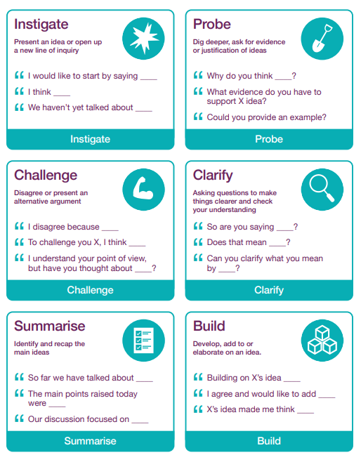

Talk Tokens
Debate: Should homework be abolished?

Slide 8
How can I support my child’s Oracy skills?
Actively engage in conversations with your child
Ask open-ended questions to initiate conversations e.g Tell me about your day?
Listen and respond
Allow your child thinking time
Be a good role model - both when speaking and listening
Read to your child, modelling appropriate expression and intonation in your voice, as well as exposing them to a wider range of vocabulary
Play games

Slide 9
Any Questions?

