Slide 1

Parent Forum on Design and Technology
2023
DT lead: Cassie Dobson

Slide 2
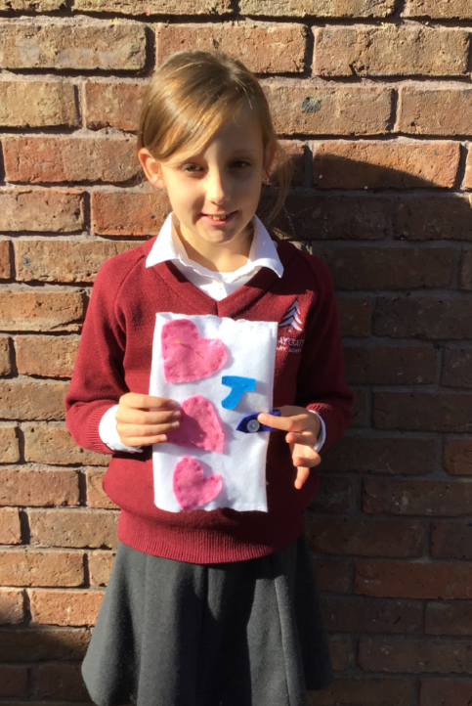
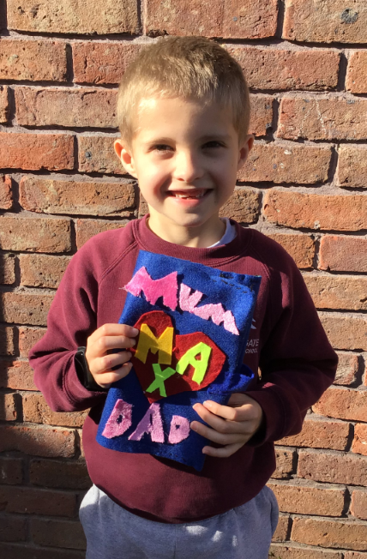
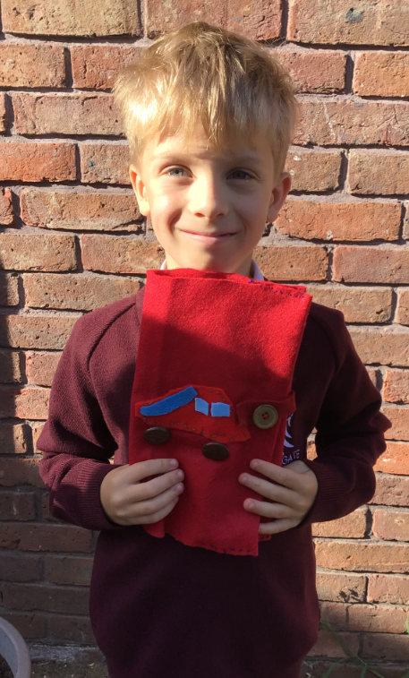

Slide 3
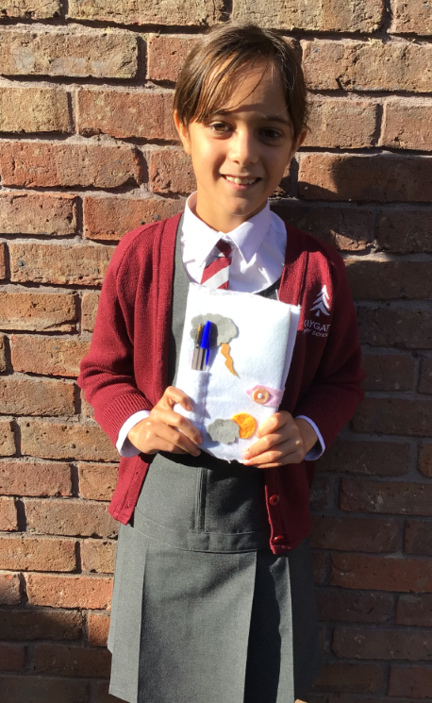
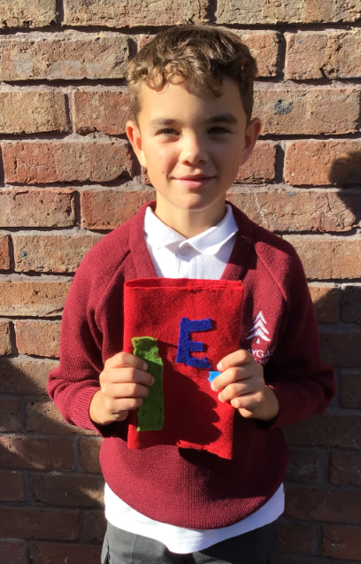
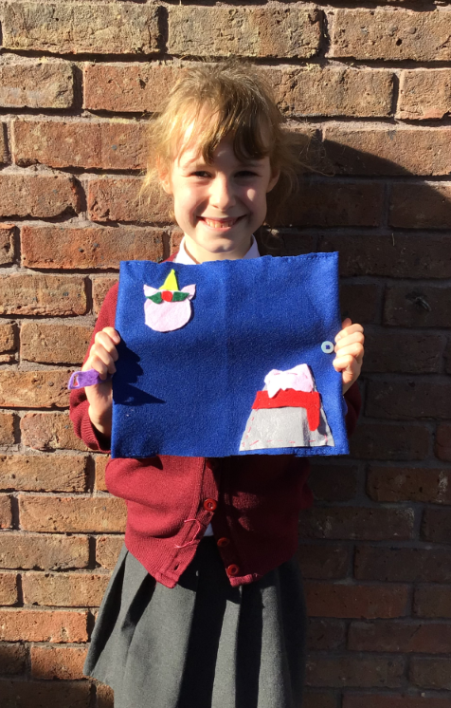

Slide 4
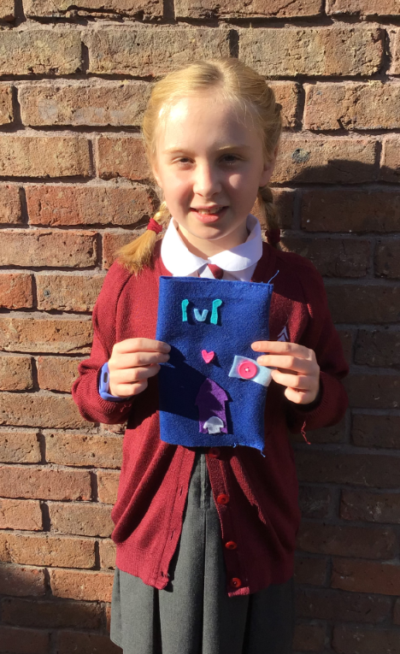
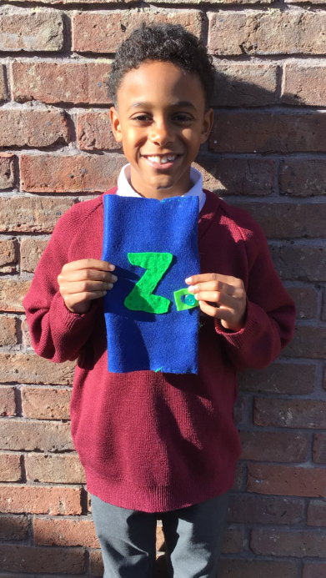
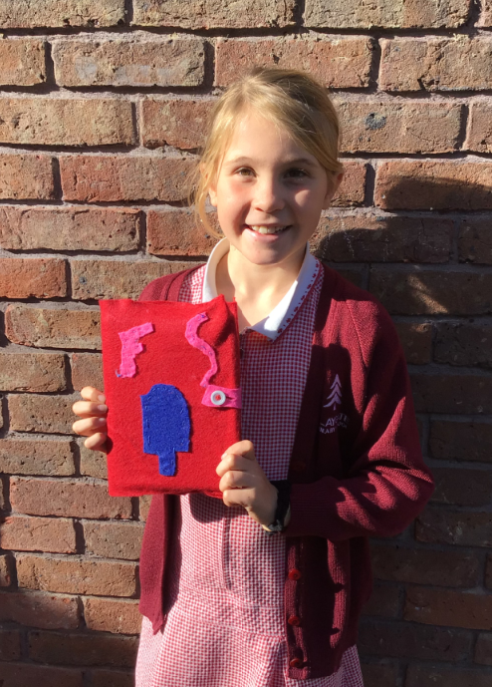

Slide 5
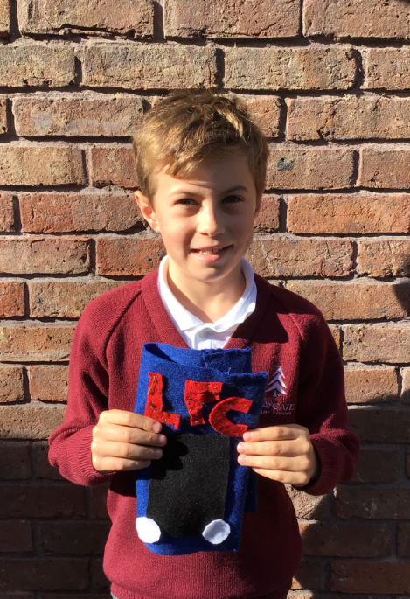
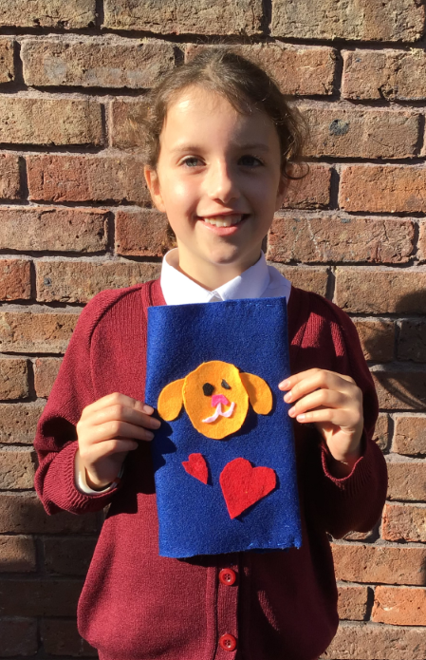
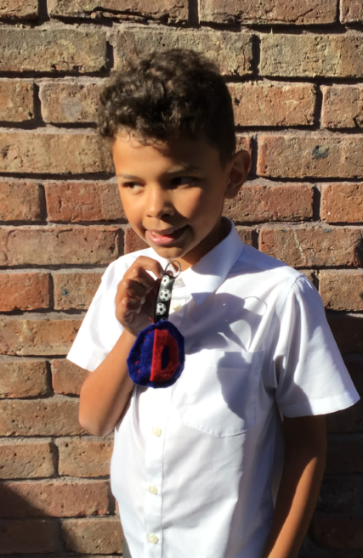

Slide 6

CPS DT Successes
Each class is teaching high quality DT through every year group
Kapow Design and Technology scheme (KS1 & 2)
Assessment system in place
Clear progression in skills and knowledge
All strands of NC covered
DT Day
Real buzz around DT amongst children and staff

Slide 7
Design and Technology vision
Design Technology is developing the skills to creatively design and make products that solve real and relevant problems. Children have the opportunity to showcase their creativity and use problem solving skills through a range of challenges. They work both as individuals and in teams to develop ideas and designs; evaluating their product throughout.
It is important that children understand the processes of designing; from planning to making, evaluating and refinement. During the teaching of design and technology, a wide range of new skills will be acquired as children work with a range of materials, including woodwork, sewing and cooking. It also draws upon the knowledge of other subjects, such as Mathematics, Science, ICT and Art. Children will also develop the life skills and knowledge associated with healthy living, food nutrition and cookery; refining and substituting ingredients to improve dishes.

Slide 8
The National Curriculum for Design and Technology aims to ensure that all children:
develop the creative, technical and practical expertise needed to perform everyday tasks confidently and to participate successfully in an increasingly technological world
build and apply a repertoire of knowledge, understanding and skills in order to design and make high-quality prototypes and products for a wide range of users.
critique, evaluate and test their ideas and products and the work of others.
understand and apply the principles of nutrition and learn how to cook.

Slide 9
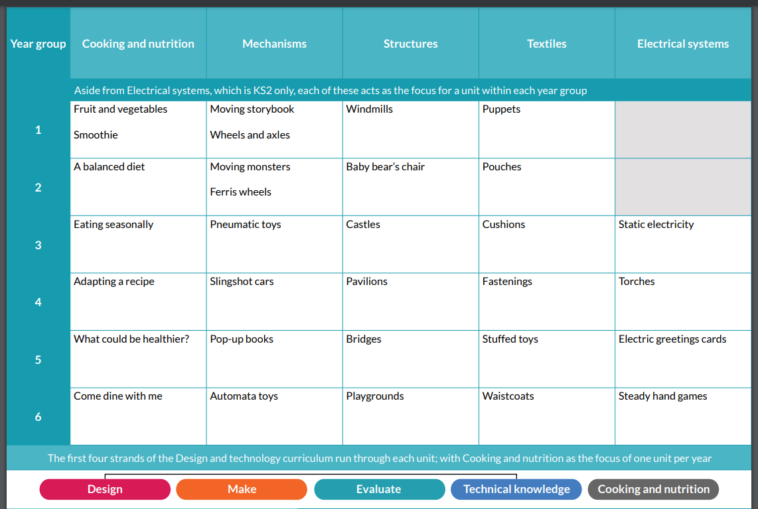

Slide 10
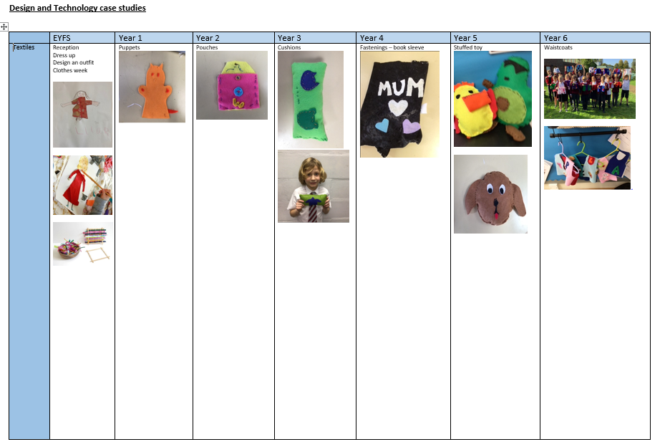

Slide 11
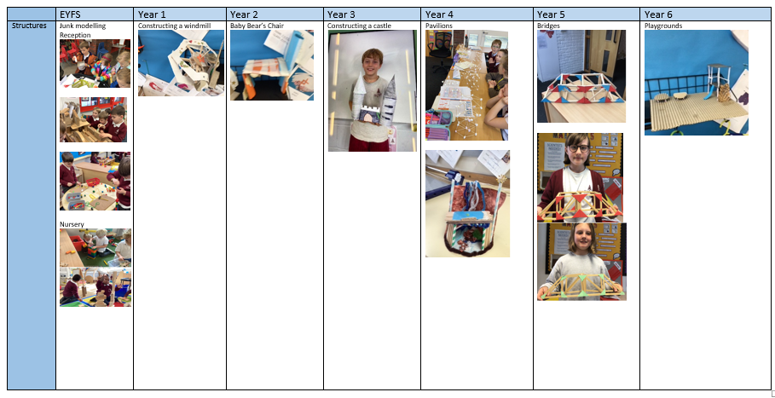

Slide 12
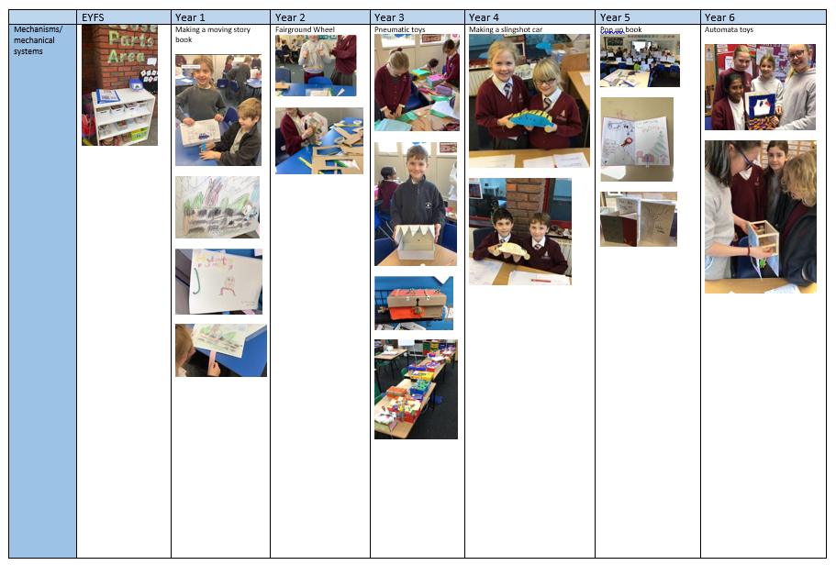

Slide 13
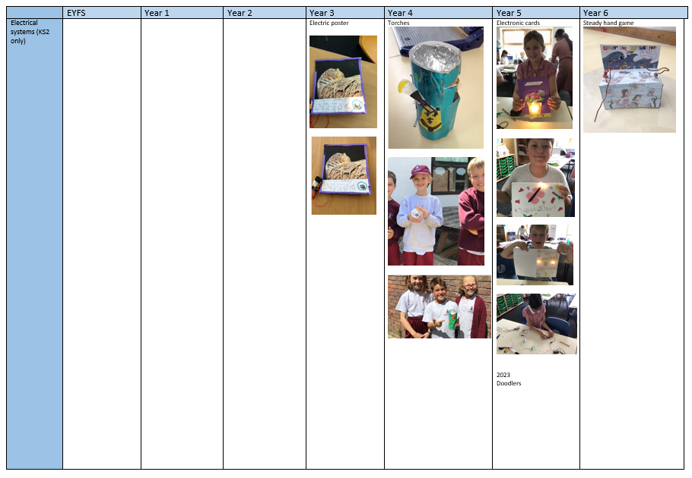

Slide 14
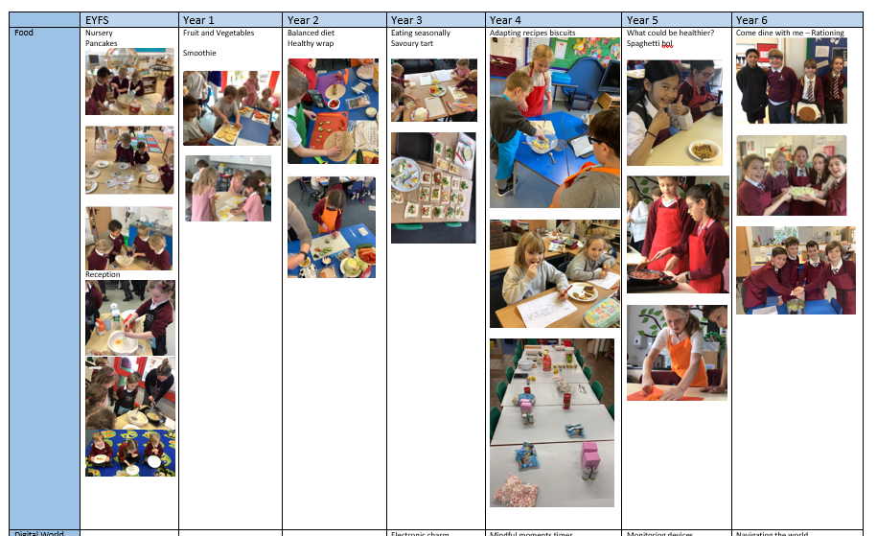

Slide 15
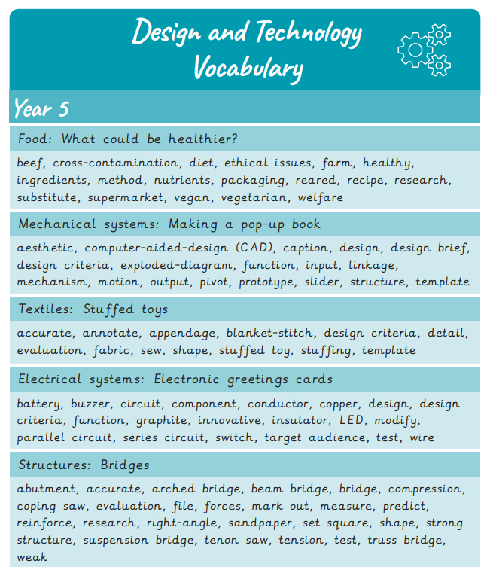
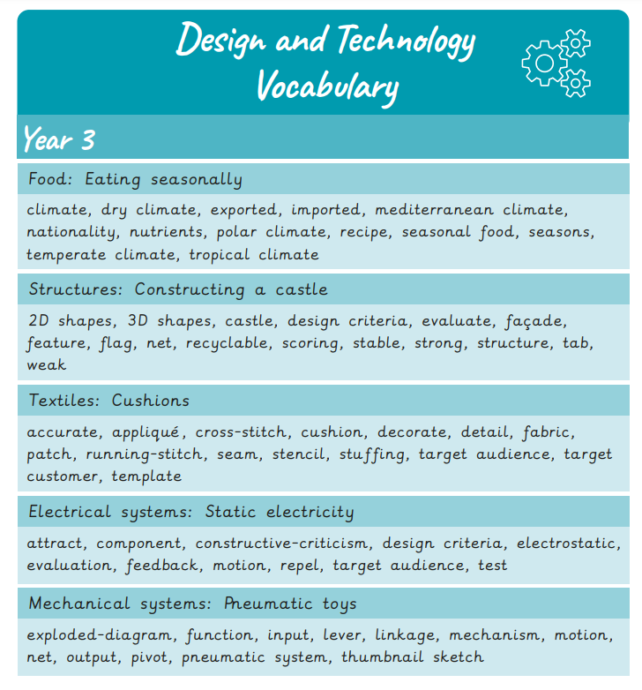
Vocabulary support

Slide 16
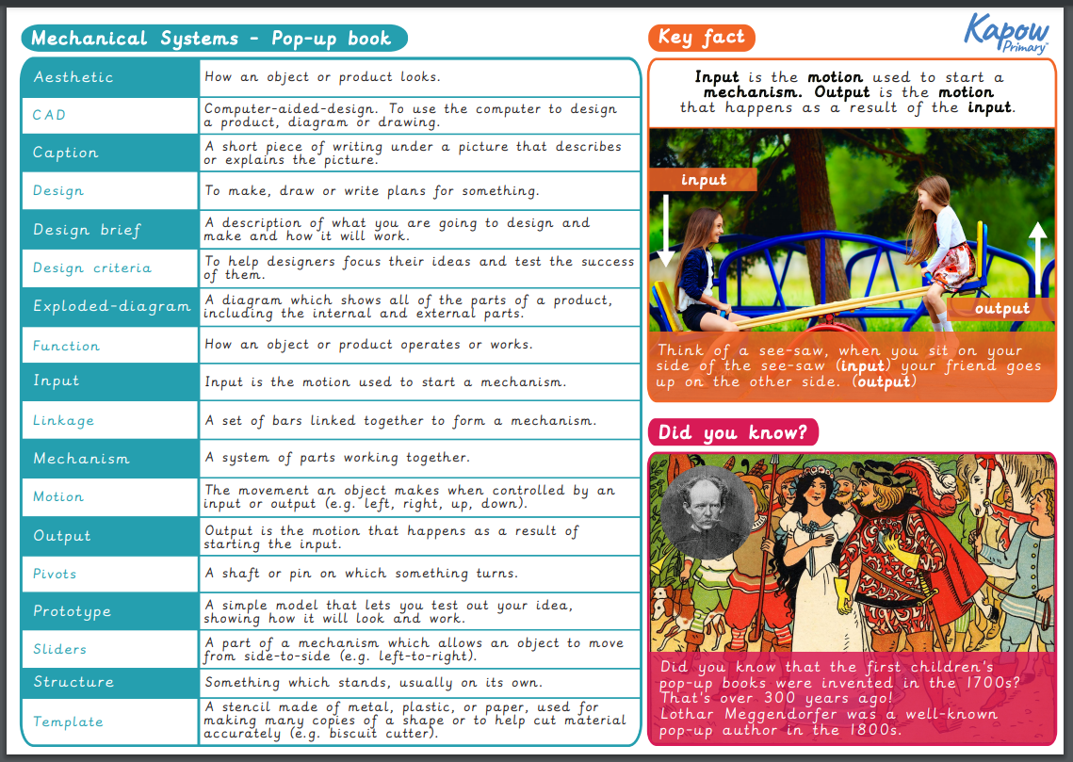
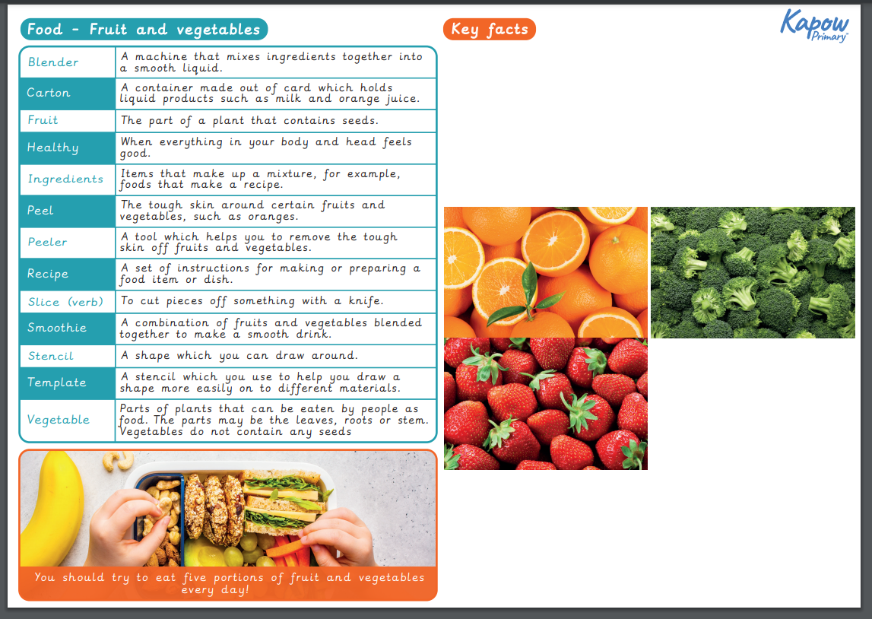
Knowledge organisers
KS2
KS1

Slide 17
CPS Design and Technology Priorities
Embed high quality Kapow scheme
Embed vocabulary and retrieval of knowledge and skills
Further assessment practice including retrieval questions at the start of every lesson and a quiz at the end
Continue to offer support to staff team and enhance staff knowledge

Slide 18
A plea for resources…
Batteries
Food resources

Slide 19
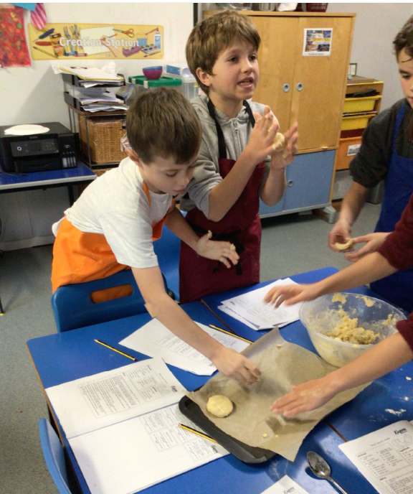
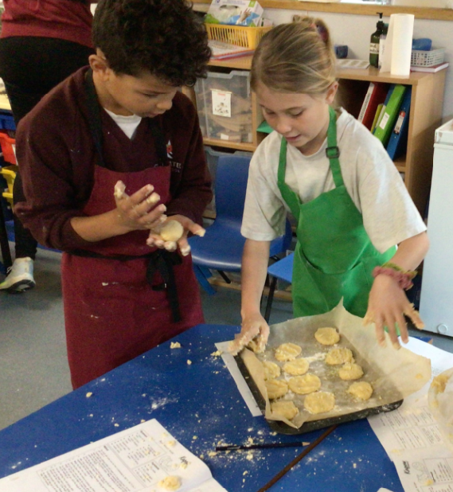

Slide 20
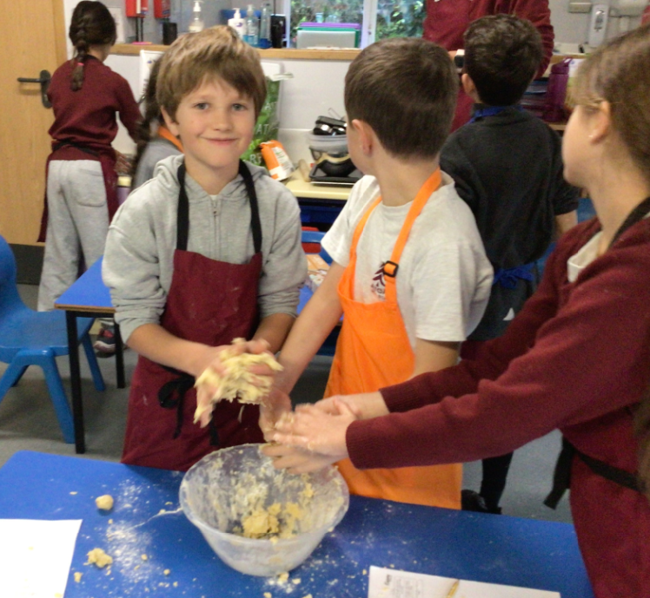
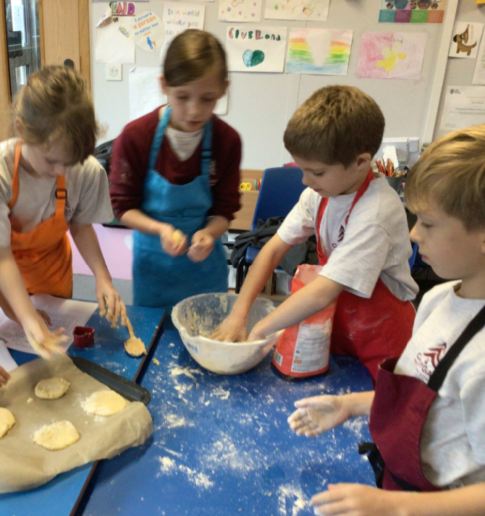
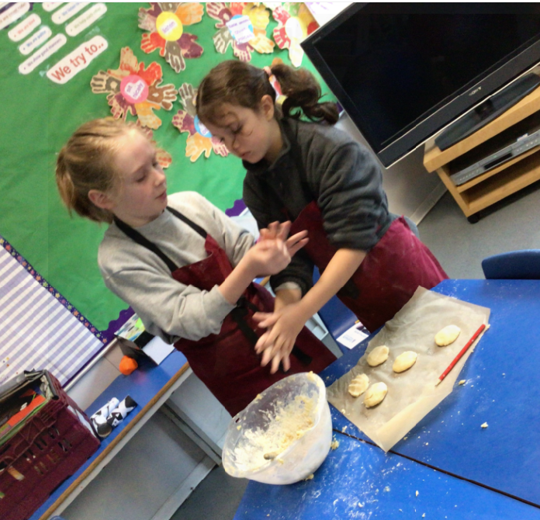

Slide 21
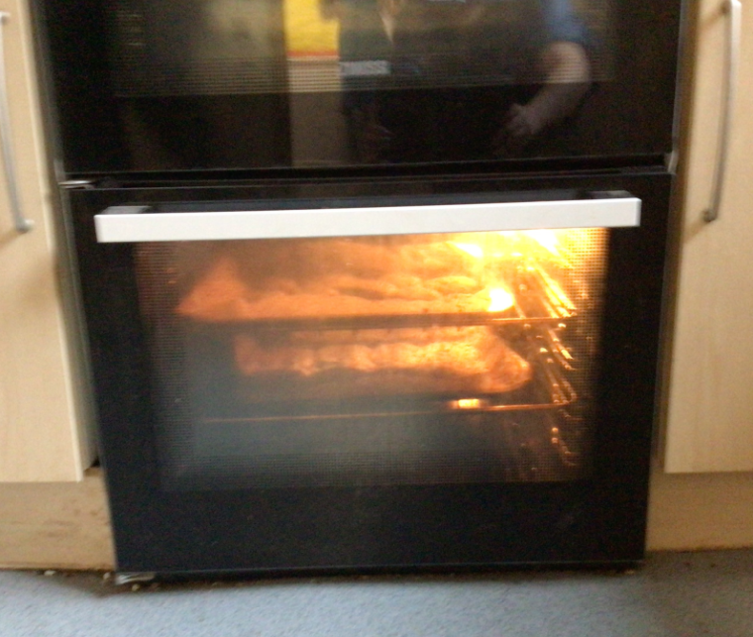
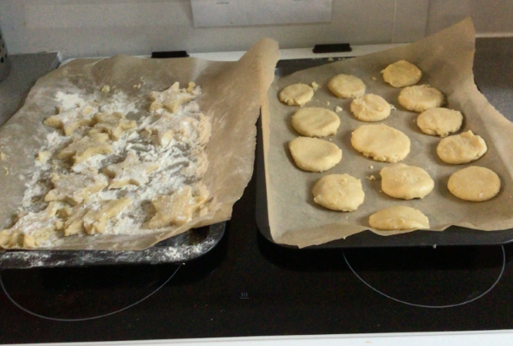
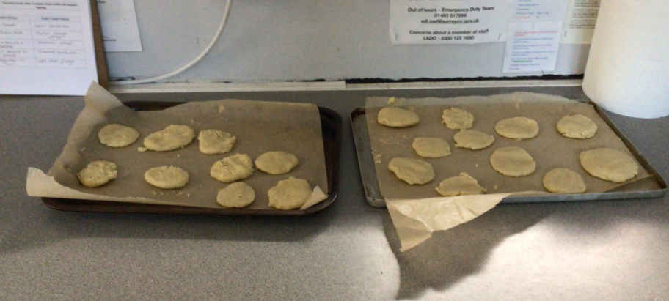

Slide 22
Any questions?

