Slide 1


Welcome to Year 5 Curriculum Evening

Slide 2
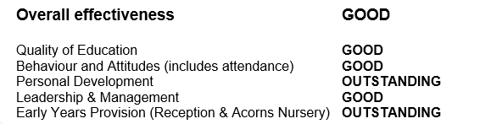

Slide 3

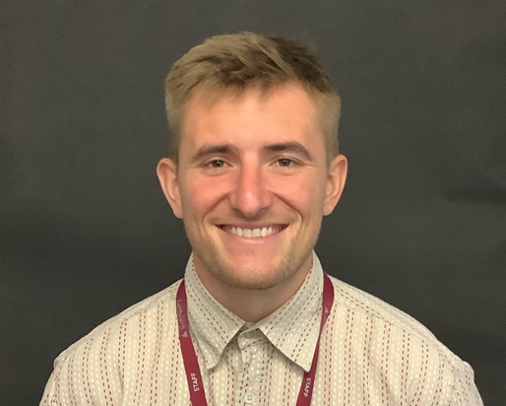
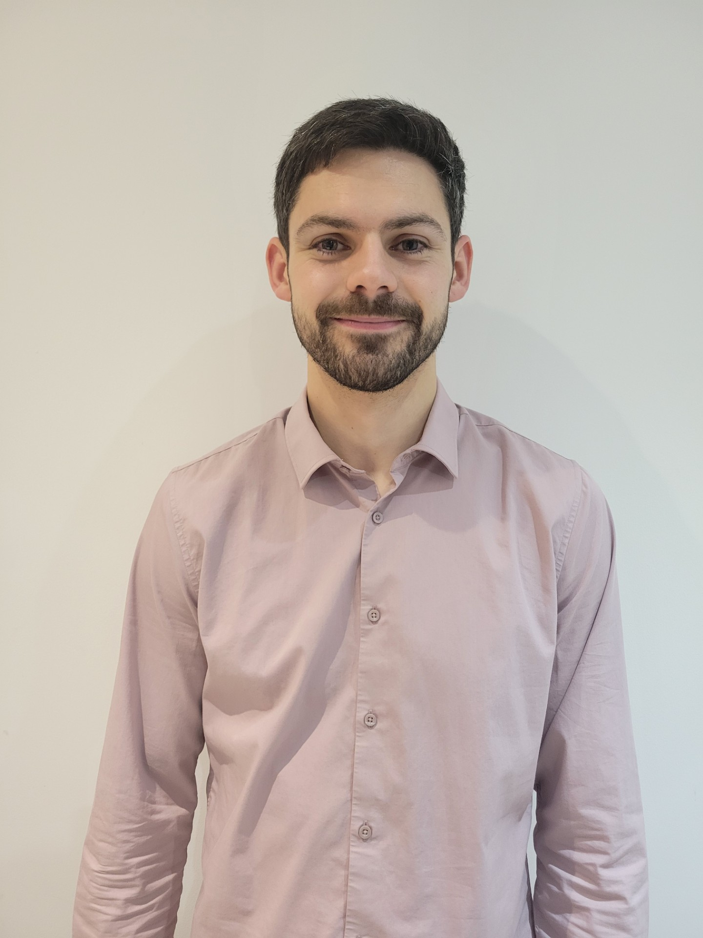
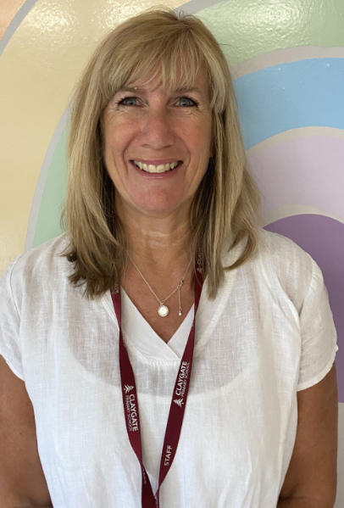
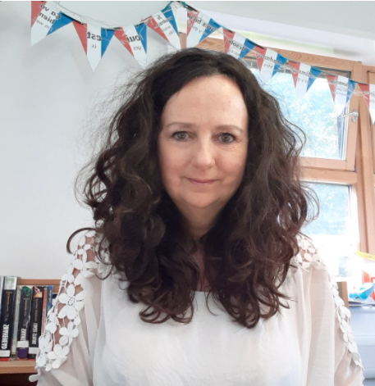
Meet the Team
Miss Nelson
Mr Jenkerson
Will Hales
Mrs Eke

Slide 4
Meet the Senior Leadership Team
Sandra Cunningham: Head Teacher
head@claygate.surrey.sch.uk
Marita Cunniffe: Inclusion Lead
sen@claygate.surrey.sch.uk
Hilary Ali: Deputy Head
hilary.ali@claygate.surrey.sch.uk

Slide 5



Our CPS Values

Slide 6
Our Expectations
Independence (including walking in / out independently)
Behaviour
Smart uniform and ready for learning (KS2 Cold Weather Uniform from Oct half term includes a tie)
Birthday books for class library are welcome. Reminder that we don’t give out sweets for allergies and religious reasons.

Slide 7
Attendance and Punctuality
Punctuality is important
Learning starts promptly at 8.35am with a learning task and interventions
Children who are late will miss learning, the outline of the day, a positive calm start to the day and can have self-esteem/social skills impacted
Too many of our children are regularly missing school – the government expects a minimum of 95% attendance
Missing out on lessons leaves children vulnerable to falling behind. Children with poor attendance tend to achieve less in both primary and secondary school (DfE)

Slide 8
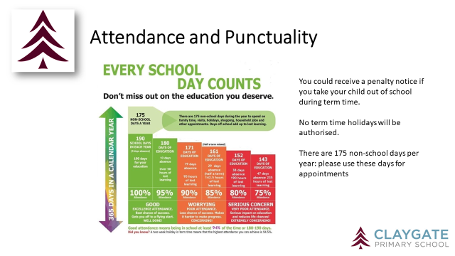

Slide 9
Attendance Protocol
Contact the office via phone or email if your child is absent. If we do not hear from you, our absence protocol is triggered and you will be contacted for safeguarding purposes
CPS follows NHS guidance (the ‘48 hour rule’): “Children with diarrhoea or vomiting should stay away from school until they have not been sick or had diarrhoea for at least 2 days (48 hours)”
Attendance is monitored closely by the school and the LA Inclusion Officer
Attendance below 90% is classed as ‘Persistent Absence’ and will result in a referral to the LA Inclusion Officer. •This may also result in a penalty notice or prosecution

Slide 10
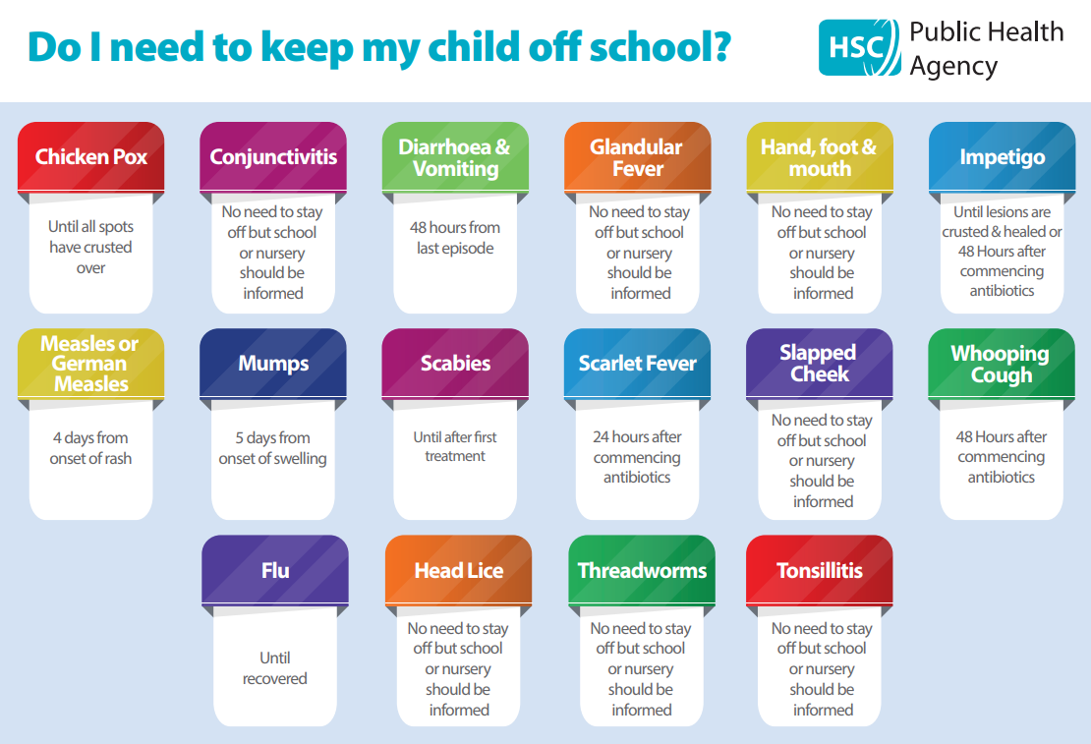

Slide 11
Timetable
PE is on a Monday and a Friday (Tuesday for Beech in Autumn 1) and children should come to school in their PE kit
Our swimming blocks are after half term in Autumn 2 and Spring 2. Children should wear PE kit on a swimming day
Home learning is set via Google Classroom
Enrichment every Wednesday will be MFIT/Computer Science this term
At the end of enrichment blocks for music & drama and computing, families will have the opportunity to come into school to share the children’s learning

Slide 12
Home Learning
English and mathematics Home Learning given out on a Friday, completed by Wednesday
Doodle Maths assignment is set to embed small step learning
Doodle English assignment alternates between comprehension skills and grammar
Home learning club once a week offers children safe space and support to complete home learning
Weekly spelling quiz on a Friday. The children are tested on 7 current spellings and 3 from previous weeks
Useful websites – TTRockstars

Slide 13
Online Safety
Taught explicitly through our PSHEE and Computing curriculum, plus regular discussion and direct teaching whenever Chromebooks are used
Consider children’s online access
4 Cs: Content, Contact, Conduct and Commerce
Social media: many apps have a minimum age use e.g. WhatsApp is 16 years old.
Check privacy settings and monitor usage
Where are devices stored? Is there unlimited access e.g. in bedrooms?
Speak to school staff if you have concerns or need support

Slide 14
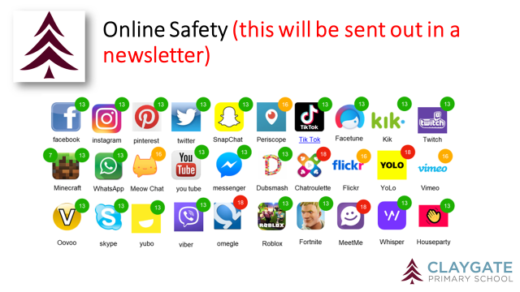

Slide 15
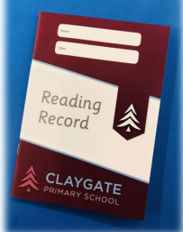
Reading
Importance of reading AND reading aloud
How to use these books
School adults record in green pen
Reading expectations
AR quizzing at home
Book of interest from class/school library weekly

Slide 16
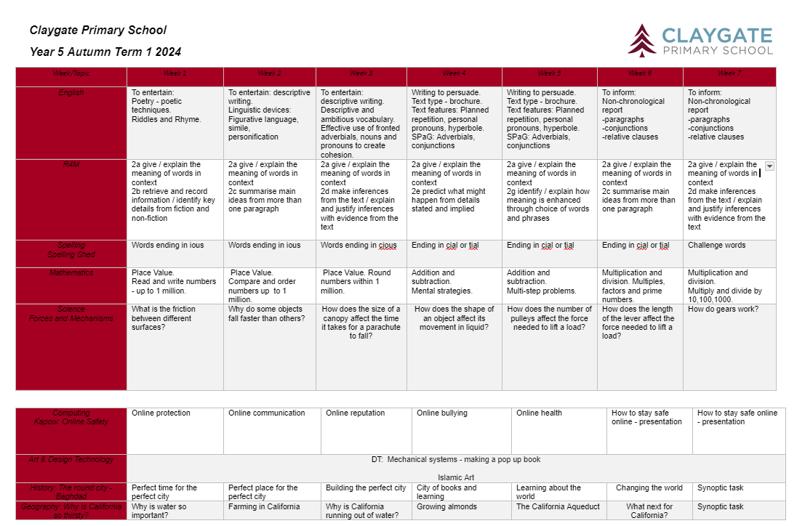
Curriculum

Slide 17
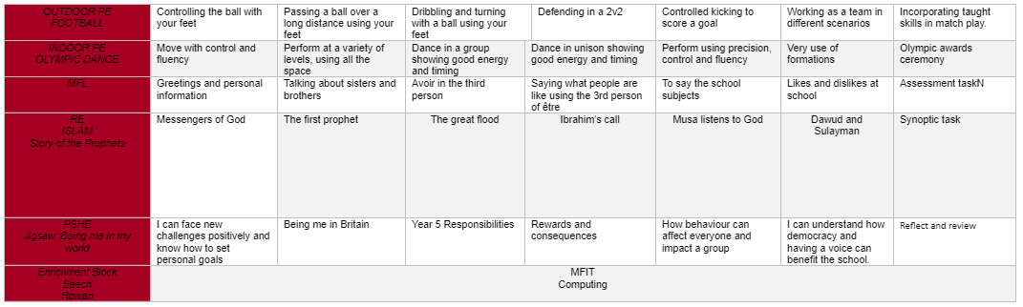
Curriculum
•RSE is taught in Summer Term: further details are on our website under PSHE: https://www.claygate.surrey.sch.uk/page/?title=PSHE&pid=65

Slide 18
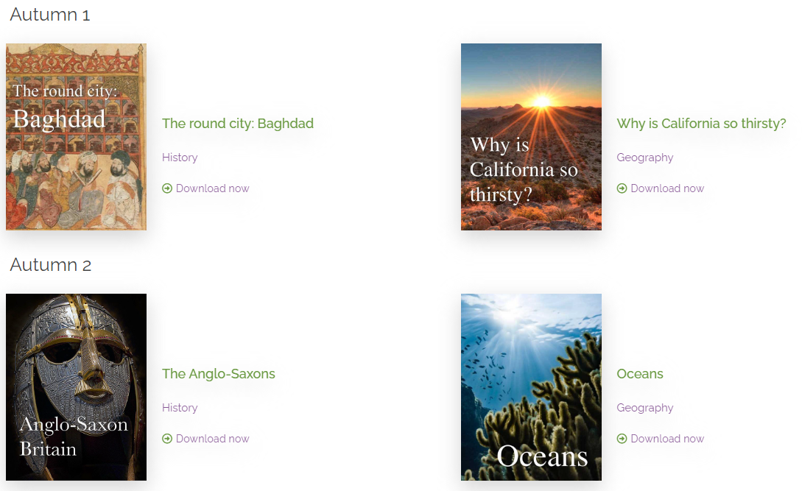

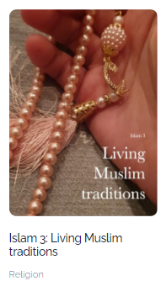
The Year 5 Curriculum

Slide 19

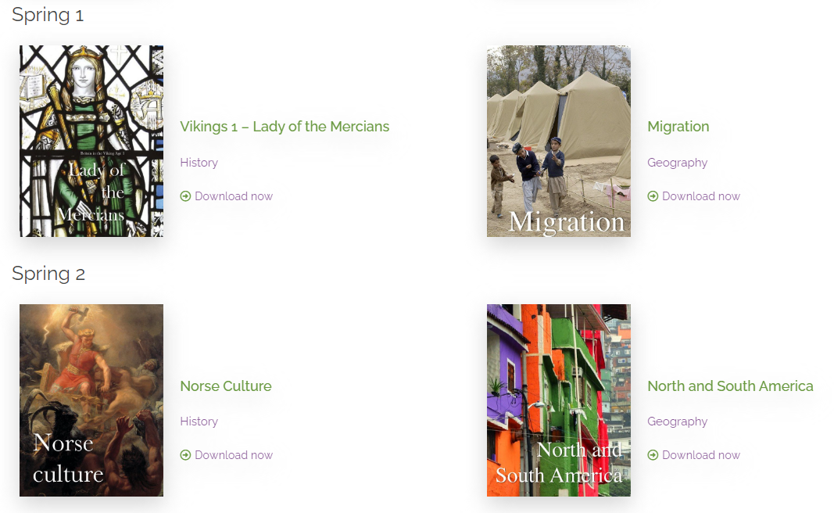
The Year 5 Curriculum

Slide 20
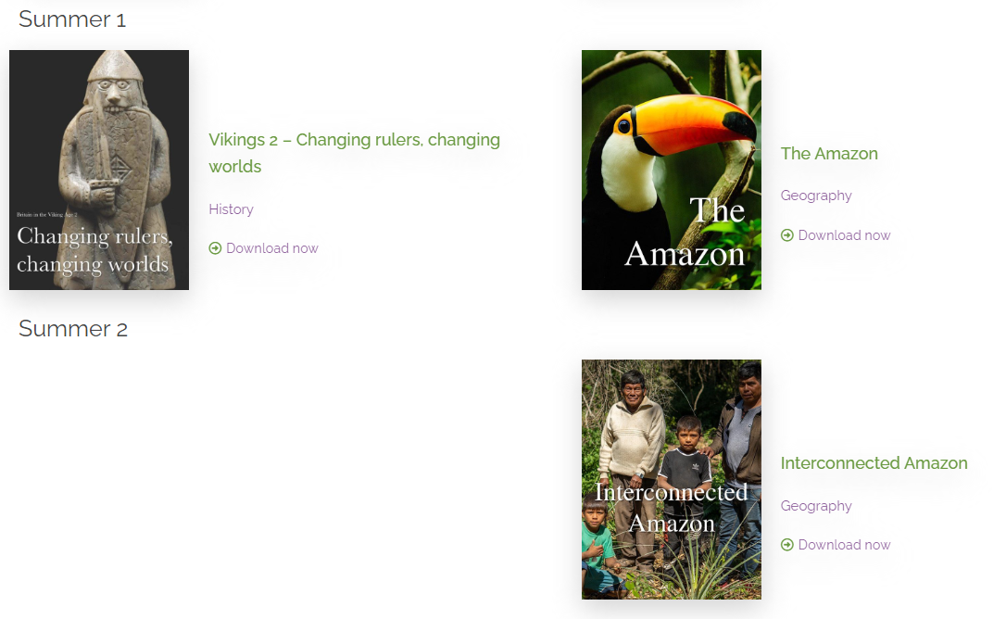


The Year 5 Curriculum
Local History Study
The Tudors

Slide 21
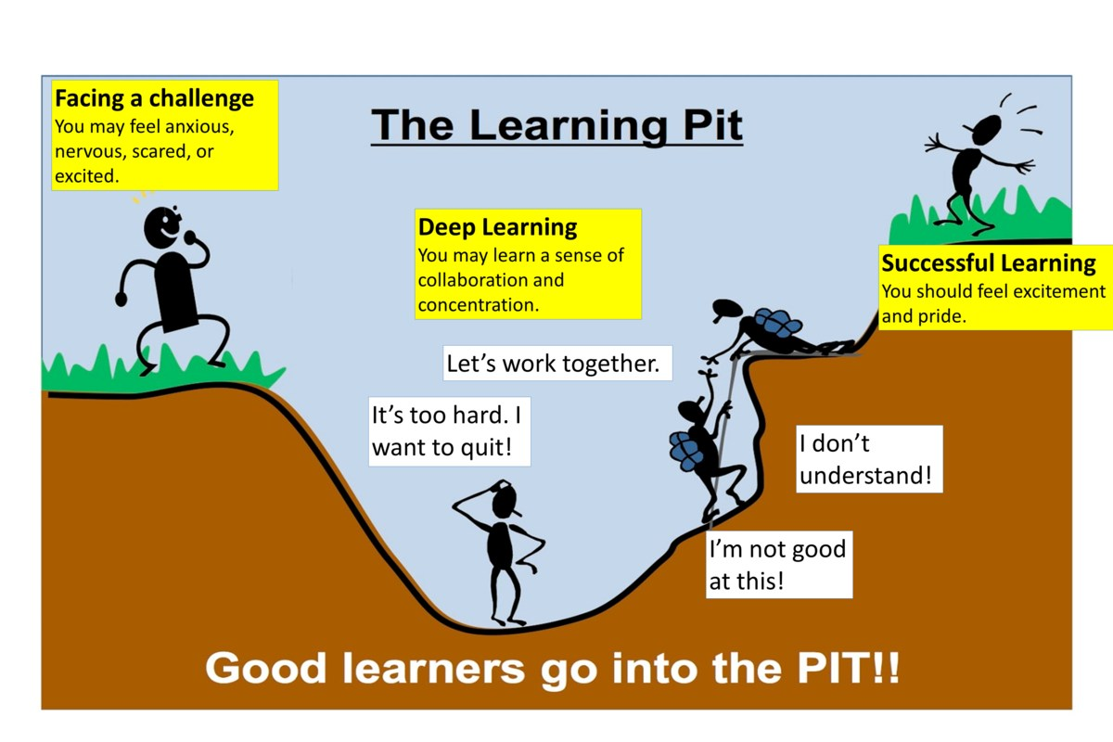
A Growth Mindset Approach
What did you do today that surprised you?
Did you make any good mistakes today?
How did you learn from your mistakes today?
What did you do today that made your brain grow?
Did you help anyone else to stretch their brain power?
What challenges did you enjoy today?
We celebrate and talk about ‘Marvellous Mistakes!’

Slide 22
Enrichment
Every Wednesday afternoon
Children engage with a rota of activities
All of our enrichment activities have a focus on pupil wellbeing
WEDNESDAY ENRICHMENT Years 3,5,6
Enrichment | Computing | M-Fit | Music & Drama | Terrific Textilers | Woodland Explorers | Multisports
Curriculum Link | Computing | PSE: Jigsaw Unit Celebrating Difference | Music and Drama | Art and Design DT | Geography and PSE | PE

Slide 23
Trips, Workshops and Visitors
Learning beyond the classroom is so valuable!
Anglo-Saxon Day – Autumn 2 Date TBC
Viking Day in Spring term – Date TBC
Visit to HTC before Easter – Date TBC
Residential trip to Hindleap Warren (31st march - Wed 2nd April)
Visit Chessington School for secondary school taster – Date TBC in Summer 2
Visit to HCP - Date TBC
Visit to London Coliseum on a Discover Opera day

Slide 24
Assessment
Assessment is ongoing
We use evidence from work in class, Maths end of unit tests, AR STAR reading tests, Science end of unit tests to make judgements on whether your child is meeting the expected standard
From Y2 onwards - discuss importance of tables up to 12 x 12. We check tables daily through low stakes quizzing and timed challenges
We have formal assessment points at the end of each term or unit
Parent consultations take place in November and March
Main written report is shared in March
Final summary report is shared in July
Parent pop ins gives your child an opportunity to share their successes each half term

Slide 25
Communication
Weekly newsletter, Twitter, Instagram, podcast and Website
Parentmail is used to share important information
office@claygate.surrey.sch.uk should be used for the majority of enquiries and communication needs (Tel 01372 465 348)
On occasion you may wish to contact a class teacher directly e.g. to share a personal update. Class teachers will endeavour to respond within 24 hours
If you have any concerns, please first talk to your child’s teacher
Please remember Mrs Cunningham and Mrs Ali are available on the gate daily

Slide 26
Safeguarding at CPS
We have a team of 4 DSLs:
Hilary Ali – Designated Safeguarding Lead
Sandra Cunningham
Marita Cunniffe
•Susan Minter DDSL
If you have a safeguarding concern, please speak to a member of the DSL team or email on dsl@Claygate.surrey.sch.uk. Further information can be found under ‘Safeguarding’ on our website.

Slide 27
Volunteers & Parents Association (CPSPA)
We have a small dedicated, trained team of volunteers. If you are interested in this role, please email Mrs Ali
All parents and carers are automatically members of Claygate Primary School Parents Association
Class reps organise cake sales and stalls at various events.

Slide 28
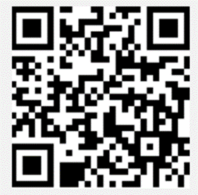
Friends of CPS
Friends Of Claygate Primary School: Voluntary donations (and even better with gift aid) helps us to keep CPS fully equipped and running
We have an online donation system via the Charity Aid Foundation. We ask you to make a voluntary contribution each month per child. If you are a tax payer, you can get tax relief if you donate through Gift Aid. This also allows us to claim basic rate tax of 20% on your donation, at no cost to you.
Here is the link to access the donation form: HTTPS://CAFDONATE.CAFONLINE.ORG/20959

