Slide 1


Parent Forum 14.11.24
Residentials, trips & visitors

Slide 2

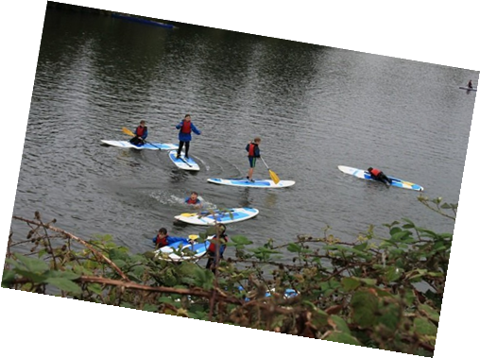
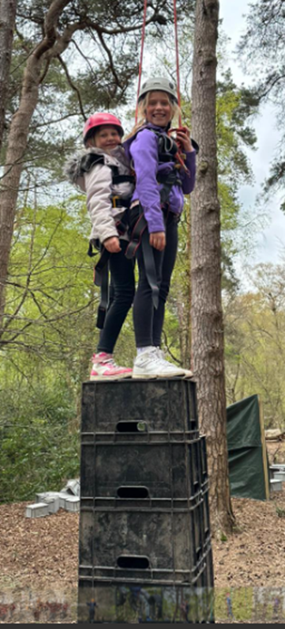
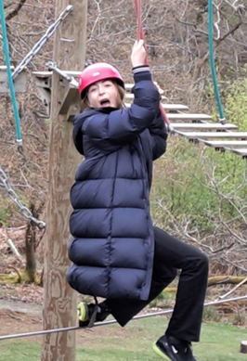
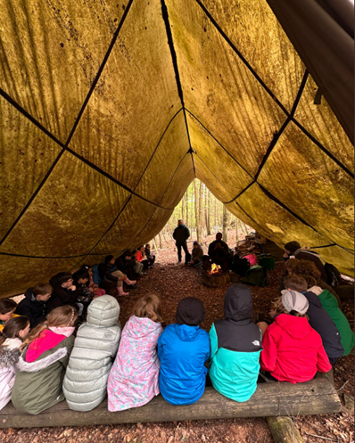
Residentials
Y4: Marchants Hill in Autumn (PGL)
Y5: Hindleap Warren in Spring (PGL)
Y6: Thames Young Mariners in Summer
All Trips 3 days & 2 nights
Maximum 1 hour away by coach
TYM: Water based activities

Slide 3
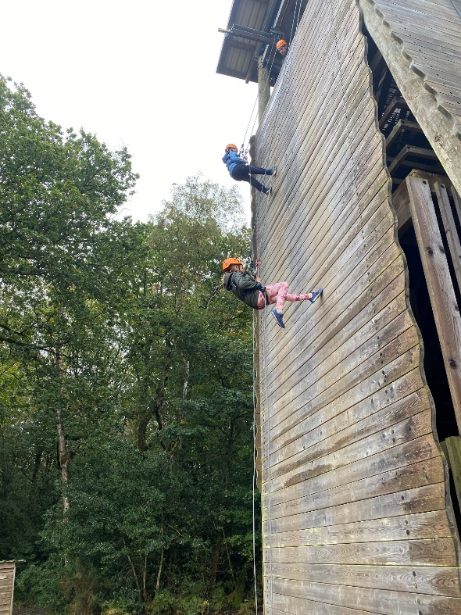
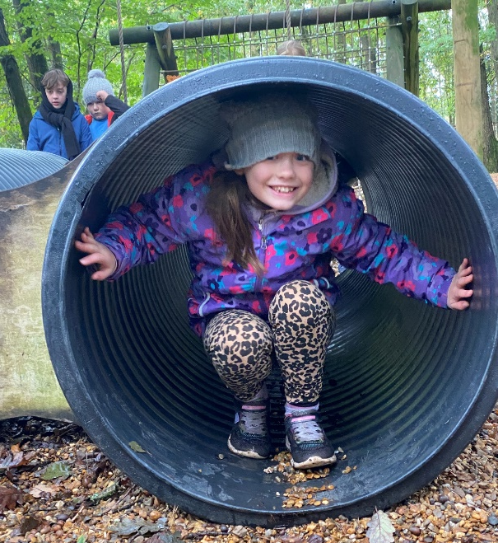
Why Residentials?
Develops independence
Team work
Confidence & Self-esteem
Broadens friendships across the year group
Develops life skills

Slide 4
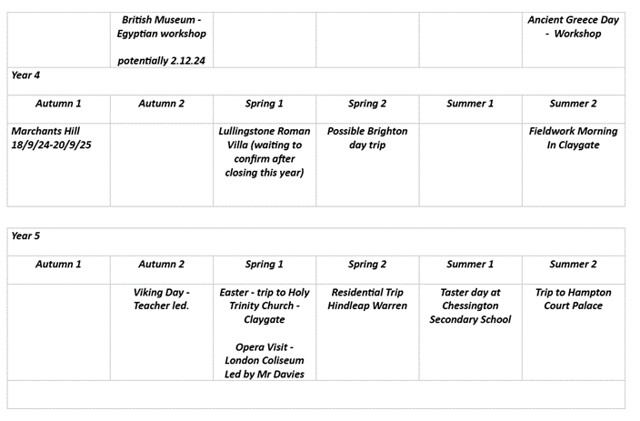
Trips
Mapped out at start of year
Start with local walks in the EYFS
Linked to key curriculum areas
Fieldwork: Geography (Y4 interviewing local residents!)
Cultural Capital – Royal Festival Hall Trip

Slide 5
Workshops & Visitors
Great Fire of London Workshop
Viking Day
Caring Hearts Day
Police Visits
Online Safety Workshops
Dogs Trust Workshops
Junior Citizen
Faith Leader Visits

Slide 6
Costings
Costings for trips are kept to under £20 per child where possible
Public transport used where possible – keeps costs down & provides children with a valuable experience
Parent helpers
We request a voluntary contribution which covers the cost of the trip, should insufficient funds be collected, the trip may be cancelled

