Slide 1
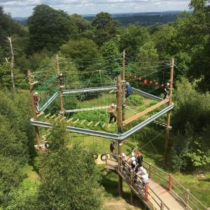
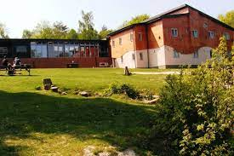


Hindleap Warren
Monday 31st March– Wednesday 2nd April 2025

Slide 2
Staff Attending
Mr Hales
Mrs Dobson
Miss Rainbow
Mrs Eke
Miss Murray

Slide 3
Monday 31st March Arrangements
Drop off your child at school at 8:40- bags can be left in the hall
All medication to be taken to Mrs Eke in the hall
Coach pick up is at 9.15am (Approximate arrival time 11am)
Children MUST bring a PACKED LUNCH and a drink (no nuts, fizzy or glass bottles please)

Slide 4
Medication
All medication to be handed directly to Mrs Eke in the hall on the morning of Monday 31sty March.
Medicine must be clearly named and labelled including travel sickness medication.
If travel sickness medication is needed, please administer before coming to school and provide clearly labelled meds for the return journey.
First aid trained staff on site.
Duty staff on site at night in the event of emergency.

Slide 5
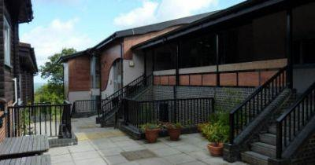
Accomodation
Sleeping in dorm rooms with bunk beds
X6 children per room
Staff rooms in same area
Children have been asked to nominate friends they would like to share with
Children will be in charge of making their own bed, practise beforehand is always appreciated!

Slide 6
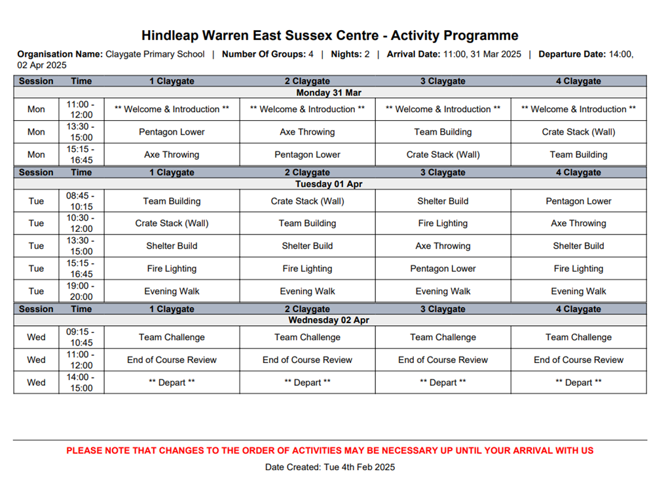
Activities:
Free-time
Sing-alongs
Football
Games
All activities are led by qualified instructors
A member of CPS staff will be supporting each group

Slide 7
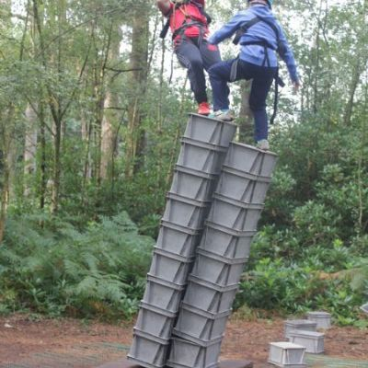
Activities:
Free-time
Sing-alongs
Football
Games

Slide 8
Food
All meals are freshly prepared on site and special dietary requirements are catered for.
We will provide children with snacks throughout the day. Please do not send children with any food, snacks or sweets.
Children will have an opportunity to visit the tuck shop where they can buy souvenirs and treats.

Slide 9
Kit List
Items not permitted:
Electronic devices including mobile phones
Sweets and snacks (we will provide some snacks and treats)
T-shirts (mixture of long and short sleeve)
Jumpers
Trousers/leggings (not jeans)
Waterproof top/coat & trousers
Sun hat
Plenty of underwear and socks
Slippers
Indoor footwear
Old trainers
Wellington boots
Towel
Toiletries
Couple of bin liners
Sun cream
A teddy or mascot
Useful tip:
Provide a bin bag or large carrier bags for dirty clothes to be packed in.
£5 spending money for the tuckshop

Slide 10
Wednesday 2nd April Arrangements
Activities will continue in the morning
Lunch will be eaten at Hindleap Warren
Pack up and depart for return to school
Departing Hindleap Warren at 14:00
Expected to arrive at school by normal pick up 15:15. Updates will be sent if we are delayed by more than 15 minutes.

Slide 11
Contact during the trip
Twitter
A member of staff will contact you on the contact numbers you have provided if there are any concerns during the trip. Please inform the office immediately if your details change.
Pleaser answer an unknown number - it may be one of the teachers calling from a mobile!

Slide 12
What happens next?
> Activities will be shared and arrangements will be and explained to the children
Any further questions?
Please contact Mrs Ali or Mr Hales if you have any further questions.

