Slide 1


Welcome to Year 1 Curriculum Evening
September 2025

Slide 2

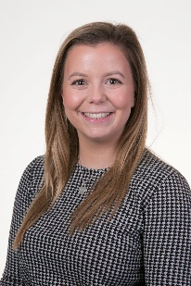
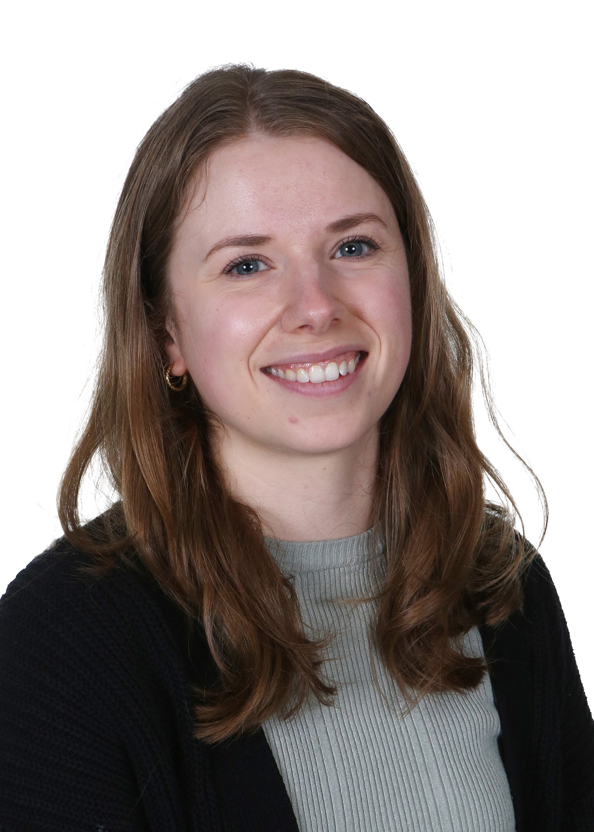
Meet the Team
Supporting Adults:
Mrs Noyes
Miss Khan
Miss Hoy Miss Duffell

Slide 3
Meet the Senior Leadership Team
Sandra Cunningham: Head Teacher
Marita Cunniffe: Inclusion Lead
Hilary Ali: Deputy Head

Slide 4



Our CPS Values

Slide 5
Our Expectations
Independence (including walking in / out independently)
Behaviour
Smart uniform and ready for learning
Birthday books for class library are welcome. Reminder that we don’t give out sweets for allergies and religious reasons.

Slide 6
Attendance and Punctuality
Punctuality is important
The school gates open at 8.35am and learning starts promptly at 8.45am with a learning task and interventions
Children who are late will miss learning, the outline of the day, a positive calm start to the day and can have self-esteem/social skills impacted
Too many of our children are regularly missing school – the government expects a minimum of 95% attendance
Missing learning leaves children vulnerable to falling behind. Children with poor attendance tend to achieve less in both primary and secondary school (DfE)

Slide 7

Attendance and Punctuality
You could receive a penalty notice if you take your child out of school during term time.
No term time holidays will be authorised.
There are 175 non-school days per year: please use these days for appointments

Slide 8
Attendance Protocol
Contact the office via phone or email if your child is absent. If we do not hear from you, our absence protocol is triggered and you will be contacted for safeguarding purposes
CPS follows NHS guidance (the ‘48 hour rule’): “Children with diarrhoea or vomiting should stay away from school until they have not been sick or had diarrhoea for at least 2 days (48 hours)”
Attendance is monitored closely by the school and the LA Inclusion Officer
Attendance below 90% is classed as ‘Persistent Absence’ and may result in a referral to the LA Inclusion Officer. This may also result in a penalty notice or prosecution

Slide 9
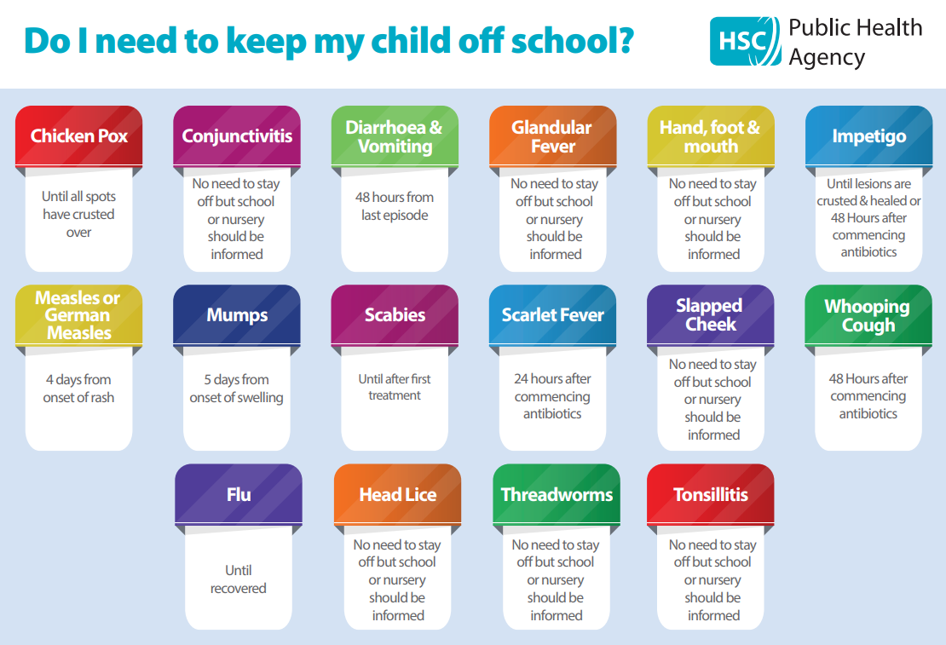
You can find this on our website under the ‘Attendance’ tab

Slide 10
Timetable
PE days for: Oak Class - *Monday (Outdoor) Thursday (Indoor)
Alder Class - *Monday (Outdoor) Thursday (Indoor)
Children should come to school in their PE kit. We send PE & Swimming timetables half termly
Our swimming blocks are Autumn 2 and Summer 1
Children should wear PE kit on a swimming day
Children should change back into uniform after a morning club
Enrichment every Wednesday will be Terrific Textiles for Alder and Music and Drama for Oak this term
At the end of enrichment blocks for music & drama, families will have the opportunity to come into school to share the children’s learning

Slide 11
Home Learning
Set on a Friday to be completed the Friday of the following week (some exceptions)
2 pieces: 1 maths 1 Topic/English/Science based
Expectation is that each piece should take no longer than 15 – 20 mins
Plus weekly Phonics
Useful websites – Doodle maths, Letterjoin, Little Wandles Letters and Sounds

Slide 12
Online Safety
Taught explicitly through our PSHEE and Computing curriculum, plus regular discussion and direct teaching whenever Chromebooks are used
Consider children’s online access
4 Cs: Content, Contact, Conduct and Commerce
Social media: many apps have a minimum age use e.g. WhatsApp is 16 years old.
Check privacy settings and monitor usage
Where are devices stored? Is there unlimited access e.g. in bedrooms?
Speak to school staff if you have concerns or need support
We are Smartphone free – children in Y6 may bring a ‘brick’ phone into school

Slide 13
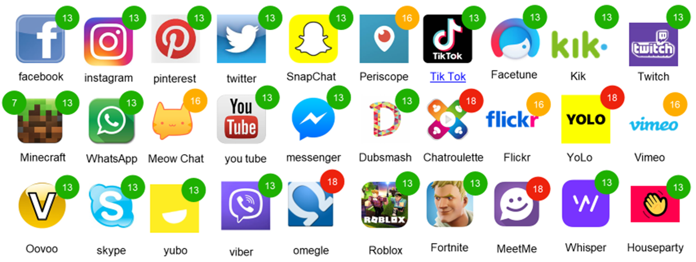
Online Safety (this will be sent out in a newsletter)

Slide 14
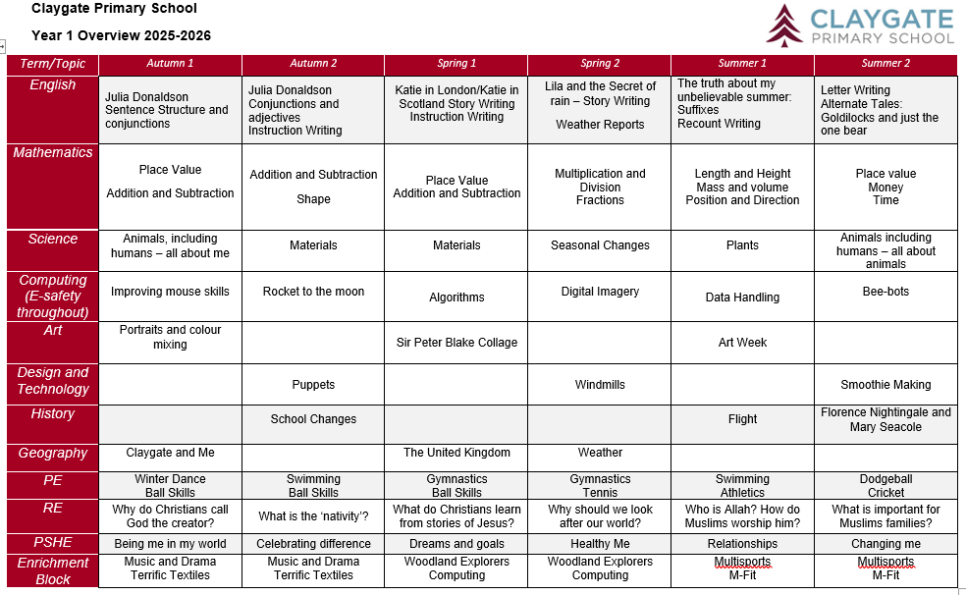
Curriculum
Claygate Primary School Website and Google Classroom
RSE is taught in Summer Term: further details are on our website under PSHE: https://www.claygate.surrey.sch.uk/page/?title=PSHE&pid=65

Slide 15

Reading
Importance of reading AND reading aloud
How to use these books
Please don’t use reading records for messages (Messages should be given to office in person or via email)
School adults record in green pen
Reading expectations
Book of interest from class/school library weekly
All children visit library once weekly

Slide 16
Phonics
Children have a daily discrete phonics session for approximately 20 minutes. We use Little Wandle Letters & Sounds
Children learn all the phonemes and corresponding graphemes for the 40+ sounds. Every phonics lesson includes an element of decoding and encoding
Y1 children take a national phonics screening check in June. Parents will be invited to a meeting to give further information about the check in the Summer Term
    June 2026
Phonic knowledge is assessed half termly using Little Wandle Letters and Sounds assessment resources. Outcomes of these assessments are used to plan additional catch up interventions for those who need it

Slide 17
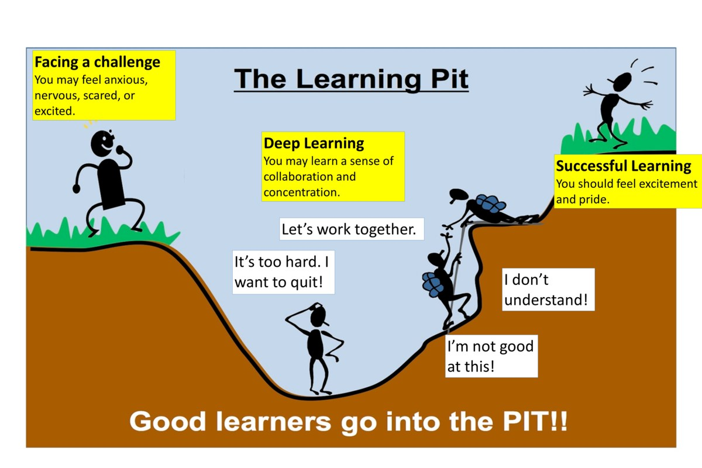
A Growth Mindset Approach
What did you do today that surprised you?
Did you make any good mistakes today?
How did you learn from your mistakes today?
What did you do today that made your brain grow?
Did you help anyone else to stretch their brain power?
What challenges did you enjoy today?
We celebrate and talk about ‘Marvellous Mistakes!’

Slide 18
Trips, Workshops and Visitors
Learning beyond the classroom is so valuable!
Proposed visits for this year: Walk to Claygate Parade – Free
Brooklands Museum – approx’ £25 per child
Chessington Zoo or Wisley Gardens – approx £25 per child
Caring Hearts Day (linked to Florence Nightingale)
Without voluntary donations trip may not be able to go ahead
Dates will be confirmed closer to the time.

Slide 19
Assessment
Assessment is ongoing
We use evidence from work in class and tests to make assessment judgments
Parent consultations take place in November and March
Main written report is shared in March
Final summary report is shared in July
Parent pop ins gives your child an opportunity to share their successes each half term

Slide 20
Communication
Weekly newsletter, Twitter, Instagram and Website
Parentmail is used to share important information
office@claygate.surrey.sch.uk should be used for the majority of enquiries and communication needs (Tel 01372 465 348)
If you have any concerns, please first talk to your child’s teacher
Please remember Mrs Cunningham and Mrs Ali are available on the gate daily

Slide 21
Safeguarding at CPS
We have a team of 4 DSLs:
Hilary Ali – Designated Safeguarding Lead
Sandra Cunningham DDSL
Marita Cunniffe DDSL
Susan Minter DDSL
If you have a safeguarding concern, please speak to a member of the DSL team or email on dsl@Claygate.surrey.sch.uk. Further information can be found under ‘Safeguarding’ on our website

Slide 22
Volunteers & Parents Association (CPSPA)
We have a small dedicated, trained team of volunteers. If you are interested in this role, please email Mrs Ali
All parents and carers are automatically members of Claygate Primary School Parents Association
Class reps organise cake sales and stalls at various events. Your class reps are:
Oak Class – Henry Le’s mum (Naomi) and George’s mum (Karen)
Alder Class – Savannah’s mum (Amanda) and Roisin’s mum (Mary)

Slide 23
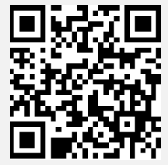
Friends of CPS
Friends Of Claygate Primary School: Voluntary donations (and even better with gift aid) helps us to keep CPS fully equipped and running
We have an online donation system via the Charity Aid Foundation. We ask you to make a voluntary contribution each month per child. If you are a tax payer, you can get tax relief if you donate through Gift Aid. This also allows us to claim basic rate tax of 20% on your donation, at no cost to you.
Here is the link to access the donation form: HTTPS://CAFDONATE.CAFONLINE.ORG/20959

