Slide 1


Welcome to Year 5 Curriculum Evening
September 2026

Slide 2

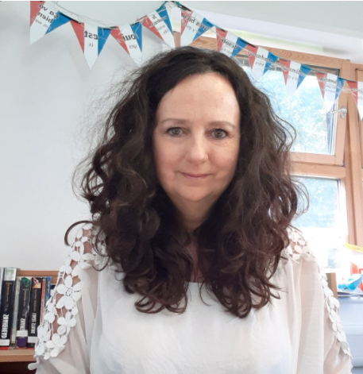
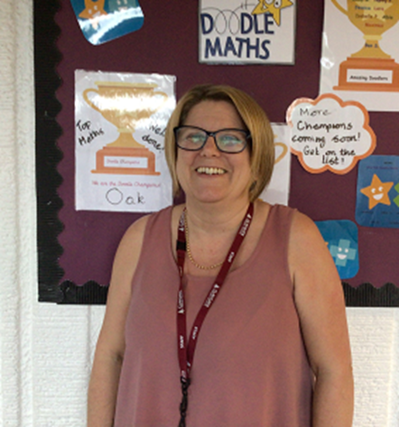
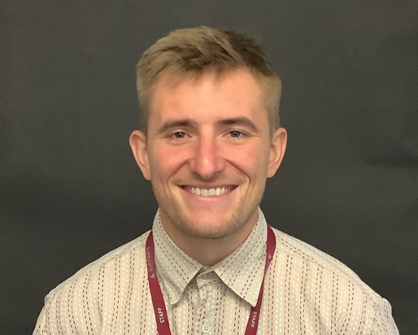
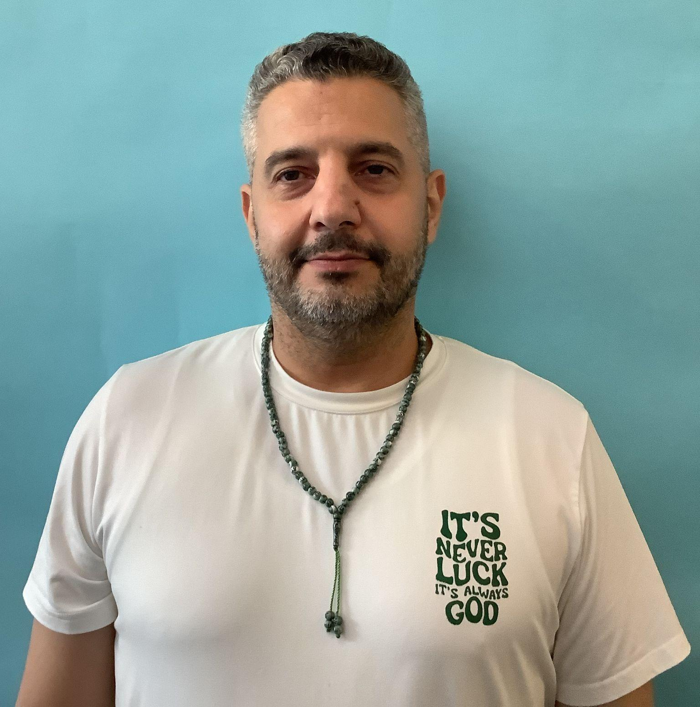
Meet the Team
Miss Nelson
Mr Hales
Mr Amir
Miss Cooper

Slide 3
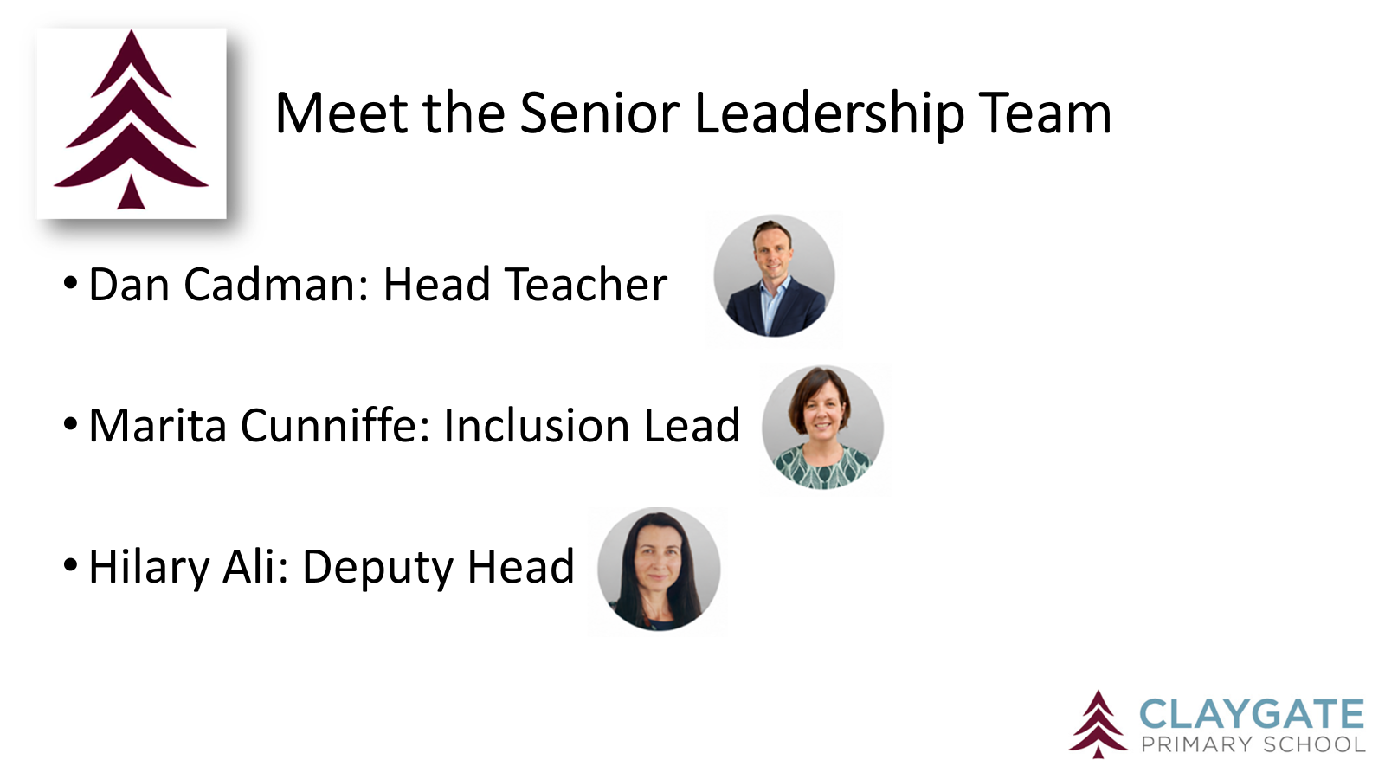

Slide 4



Our CPS Values

Slide 5
Our Expectations
Independence (including walking in / out independently)
Behaviour - good choices, polite and kind.
Smart uniform and ready for learning (KS2 Cold Weather Uniform from Oct half term includes a tie)
Birthday books for class library are welcome. Reminder that we don’t give out sweets for allergies and religious reasons.

Slide 6
Attendance and Punctuality
Punctuality is important
The school gates open at 8.35am and learning starts promptly at 8.45am with a learning task and interventions (this could include giving feedback on previous lesson so misconceptions are addressed)
Children who are late will miss learning, the outline of the day, a positive calm start to the day and can have self-esteem/social skills impacted
Too many of our children are regularly missing school – the government expects a minimum of 96% attendance
Missing learning leaves children vulnerable to falling behind. Children with poor attendance tend to achieve less in both primary and secondary school (DfE)

Slide 7
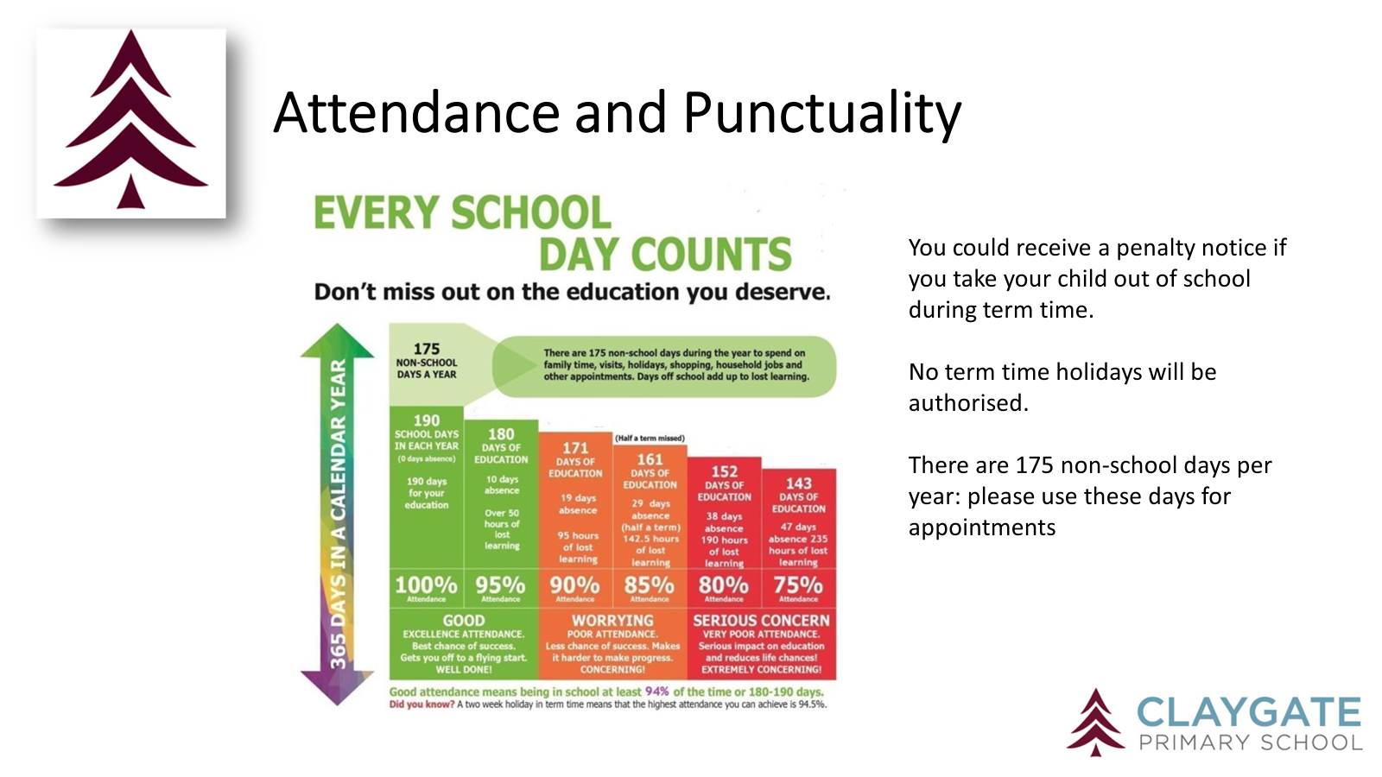

Slide 8
Attendance Protocol
Contact the office via phone or email if your child is absent. If we do not hear from you, our absence protocol is triggered and you will be contacted for safeguarding purposes
CPS follows NHS guidance (the ‘48 hour rule’): “Children with diarrhoea or vomiting should stay away from school until they have not been sick or had diarrhoea for at least 2 days (48 hours)”
Attendance is monitored closely by the school and the LA Inclusion Officer
Attendance below 90% is classed as ‘Persistent Absence’ and will result in a referral to the LA Inclusion Officer. •This may also result in a penalty notice or prosecution

Slide 9
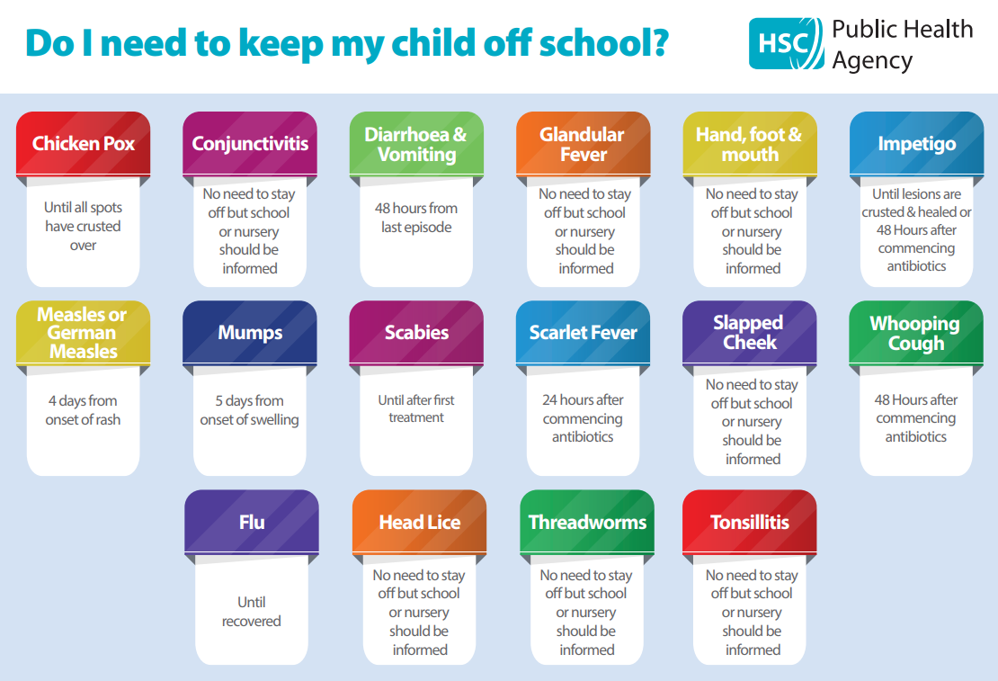

Slide 10
Timetable
PE is on Monday (outside) and Friday (inside). Children should come to school in their PE kit. We send PE & Swimming timetables half termly
Our swimming blocks are in Autumn 2 and Spring 2. Children should wear PE kit on a swimming day
Children should change back into uniform after a morning club
Home learning is set via Google Classroom – every Friday.
Enrichment will be every Tuesday this term. Rowan Class- Music and Drama. Beech Class – DT Terrific Textiles.
At the end of enrichment blocks for music & drama, families will have the opportunity to come into school to share the children’s learning

Slide 11
Home Learning
Mathematics and English home learning set on a Friday, completed by Wednesday
Doodle Maths assignment is set to embed small step learning
Doodle English assignment alternates between comprehension skills and grammar
Home learning club once a week offers children safe space and support to complete home learning
Weekly spelling quiz on a Friday. The children are tested on 7 current spellings and 3 from previous weeks
Useful websites – TTRockstars and Doodle Tables

Slide 12
Online Safety
Taught explicitly through our PSHEE and Computing curriculum, plus regular discussion and direct teaching whenever Chromebooks are used
Consider children’s online access
4 Cs: Content, Contact, Conduct and Commerce
Social media: many apps have a minimum age use e.g. WhatsApp is 16 years old.
Check privacy settings and monitor usage
Where are devices stored? Is there unlimited access e.g. in bedrooms?
Speak to school staff if you have concerns or need support
We are Smartphone free – children in Y6 may bring a ‘brick’ phone into school

Slide 13
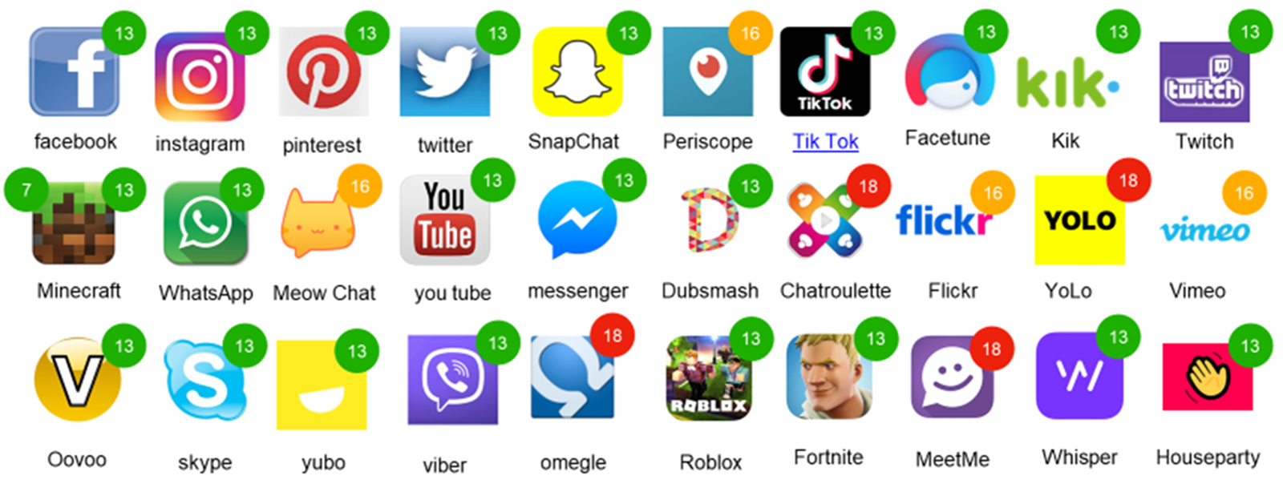
Online Safety (this will be sent out in a newsletter)

Slide 14

Reading
Importance of reading AND reading aloud
Please don’t use reading records for messages (Messages should be given to office in person or via email)
School adults record in green pen
Reading expectations
AR quizzing at home - https://login.renaissance.com/12d2c6ee-7da9-4291-af81-9f099f5b3870?state=172c85fd-9ebc-495d-a51d-1aaf94c4c319
All children visit library once weekly - to ensure range of genres and challenge.

Slide 15
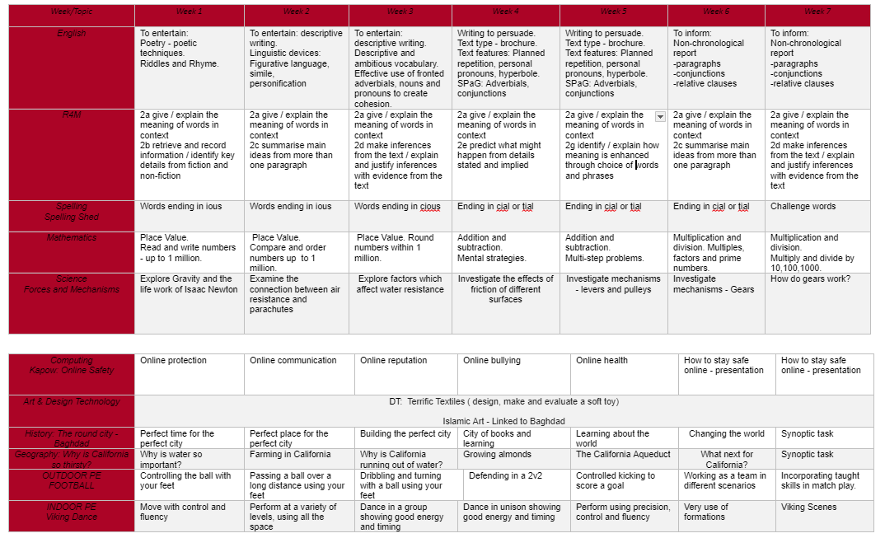
Curriculum

Slide 16
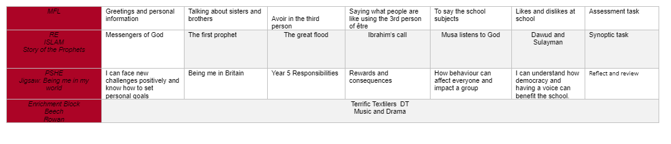
Curriculum
RSE is taught in Summer Term: further details are on our website under PSHE: https://www.claygate.surrey.sch.uk/page/?title=PSHE&pid=65

Slide 17


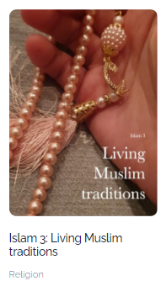
The Year 5 Curriculum

Slide 18

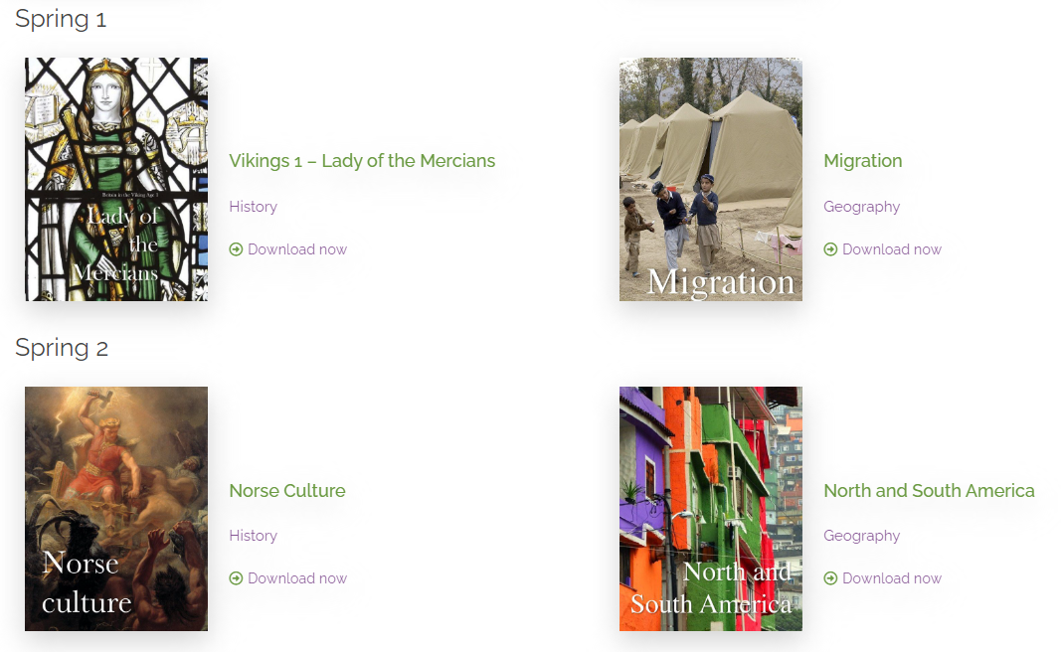
The Year 5 Curriculum

Slide 19
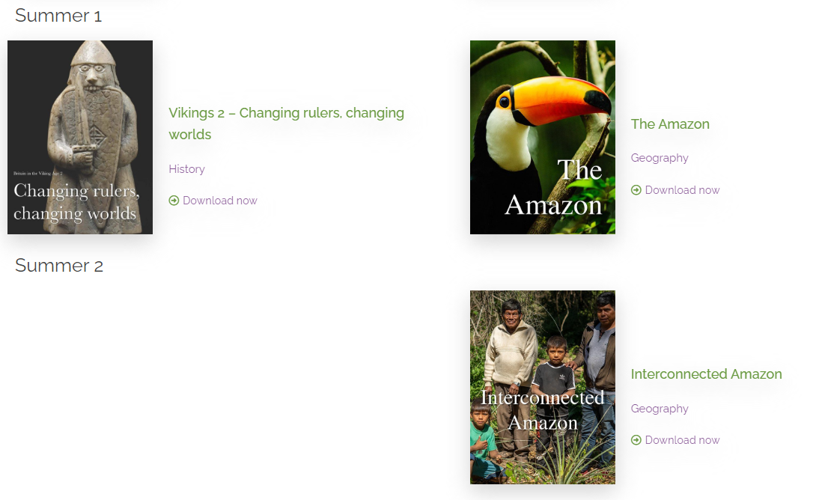


The Year 5 Curriculum
Local History Study
The Tudors

Slide 20
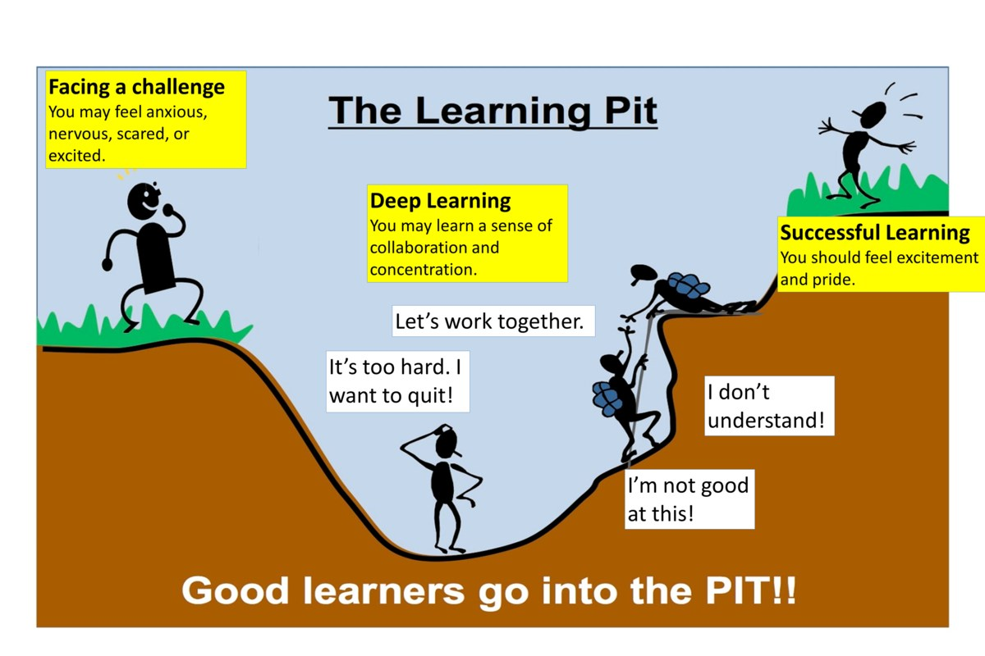
A Growth Mindset Approach
What did you do today that surprised you?
Did you make any good mistakes today?
How did you learn from your mistakes today?
What did you do today that made your brain grow?
Did you help anyone else to stretch their brain power?
What challenges did you enjoy today?
We celebrate and talk about ‘Marvellous Mistakes!’

Slide 21
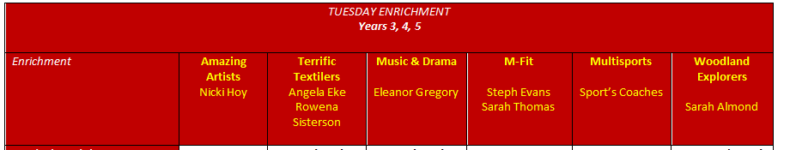
Enrichment
Every Tuesday afternoon
Children engage with a rota of activities
All of our enrichment activities have a focus on pupil wellbeing

Slide 22
Trips, Workshops and Visitors
Learning beyond the classroom is so valuable!
Viking Day in Spring term – Date TBC
Field work conducted in Claygate Village - Spring Term date TBC
Visit to HTC before Easter – Date TBC
Residential trip to Hindleap Warren (14th April - 16th April 2027)
Visit Chessington School for secondary school taster – parents are asked to transport children to the school - June 2027.

Slide 23
Assessment
Assessment is ongoing
We use evidence from work in class, Maths end of unit tests, AR STAR reading tests, Science end of unit tests to make judgements on whether your child is meeting the expected standard
Automaticity of times tables is still a focus moving into UKS2 - this quick recall will be needed in every maths lesson.
We have formal assessment points at the end of each term or unit
Parent consultations take place in November and March
Main written report is shared in March
Final summary report is shared in July
Parent pop ins gives your child an opportunity to share their successes each half term

Slide 24
Communication
•Weekly newsletter, Instagram and Website
•Parentmail is used to share important information
•office@claygate.surrey.sch.uk should be used for the majority of enquiries and communication needs (Tel 01372 465 348)
•If you have any concerns, please first talk to your child’s teacher
•Please remember Mr Cadman and Mrs Ali are available on the gate daily

Slide 25
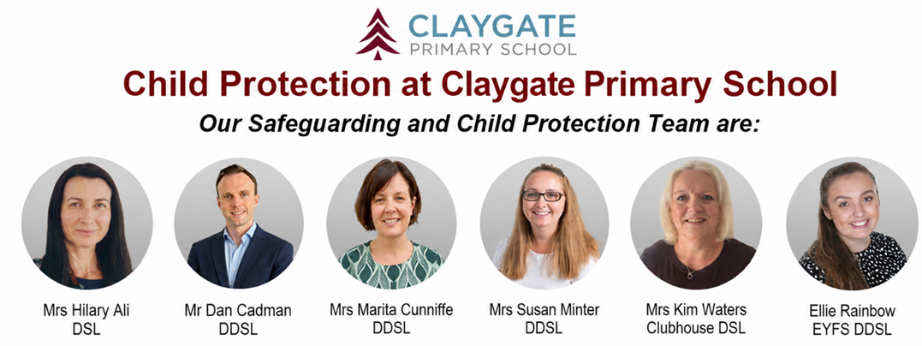
Safeguarding at CPS
We have a team of 5 DSLs:
•Hilary Ali – Designated Safeguarding Lead
•Dan Cadman DDSL
•Marita Cunniffe DDSL
•Susan Minter DDSL
•Ellie Rainbow: EYFS DDSL
•
If you have a safeguarding concern, please speak to a member of the DSL team or email on dsl@Claygate.surrey.sch.uk. Further information can be found under ‘Safeguarding’ on our website

Slide 26
Volunteers & Parents Association (CPSPA)
We have a small dedicated, trained team of volunteers. If you are interested in this role, please email Mrs Ali
All parents and carers are automatically members of Claygate Primary School Parents Association
Class reps organise cake sales and stalls at various events.

Slide 27
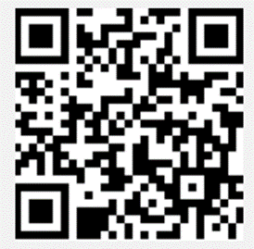
Friends of CPS
Friends Of Claygate Primary School: Voluntary donations (and even better with gift aid) helps us to keep CPS fully equipped and running
We have an online donation system via the Charity Aid Foundation. We ask you to make a voluntary contribution each month per child. If you are a tax payer, you can get tax relief if you donate through Gift Aid. This also allows us to claim basic rate tax of 20% on your donation, at no cost to you.
Here is the link to access the donation form: HTTPS://CAFDONATE.CAFONLINE.ORG/20959

