Slide 1


Welcome to Year 3 Curriculum Evening
September 2026

Slide 2

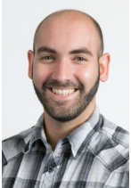
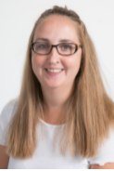
Meet the Team
Mr Godfrey – Hazel
Mrs Minter– Sycamore
Miss Frame , Mrs Ozer & Mr Matt

Slide 3

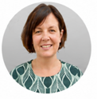
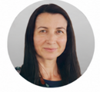
Meet the Senior Leadership Team
Dan Cadman: Head Teacher
Marita Cunniffe: Inclusion Lead
Hilary Ali: Deputy Head

Slide 4



Our CPS Values
CPS Values
Safe and healthy
Courageous
Achievers
Responsible
Respectful
Friendly

Slide 5
Our Expectations
Independence (including walking in / out independently)
Behaviour
Smart uniform and ready for learning (KS2 Cold Weather Uniform from Oct half term includes a tie)
Birthday books for class library are welcome. Reminder that we don’t give out sweets for allergies and religious reasons.
Children are invited to wear mufti on their birthday
Notes:
Don’t have to wear mufti. If it falls on weekend

Slide 6
Attendance and Punctuality
Punctuality is important
The school gates open at 8.35am and learning starts promptly at 8.45am with a learning task and interventions
Children who are late will miss learning, the outline of the day, a positive calm start to the day and can have self-esteem/social skills impacted
Too many of our children are regularly missing school – the government expects a minimum of 96% attendance
Missing learning leaves children vulnerable to falling behind. Children with poor attendance tend to achieve less in both primary and secondary school (DfE)
Notes:
(please say this could include giving feedback on previous lesson so misconceptions are addressed)

Slide 7

Attendance and Punctuality
You could receive a penalty notice if you take your child out of school during term time.
No term time holidays will be authorised.
There are 175 non-school days per year: please use these days for appointments

Slide 8
Attendance Protocol
Contact the office via phone or email if your child is absent. If we do not hear from you, our absence protocol is triggered and you will be contacted for safeguarding purposes
CPS follows NHS guidance (the ‘48 hour rule’): “Children with diarrhoea or vomiting should stay away from school until they have not been sick or had diarrhoea for at least 2 days (48 hours)”
Attendance is monitored closely by the school and the LA Inclusion Officer
Attendance below 90% is classed as ‘Persistent Absence’ and may result in a referral to the LA Inclusion Officer. This may also result in a penalty notice or prosecution

Slide 9
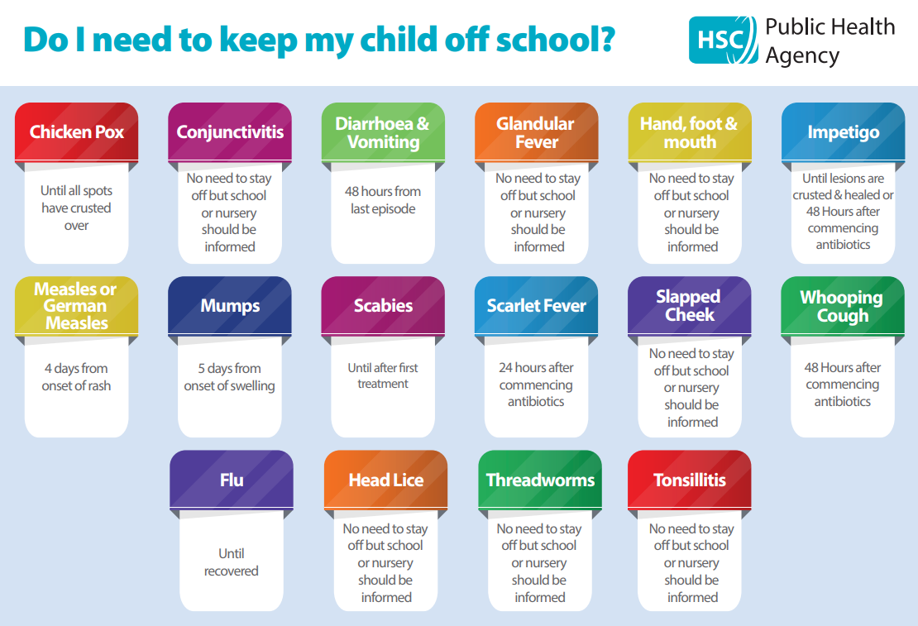
You can find this on our website under the ‘Attendance’ tab

Slide 10
Timetable
Sycamore: PE is on Wednesday (indoor) and Thursdays (outdoor)
Hazel: PE is on Wednesday (indoor) and Thursdays (outdoor)
Children should come to school in their PE kit on PE days
Our swimming blocks are:
Sycamore: Autumn 1 Wednesdays
Hazel: Autumn 2 Wednesdays (tbc)
Children should wear PE kit on a swimming day.
Home learning is set via Google Classroom
Enrichment every Tuesday will be Amazing Artists for Hazel this term and Woodland Learners for Sycamore.
At the end of enrichment blocks for music & drama, families will have the opportunity to come into school to share the children’s learning
Notes:
Timetables are sent via Parentmail. If unsure email the school office. Sometimes timetable changes are sent via class reps.

Slide 11
Home Learning
Home learning is set on Fridays at 4pm and due on Wednesdays.
  Home learning should take no more than 30 minutes per subject and will consolidate previous learning or prepare for future lessons.
Spellings to practice at home. Feel free to test at home too. The children are tested on 7 current spellings and 3 from previous weeks
Useful websites – Times Tables Rockstars (TTRS), Doodle, Accelerated Reader (AR), Numbots
Notes:
Links to websites can be found on Google Classroom
Children may complete AR quizzes at home if they wish

Slide 12
Online Safety
Taught explicitly through our PSHEE and Computing curriculum, plus regular discussion and direct teaching whenever Chromebooks are used
Consider children’s online access
4 Cs: Content (“What am I seeing?”), Contact (“Who am I talking to?”), Conduct (“How am I behaving, and how are others behaving towards me?”) and Commerce (“What am I buying, paying for or giving away?”)
Social media: many apps have a minimum age use e.g. WhatsApp is 16 years old.
Check privacy settings and monitor usage
Where are devices stored? Is there unlimited access e.g. in bedrooms?
Speak to school staff if you have concerns or need support
Children are permitted to wear Fitness tracking watches (however Smart watches are not permitted)
Notes:
All children sign an acceptable agreement policy
Watches that access the internet, take photos, etc are not permitted

Slide 13
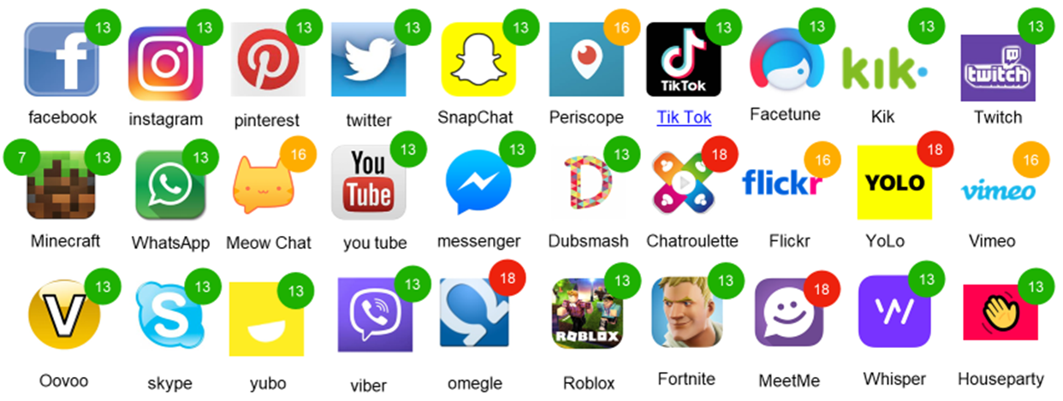
Online Safety
Notes:
These may not be up to date so please do check. Be aware that a new government ban will raise the age limit to 16 years old for some of these apps. Current Age restrictions for a variety of Apps will be sent out via the newsletter.

Slide 14
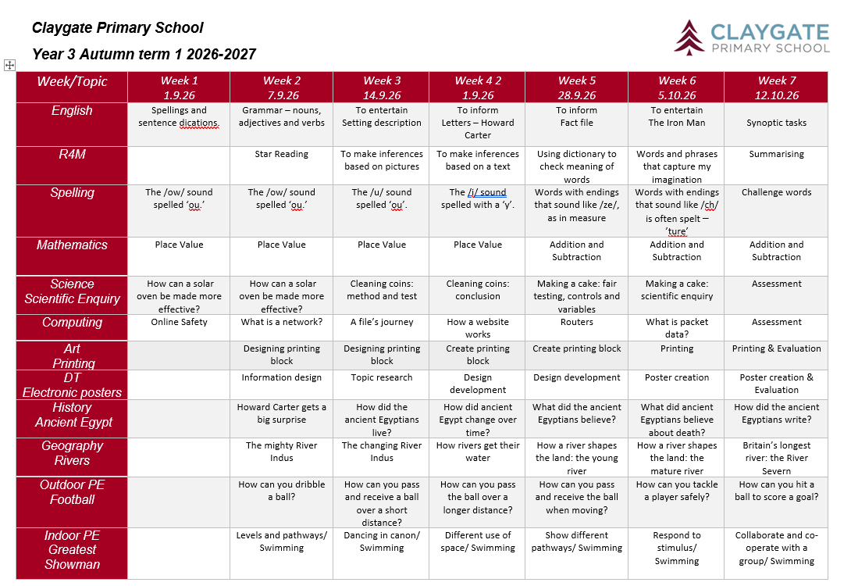
Curriculum
Half term Topic Web
Topic web can be found on the school website and Google Classroom
RSE is taught in Summer Term: further details are on our website under PSHE: https://www.claygate.surrey.sch.uk/page/?title=PSHE&pid=65
Our MFL in KS2 is French
Enrichment will be on Tuesday - timetable has been shared via parentmail

Slide 15

Reading
Importance of reading AND reading aloud
How to use these books
Please don’t use reading records for messages (Messages should be given to office in person or via email)
School adults record in green pen
Reading expectations
AR quizzing at home
Book of interest from class/school library weekly
All children visit library once weekly

Slide 16
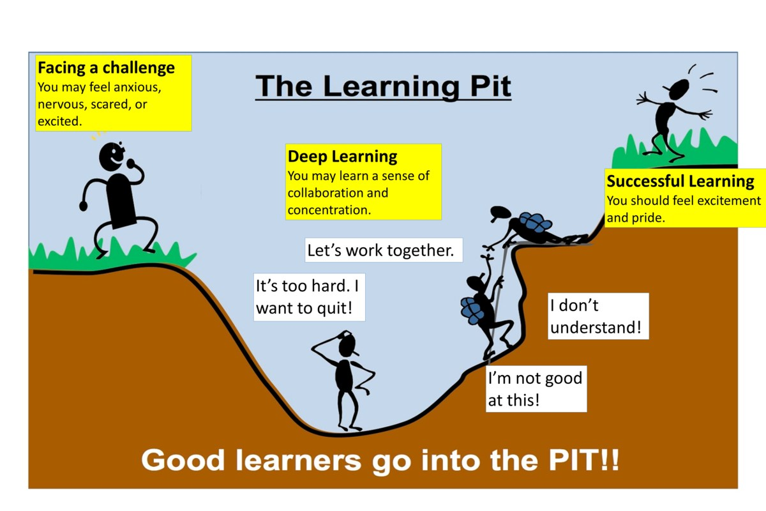
A Growth Mindset Approach
What did you do today that surprised you?
Did you make any good mistakes today?
How did you learn from your mistakes today?
What did you do today that made your brain grow?
Did you help anyone else to stretch their brain power?
What challenges did you enjoy today?
We celebrate and talk about ‘Marvellous Mistakes!’

Slide 17
Trips, Workshops and Visitors
Learning beyond the classroom is so valuable!
Autumn: Bough Beech Reservoir, Thursday 12th November 2026, approx.’ cost £18.00.
We will aim to have at least one educational trip, workshop or visitor per term, this may include our local area or workshops in school.
Notes:
Without voluntary donations trip may not be able to go ahead

Slide 18
Assessment
Assessment is ongoing
We use evidence from work in class and tests to make assessment judgments
From Y2 onwards – We check tables daily through low stakes quizzing and timed challenges
Parent consultations take place in November and March
Main written report is shared in March
Final summary report is shared in July
Parent pop ins gives your child an opportunity to share their successes each half term
Notes:
Children will have learnt 2s, 5s and 10s, in Year 3 we teach the 3, 4 and 8 times tables – up to 12 times
In year 4 the children will take a Multiplication Times Table Check
We will often use assessments to inform our teaching and will adapt our questioning and slides (EMW) to recap learning as needed.

Slide 19
Communication
Weekly newsletter, Instagram and Website
Parentmail is used to share important information
office@claygate.surrey.sch.uk should be used for the majority of enquiries and communication needs (Tel 01372 465 348)
If you have any concerns, please first talk to your child’s teacher
Please remember Mr Cadman and Mrs Ali are available on the gate daily
Notes:
We are moving our social media from X to Instagram. The school has used X for the last few years as our social media account. This is just another way of doing that.
If anyone does not want their child on social media, just contact the office to let us know and we will ensure they are not.
Core messages and important information will not be posted on Instagram. They will come from the office and newsletters.
If you wish for us to view the message sent to the office, feel free to copy us in. However, we should not be receiving direct emails.

Slide 20
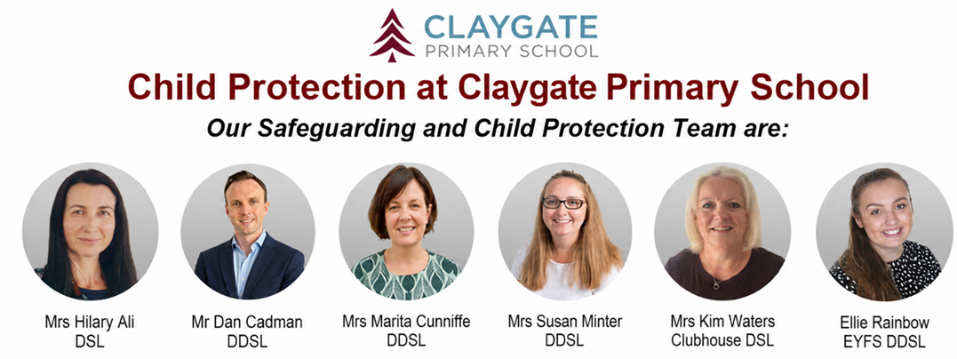
Safeguarding at CPS
We have a team of 6 DSLs:
Hilary Ali – Designated Safeguarding Lead
Dan Cadman DDSL
Marita Cunniffe DDSL
Susan Minter DDSL
Kim Waters Clubhouse DSL
Ellie Rainbow: EYFS DDSL
If you have a safeguarding concern, please speak to a member of the DSL team or email on dsl@Claygate.surrey.sch.uk. Further information can be found under ‘Safeguarding’ on our website

Slide 21
Volunteers & Parents Association (CPSPA)
We have a small dedicated, trained team of volunteers. If you are interested in this role, please email Mrs Ali
All parents and carers are automatically members of Claygate Primary School Parents Association
Class reps organise cake sales and stalls at various events. Your class reps are Ruth and Rhys for Hazel, and Helen and Cami for Sycamore.

Slide 22
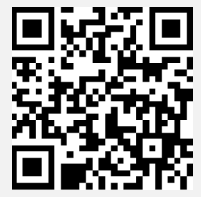
Friends of CPS
Friends Of Claygate Primary School: Voluntary donations (and even better with gift aid) helps us to keep CPS fully equipped and running
We have an online donation system via the Charity Aid Foundation. We ask you to make a voluntary contribution each month per child. If you are a tax payer, you can get tax relief if you donate through Gift Aid. This also allows us to claim basic rate tax of 20% on your donation, at no cost to you.
Here is the link to access the donation form: HTTPS://CAFDONATE.CAFONLINE.ORG/20959

