Slide 1


Welcome to Year 2 Curriculum Evening
September 2026

Slide 2

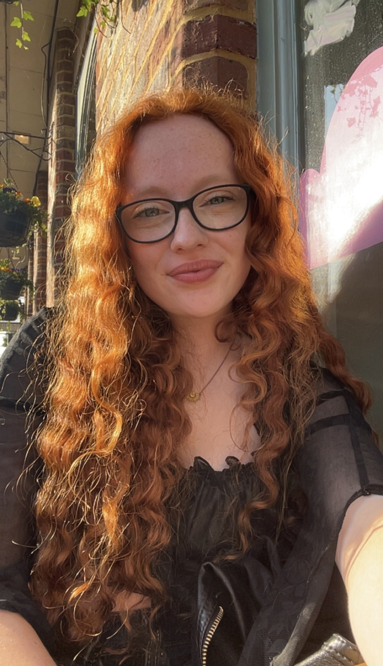
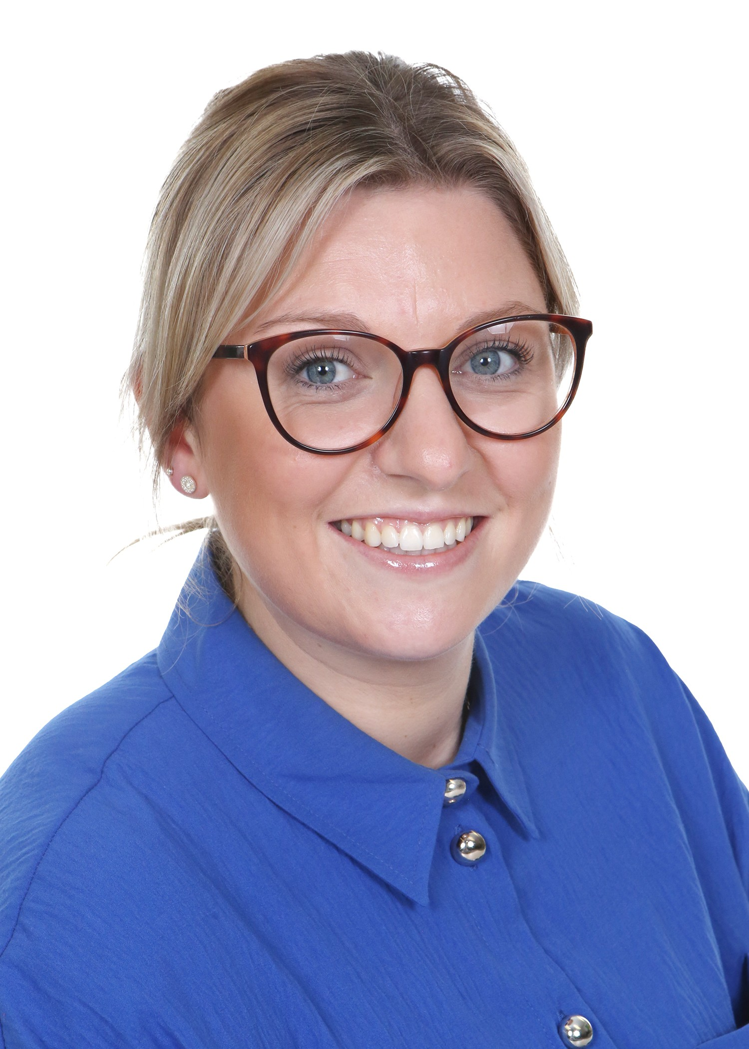
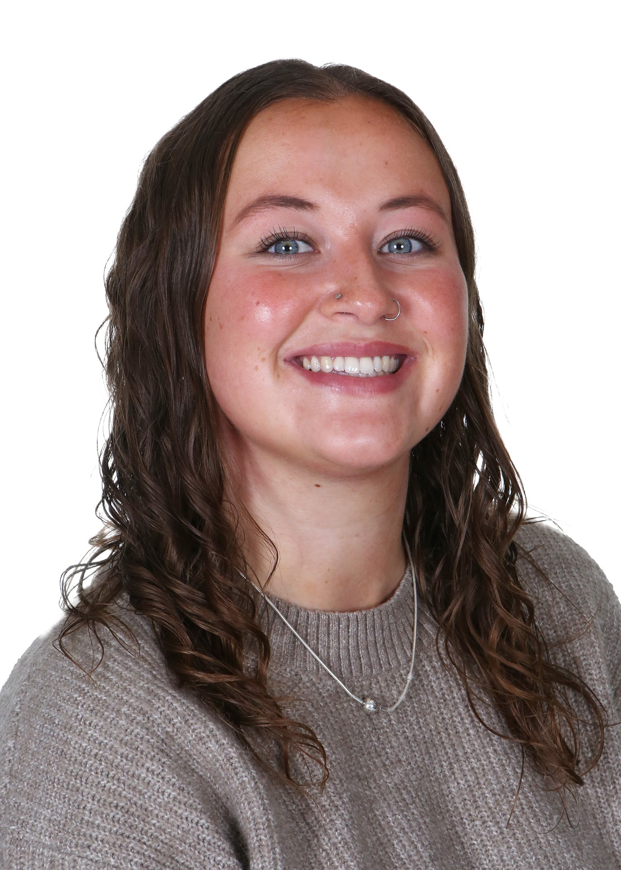
Meet the Team
Mrs Goddard
Chestnut Class
Miss Murray
Elm Class
Miss Martin
TA

Slide 3

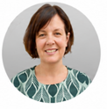
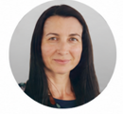
Meet the Senior Leadership Team
Dan Cadman: Head Teacher
Marita Cunniffe: Inclusion Lead
Hilary Ali: Deputy Head

Slide 4



Our CPS Values

Slide 5
Our Expectations
Independence (including walking in / out independently)
Promoting positive behaviour
Smart uniform and ready for learning
Birthday books for class library are welcome.
Reminder that we don’t give out sweets for allergies and religious reasons.

Slide 6
Attendance and Punctuality
Punctuality is important
The school gates open at 8.35am and learning starts promptly at 8.45am with a learning task and interventions (this could include giving feedback on previous lesson so misconceptions are addressed)
Children who are late will miss learning, the outline of the day, a positive calm start to the day and can have self-esteem/social skills impacted
Too many of our children are regularly missing school – the government expects a minimum of 96% attendance
Missing learning leaves children vulnerable to falling behind. Children with poor attendance tend to achieve less in both primary and secondary school (DfE)

Slide 7

Attendance and Punctuality
You could receive a penalty notice if you take your child out of school during term time.
No term time holidays will be authorised.
There are 175 non-school days per year: please use these days for appointments

Slide 8
Attendance Protocol
Contact the office via phone or email if your child is absent. If we do not hear from you, our absence protocol is triggered and you will be contacted for safeguarding purposes
CPS follows NHS guidance (the ‘48 hour rule’): “Children with diarrhoea or vomiting should stay away from school until they have not been sick or had diarrhoea for at least 2 days (48 hours)”
Attendance is monitored closely by the school and the LA Inclusion Officer
Attendance below 90% is classed as ‘Persistent Absence’ and may result in a referral to the LA Inclusion Officer. This may also result in a penalty notice or prosecution

Slide 9
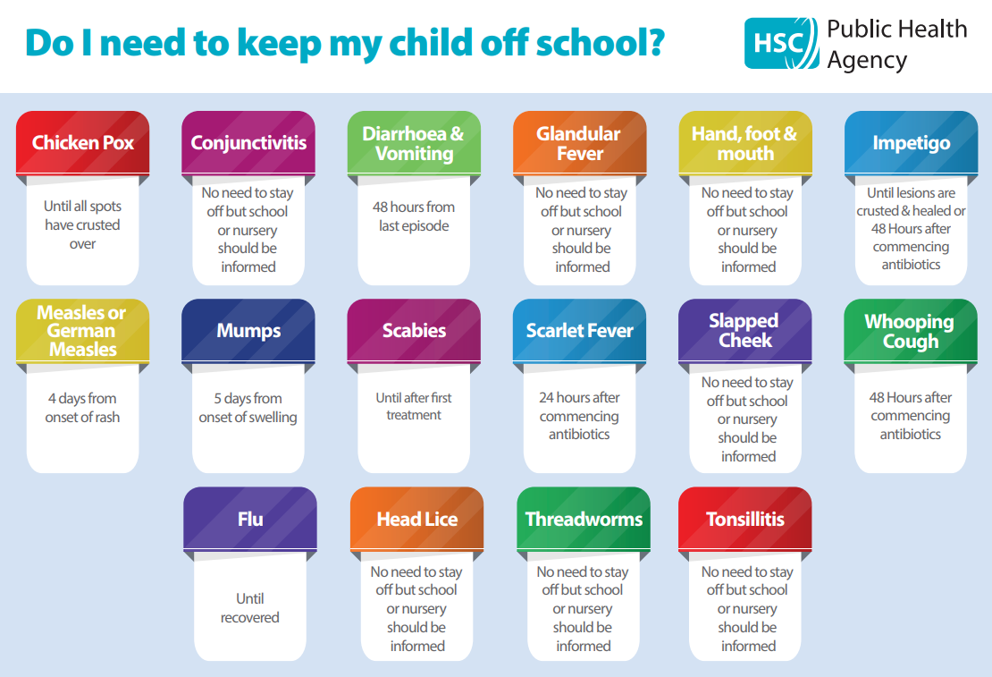
You can find this on our website under the ‘Attendance’ tab

Slide 10
Timetable
PE is on Tuesday (Chestnut) and children should come to school in their PE kit. We send PE & Swimming timetables half termly.
Our swimming block is Autumn 1. Children should wear PE kit on a swimming day (Chestnut- Thursday / Elm- Friday)
Enrichment every Wednesday. (Chestnut- M-Fit/ Elm- Multisports) (This allows children to dive deeper into linked curriculum areas)
At the end of enrichment blocks for music & drama, families will have the opportunity to come into school to share the children’s learning
Children should change back into uniform after a morning club

Slide 11
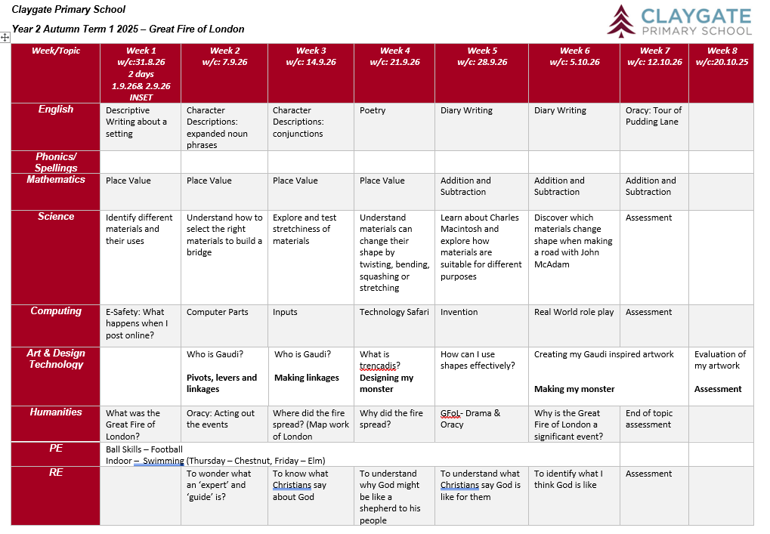
Topic Web
This can be accessed on our website.

Slide 12
Home Learning
Shared on Friday 3.15pm to be completed by the following Friday.
(Doodle Learning, TTRS)
Spellings to practise at home. Feel free to test at home too. The children are tested on 7 current spellings and 3 from previous week, every Friday. We follow Little Wandle Spelling- After October half term
Spellings will be introduced half way of first half term
Useful websites – TTrockstars, Doodle and anything else!
AR can be used at home to quiz – link on GC

Slide 13
Online Safety
Taught explicitly through our PSHEE and Computing curriculum, plus regular discussion and direct teaching whenever Chromebooks are used
Consider children’s online access
4 Cs: Content, Contact, Conduct and Commerce
Social media: many apps have a minimum age use e.g. WhatsApp is 16 years old.
Check privacy settings and monitor usage
Where are devices stored? Is there unlimited access e.g. in bedrooms?
Speak to school staff if you have concerns or need support
We are Smartphone free – children in Y6 may bring a ‘brick’ phone into school

Slide 14
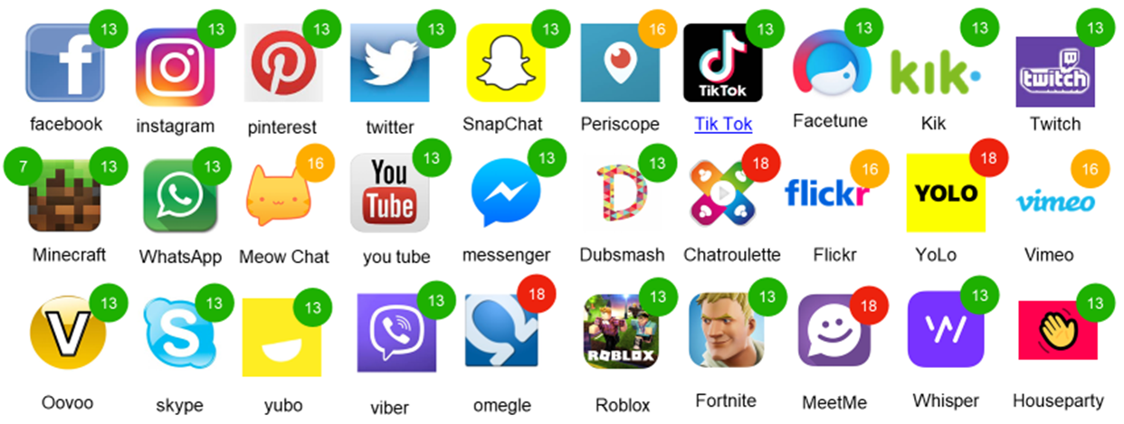
Online Safety

Slide 15
Curriculum
Signpost to website and Google Classroom
RSE is taught in Summer Term: further details are on our website under PSHE: https://www.claygate.surrey.sch.uk/page/?title=PSHE&pid=65
Our MFL in KS2 is French

Slide 16

Reading
Importance of reading AND reading aloud
How to use these books
Please don’t use reading records for messages (Messages should be given to office in person or via email)
School adults record in green pen
Reading expectations
AR quizzing at home
Book of interest from class/school library weekly
All children visit library once weekly

Slide 17
Phonics (EYFS/KS1)
We use Little Wandle Letters & Sounds
Children have a daily discrete phonics session for approximately 20 minutes.
Children learn all the phonemes and corresponding graphemes for the 40+ sounds. Every phonics lesson includes an element of decoding and encoding
Y2 pupils who did not meet standard in Y1 phonics check will retake in June 2026
Phonic knowledge is assessed half termly using Little Wandle Letters and Sounds assessment resources. Outcomes of these assessments are used to plan additional catch up interventions for those who need it

Slide 18
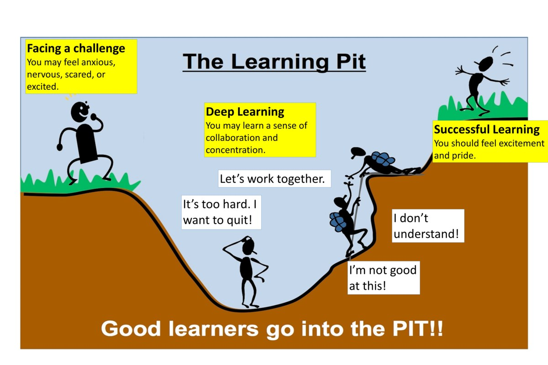
A Growth Mindset Approach
What did you do today that surprised you?
Did you make any good mistakes today?
How did you learn from your mistakes today?
What did you do today that made your brain grow?
Did you help anyone else to stretch their brain power?
What challenges did you enjoy today?
We celebrate and talk about ‘Marvellous Mistakes!’

Slide 19

Trips, Workshops and Visitors
Learning beyond the classroom is so valuable!
Look Out Discovery Centre- Science
Moon Landing workshop – Man on the Moon.
Parent helpers

Slide 20
Assessment
Assessment is ongoing
We use evidence from work in class and tests to make assessment judgments
From Y2 onwards - discuss importance of tables up to 12 x 12. We check tables daily through low stakes quizzing and timed challenges
Parent consultations take place in November and March
Main written report is shared in March
Final summary report is shared in July
Parent pop ins gives your child an opportunity to share their successes each half term

Slide 21
Communication
Weekly newsletter (sent on Sunday evening) , Instagram and Website
Parentmail is used to share important information
office@claygate.surrey.sch.uk should be used for the majority of enquiries and communication needs (Tel 01372 465 348)
If you have any concerns, please first talk to your child’s teacher
Please remember Mr Cadman and Mrs Ali are available on the gate daily

Slide 22
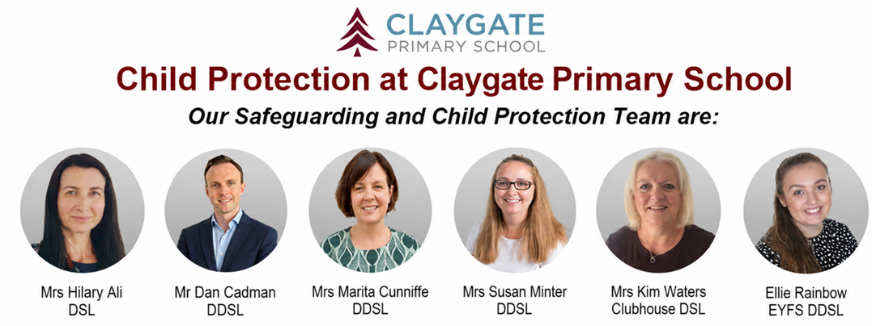
Safeguarding at CPS
We have a team of 5 DSLs:
Hilary Ali – Designated Safeguarding Lead
Dan Cadman DDSL
Marita Cunniffe DDSL
Susan Minter DDSL
Ellie Rainbow: EYFS DDSL
If you have a safeguarding concern, please speak to a member of the DSL team or email on dsl@Claygate.surrey.sch.uk. Further information can be found under ‘Safeguarding’ on our website

Slide 23
Volunteers & Parents Association (CPSPA)
We have a small dedicated, trained team of volunteers. If you are interested in this role, please email Mrs Ali
All parents and carers are automatically members of Claygate Primary School Parents Association
Class reps organise cake sales and stalls at various events.

Slide 24
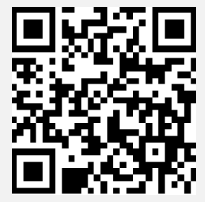
Friends of CPS
Friends Of Claygate Primary School: Voluntary donations (and even better with gift aid) helps us to keep CPS fully equipped and running
We have an online donation system via the Charity Aid Foundation. We ask you to make a voluntary contribution each month per child. If you are a tax payer, you can get tax relief if you donate through Gift Aid. This also allows us to claim basic rate tax of 20% on your donation, at no cost to you.
Here is the link to access the donation form: HTTPS://CAFDONATE.CAFONLINE.ORG/20959

