Slide 1


Welcome to
Year 4 Curriculum Evening
September 2026
Aspen Class and
Pine Class

Slide 2

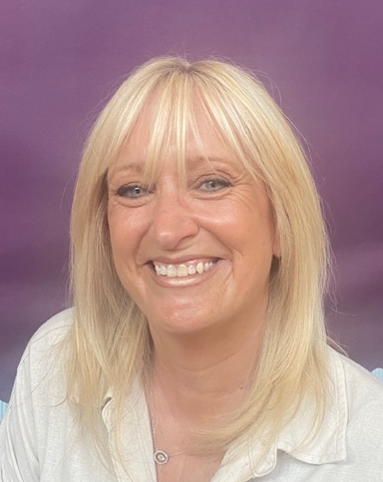
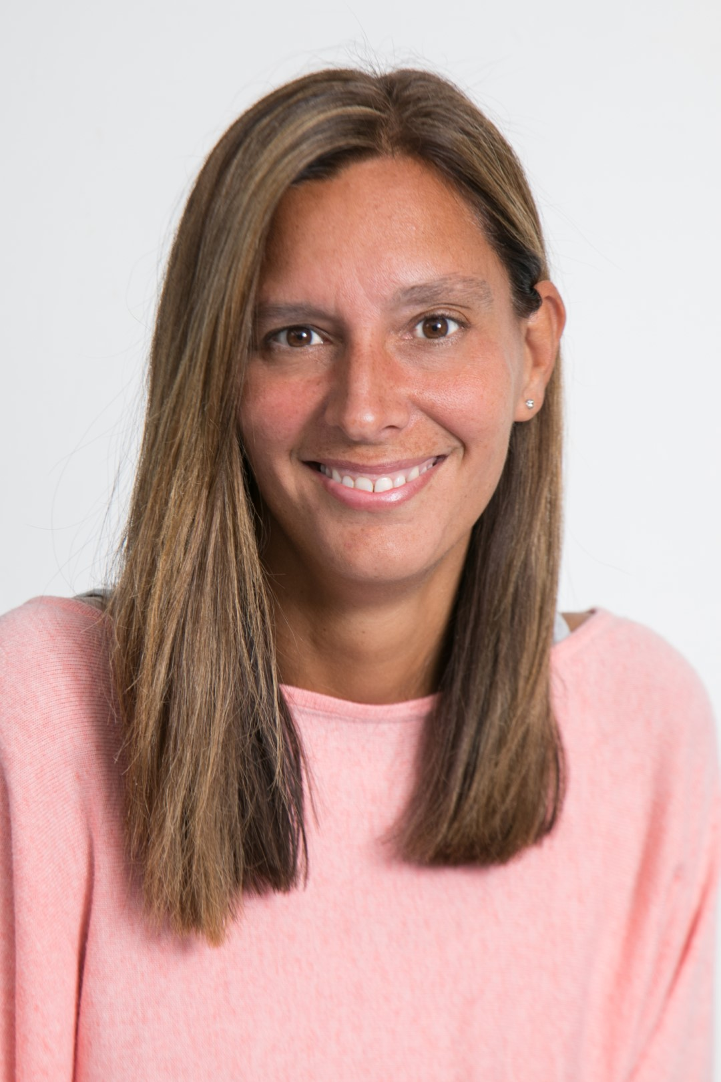
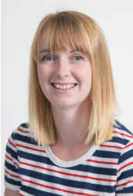
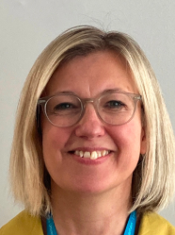
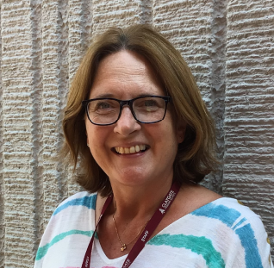
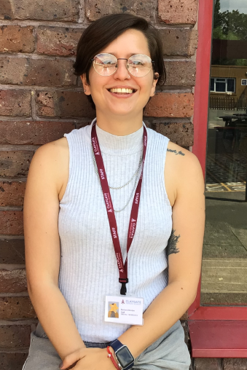
Meet the Team
Year 4 Additional adults
Mrs Sisterson
Mrs Thomas
Miss Mendes
Mrs Cassie Dobson
Aspen Class
Mon-Thursday
cassie.dobson@claygate.surrey.sch.uk
Mrs Louise Pendry
Aspen Class
Thursday-Friday
louise.pendry@claygate.surrey.sch.uk
Mrs Jenni Hoxley
Pine Class
jenni Hoxley@claygate.surrey.sch.uk
Notes:
Both

Slide 3

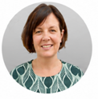
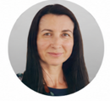
Meet the Senior Leadership Team
Dan Cadman: Head Teacher
Marita Cunniffe: Inclusion Lead
Hilary Ali: Deputy Head

Slide 4



Our CPS Values

Slide 5
Our Expectations
Independence (including walking in / out independently)
Behaviour
Smart uniform and ready for learning (KS2 Cold Weather Uniform from Oct half term includes a tie)
Birthday books for class library are welcome. Reminder that we don’t give out sweets for allergies and religious reasons.

Slide 6
Attendance and Punctuality
Punctuality is important
The school gates open at 8.35am and learning starts promptly at 8.45am with a learning task and interventions (this could include giving feedback on previous lesson so misconceptions are addressed)
Children who are late will miss learning, the outline of the day, a positive calm start to the day and can have self-esteem/social skills impacted
Too many of our children are regularly missing school – the government expects a minimum of 95% attendance
Missing learning leaves children vulnerable to falling behind. Children with poor attendance tend to achieve less in both primary and secondary school (DfE)

Slide 7

Attendance and Punctuality
You could receive a penalty notice if you take your child out of school during term time.
No term time holidays will be authorised.
There are 175 non-school days per year: please use these days for appointments

Slide 8
Attendance Protocol
Contact the office via phone or email if your child is absent. If we do not hear from you, our absence protocol is triggered and you will be contacted for safeguarding purposes
CPS follows NHS guidance (the ‘48 hour rule’): “Children with diarrhoea or vomiting should stay away from school until they have not been sick or had diarrhoea for at least 2 days (48 hours)”
Attendance is monitored closely by the school and the LA Inclusion Officer
Attendance below 90% is classed as ‘Persistent Absence’ and may result in a referral to the LA Inclusion Officer. This may also result in a penalty notice or prosecution

Slide 9
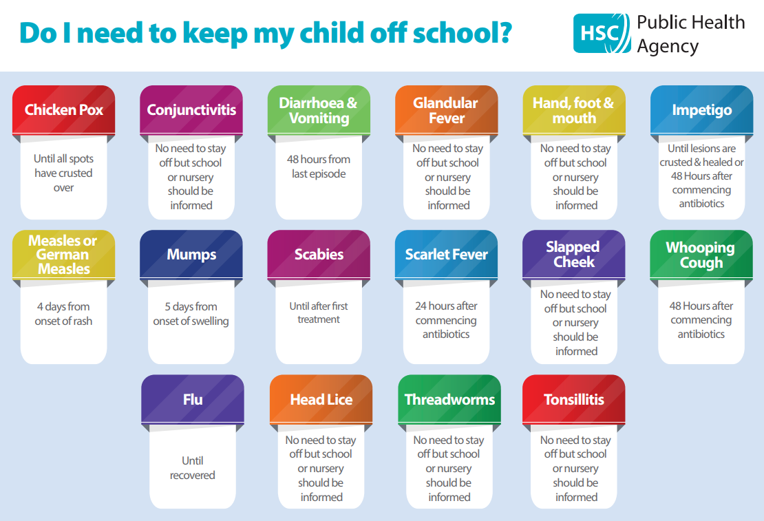

Slide 10
Timetable
PE is on Monday and Friday for Aspen and Monday and Tuesday for Pine and children should come to school in their PE kit – Autumn 1 only.
Our swimming blocks are Spring 1 and Summer 2 Children should wear PE kit on a swimming day
Home learning is set via Google Classroom
Enrichment every will be every Tuesday this term and this term will be Mfit (Aspen) and Multisports (Pine).
At the end of enrichment blocks for music & drama, families will have the opportunity to come into school to share the children’s learning

Slide 11
Home Learning
Home Learning should take 20 minutes for English and 20 minutes for maths. Due in by Wednesday. Set on GC.
TT
Spellings to practice at home. Feel free to test at home too. The children are tested on 7 current spellings and 3 from previous weeks
Useful websites – TTtables rockstars, Doodle and AR

Slide 12
Online Safety
Taught explicitly through our PSE and Computing curriculum, plus regular discussion and direct teaching whenever Chromebooks are used
Consider children’s online access
4 Cs: Content, contact, conduct and commerce
Social media: many apps have a minimum age use e.g. WhatsApp is 13 years old.
Check privacy settings and monitor usage
Where are devices stored? Is there unlimited access e.g. in bedrooms?
Speak to school staff if you have concerns or need support
We are Smartphone free

Slide 13
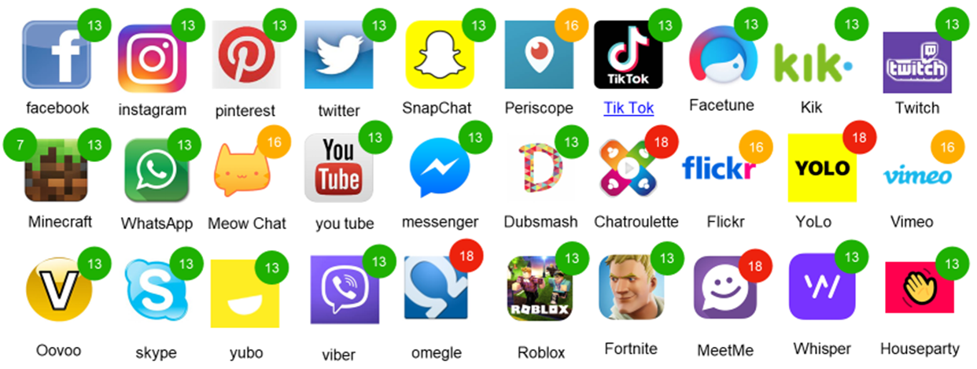
Online Safety (this will be sent out in a newsletter)

Slide 14
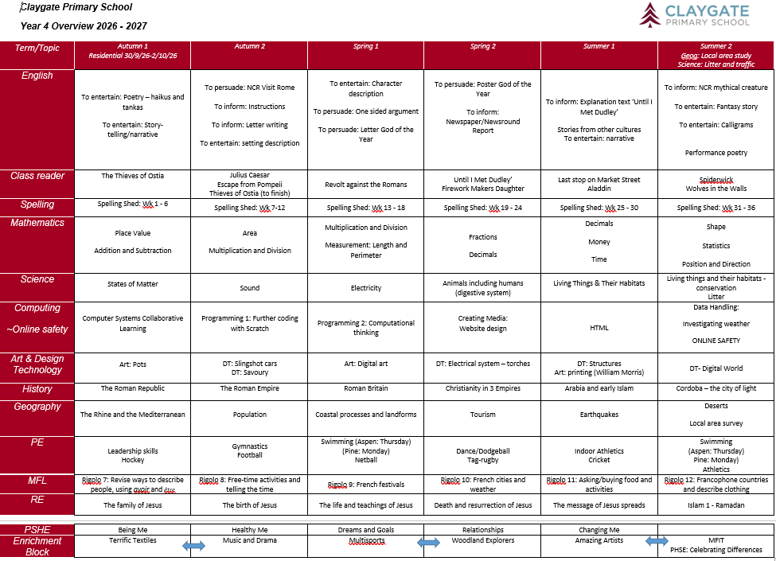
Curriculum
Yearly overview

Slide 15
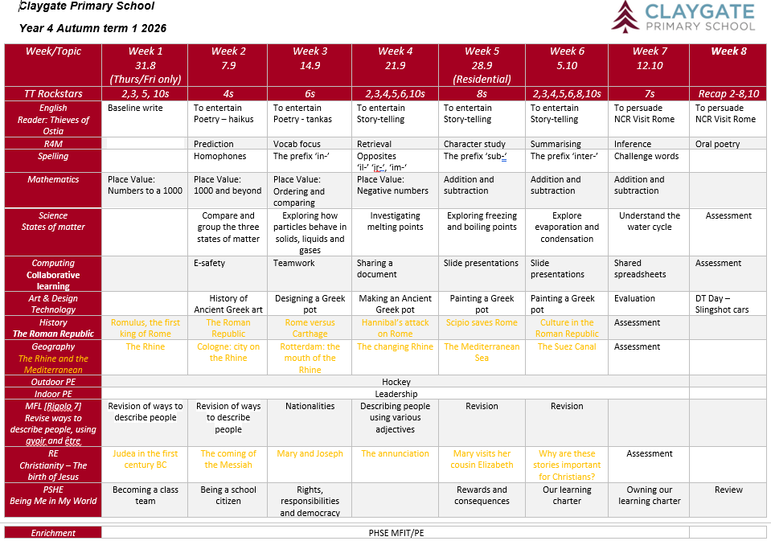
Curriculum Topic Web
Notes:
HM

Slide 16

Reading
Importance of reading AND reading aloud
How to use these books
Please don’t use reading records for messages
(Messages should be given to office in person or via
email)
School adults record in green pen
Reading expectations
AR quizzing at home
Book of interest from class/school library weekly
All children visit library once weekly

Slide 17
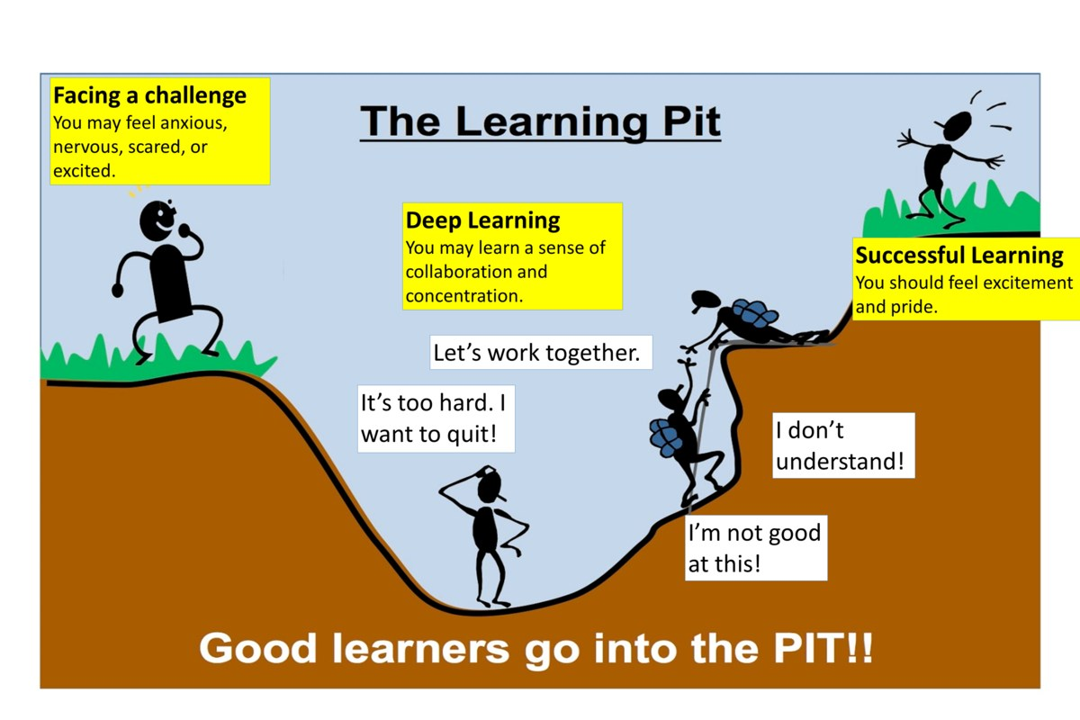
A Growth Mindset Approach
What did you do today that surprised you?
Did you make any good mistakes today?
How did you learn from your mistakes today?
What did you do today that made your brain grow?
Did you help anyone else to stretch their brain power?
What challenges did you enjoy today?
We celebrate and talk about ‘Marvellous Mistakes!’

Slide 18
Enrichment
Every Tuesday afternoon. Children engage with a rota of activities
All of our enrichment activities have a focus on pupil wellbeing

Slide 19
Trips, Workshops and Visitors
We are currently exploring what day trips we are going to organise this year. Watch this space!
We have our residential to Marchant Hill booked for this term
(More to come later!)

Slide 20
Assessment
Assessment is ongoing
We use evidence from work in class, Maths end of unit tests, AR STAR reading tests, Science end of unit tests to make judgements on whether your child is meeting the expected standard
Importance of tables up to 12 x 12. We check tables daily through low stakes quizzing and timed challenges
We have formal assessment points at the end of each term or unit
Parent consultations take place in November and March
Main written report is shared in March
Final assessment summary is shared in July
Parent pop ins gives your child an opportunity to share their successes each half term

Slide 21
Multiplication Tables Check (MTC)
Times Tables in Y4 will be tested up to 12 x 12.
6 seconds per question. 25 questions.
MTC will be tested on Chrome books.
Three week period around 3rd June (tbc).
Notes:
MJ

Slide 22
Communication
Weekly newsletter, Instagram and website
Parentmail is used to share important information
office@claygate.surrey.sch.uk should be used for the majority of enquiries and communication needs (Tel 01372 465 348)
If you have any concerns, please first talk to your child’s teacher
Please remember Mr Cadman and Mrs Ali are available on the gate daily
Notes:
MJ

Slide 23
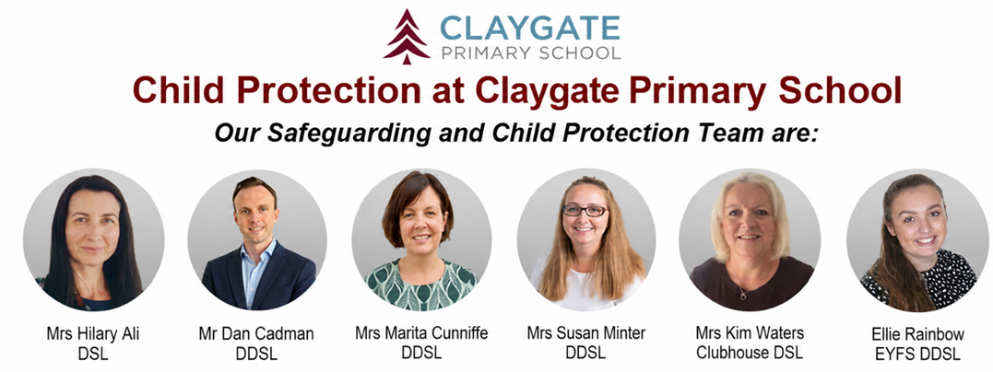
Safeguarding at CPS
We have a team of 5 DSLs:
Hilary Ali – Designated Safeguarding Lead
Dan Cadman DDSL
Marita Cunniffe DDSL
Susan Minter DDSL
Ellie Rainbow: EYFS DDSL
If you have a safeguarding concern, please speak to a member of the DSL team or email on dsl@Claygate.surrey.sch.uk. Further information can be found under ‘Safeguarding’ on our website

Slide 24
Volunteers, PA and Friends
We have a small dedicated, trained team of volunteers. If you are interested in this role, please email Mrs Ali
All parents and carers are automatically members of Claygate Primary School Parents Association
Class reps organise cake sales and stalls at various events

Slide 25
Friends of CPS
Friends Of Claygate Primary School: Voluntary donations (and even better with gift aid) helps us to keep CPS fully equipped and running
We have an online donation system via the Charity Aid Foundation. We ask you to make a voluntary contribution each month per child. If you are a tax payer, you can get tax relief if you donate through Gift Aid. This also allows us to claim basic rate tax of 20% on your donation, at no cost to you.
Here is the link to access the donation form: HTTPS://CAFDONATE.CAFONLINE.ORG/20959

